Slide 1
T7 Infoshare

Slide 2
Agenda
Distributed identities – What’s this?
  Let’s start with our use cases – and what we did to support them
  What is «distributed» promising to change?
  We’re covered – Why should we care?
Things to consider:
  The political agenda
  The opportunities
  The risks
Things to do as a community
Good examples for that
  The word goes to our experts
Discussion and next steps
  Periodic updates of this style

Slide 3
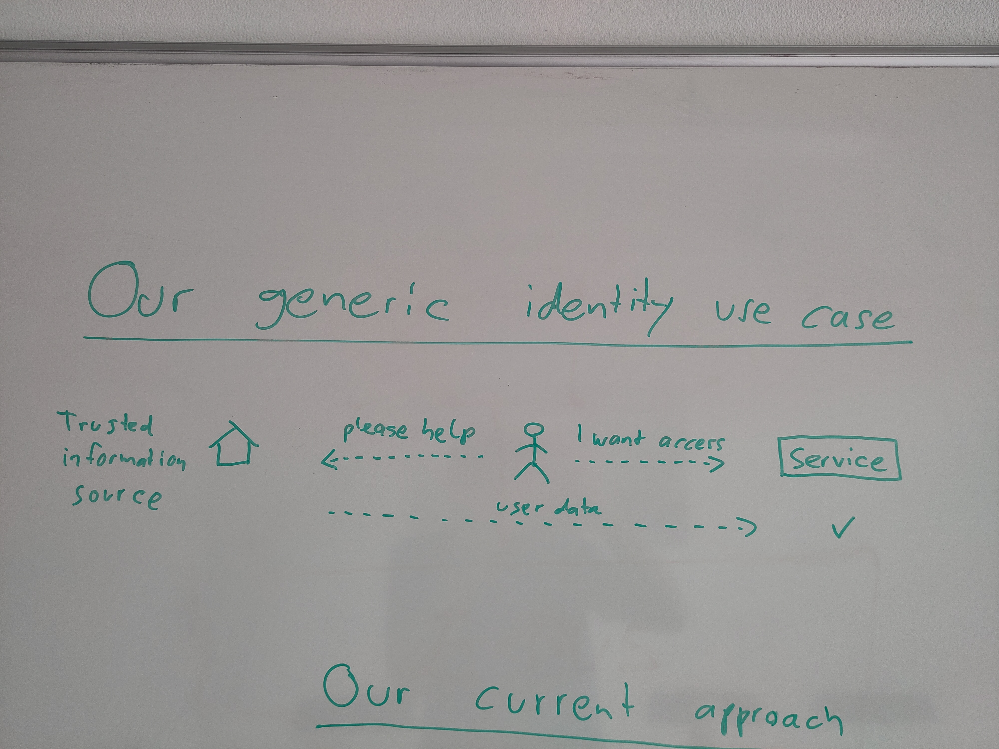

Slide 4
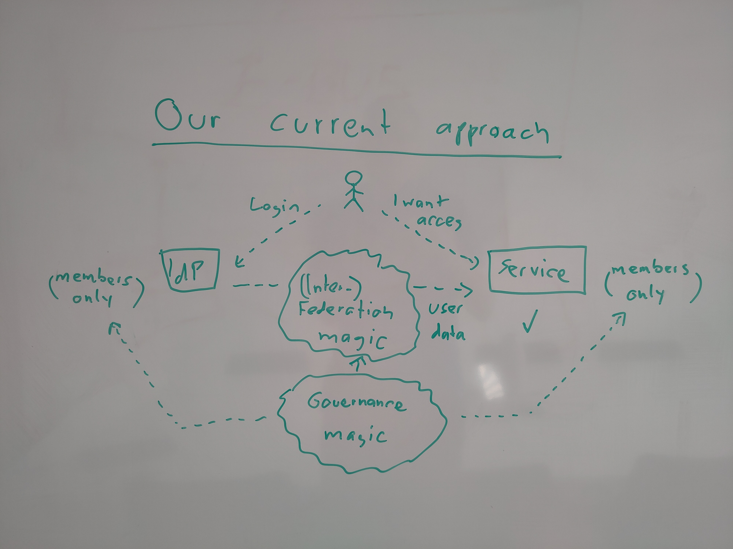

Slide 5
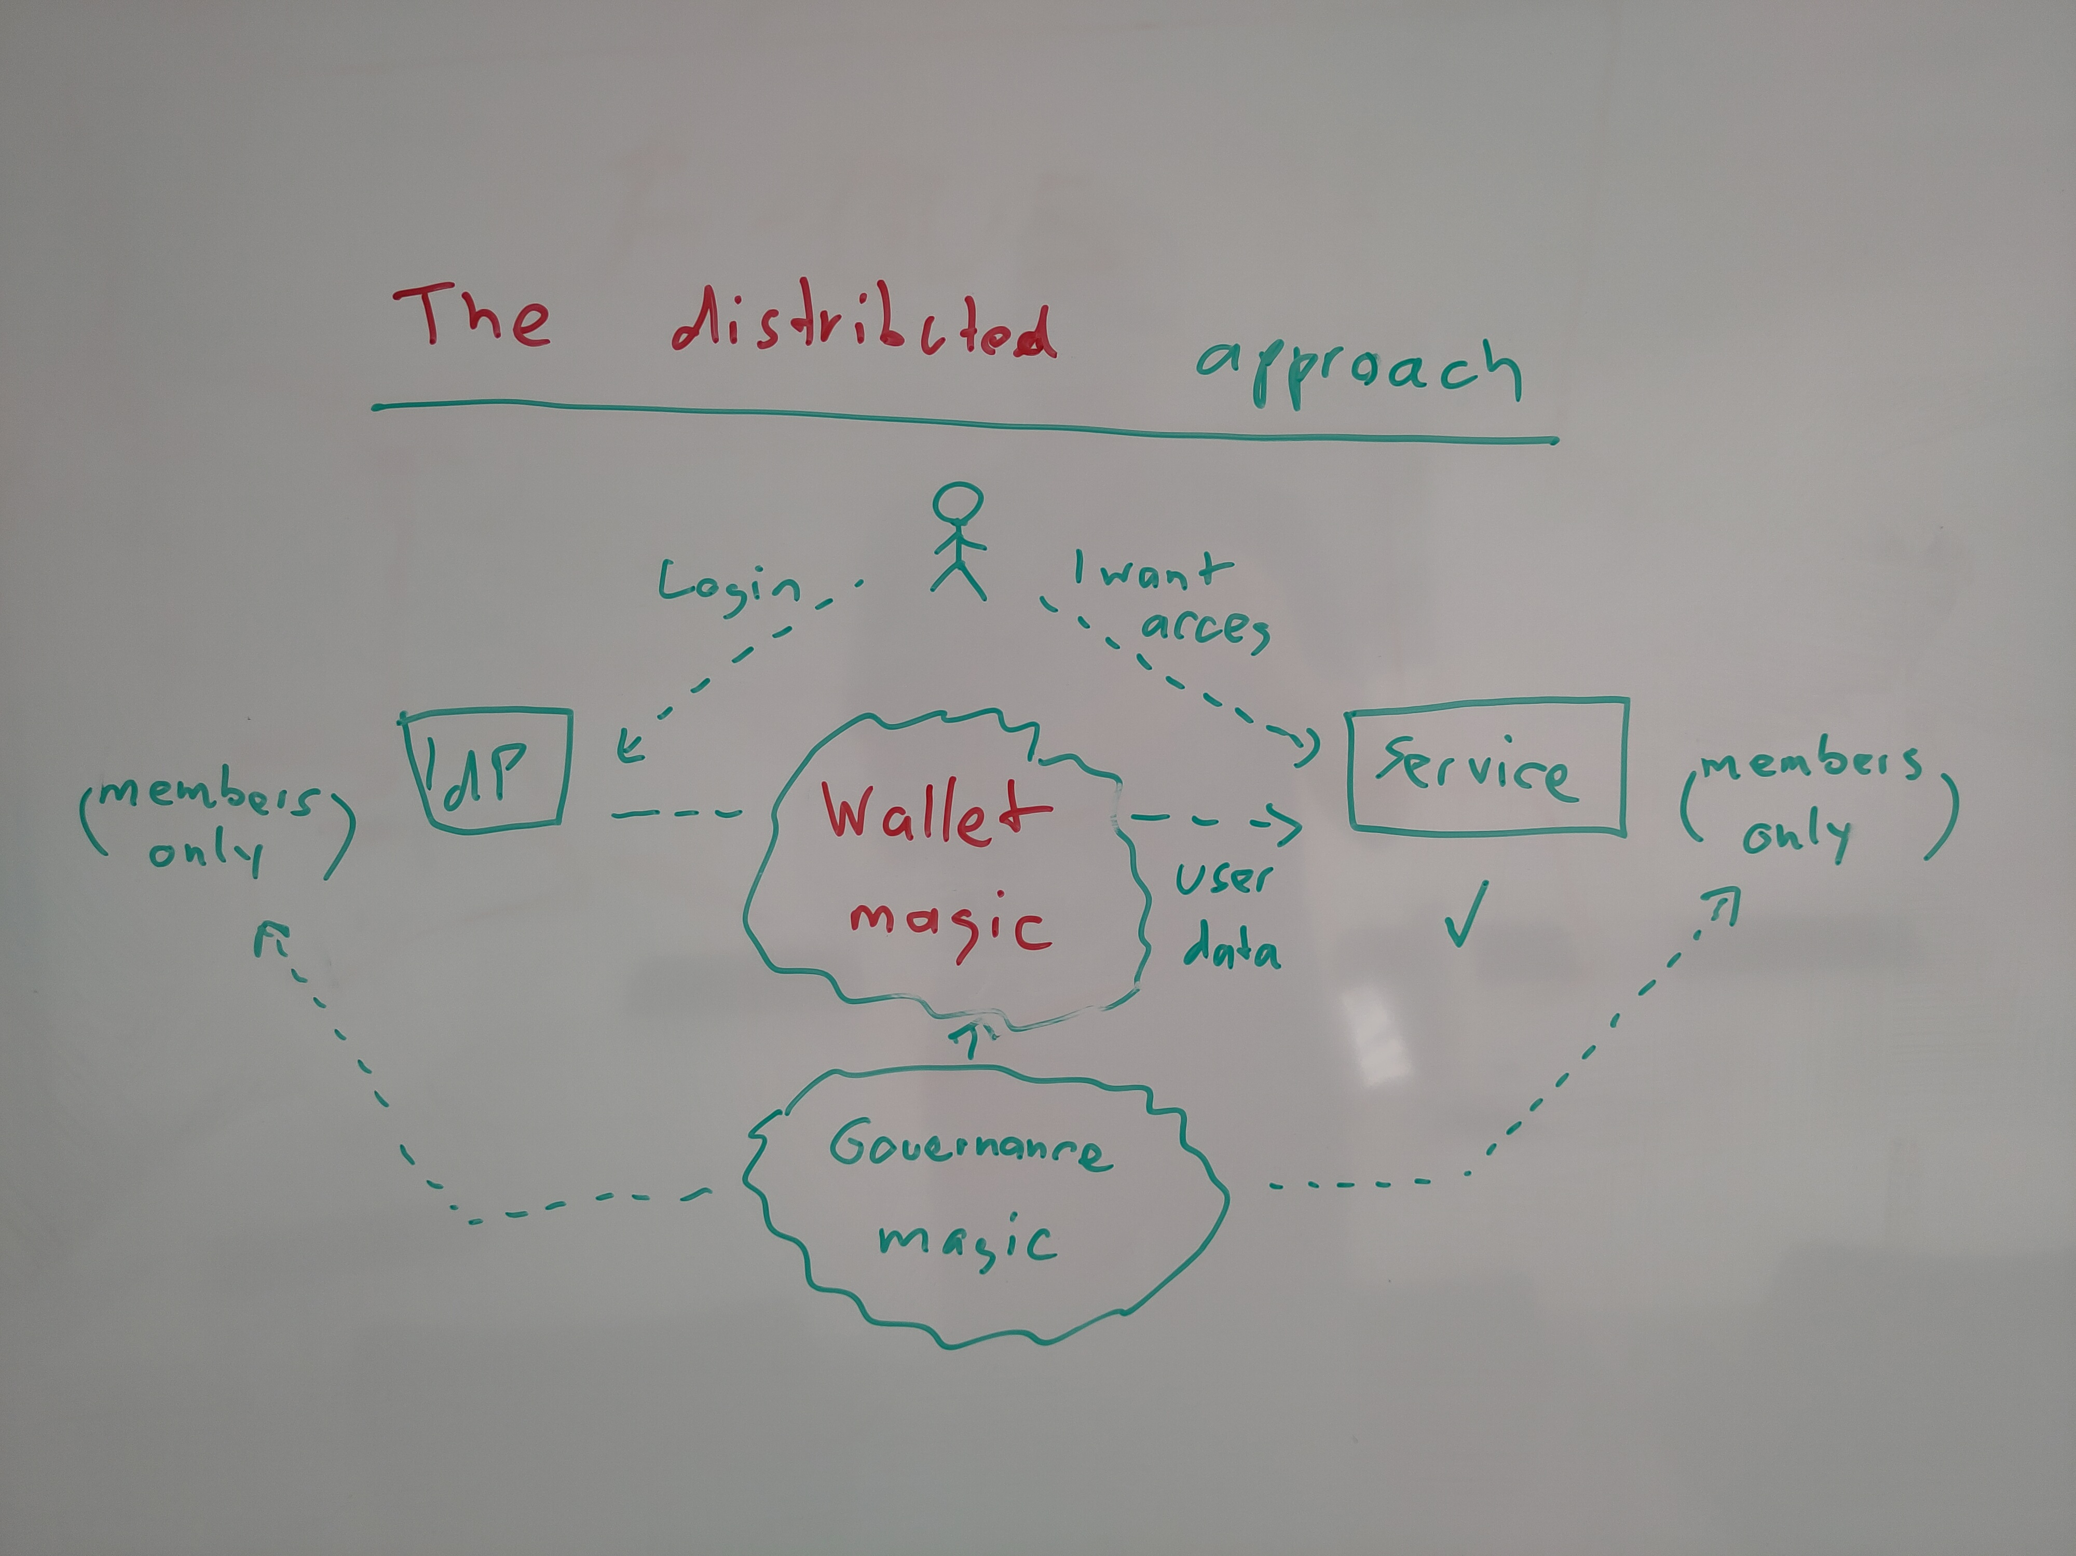

Slide 6
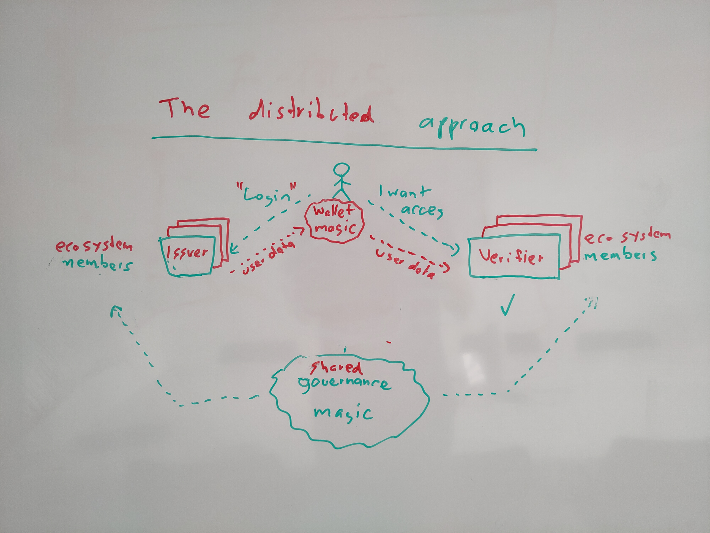

Slide 7
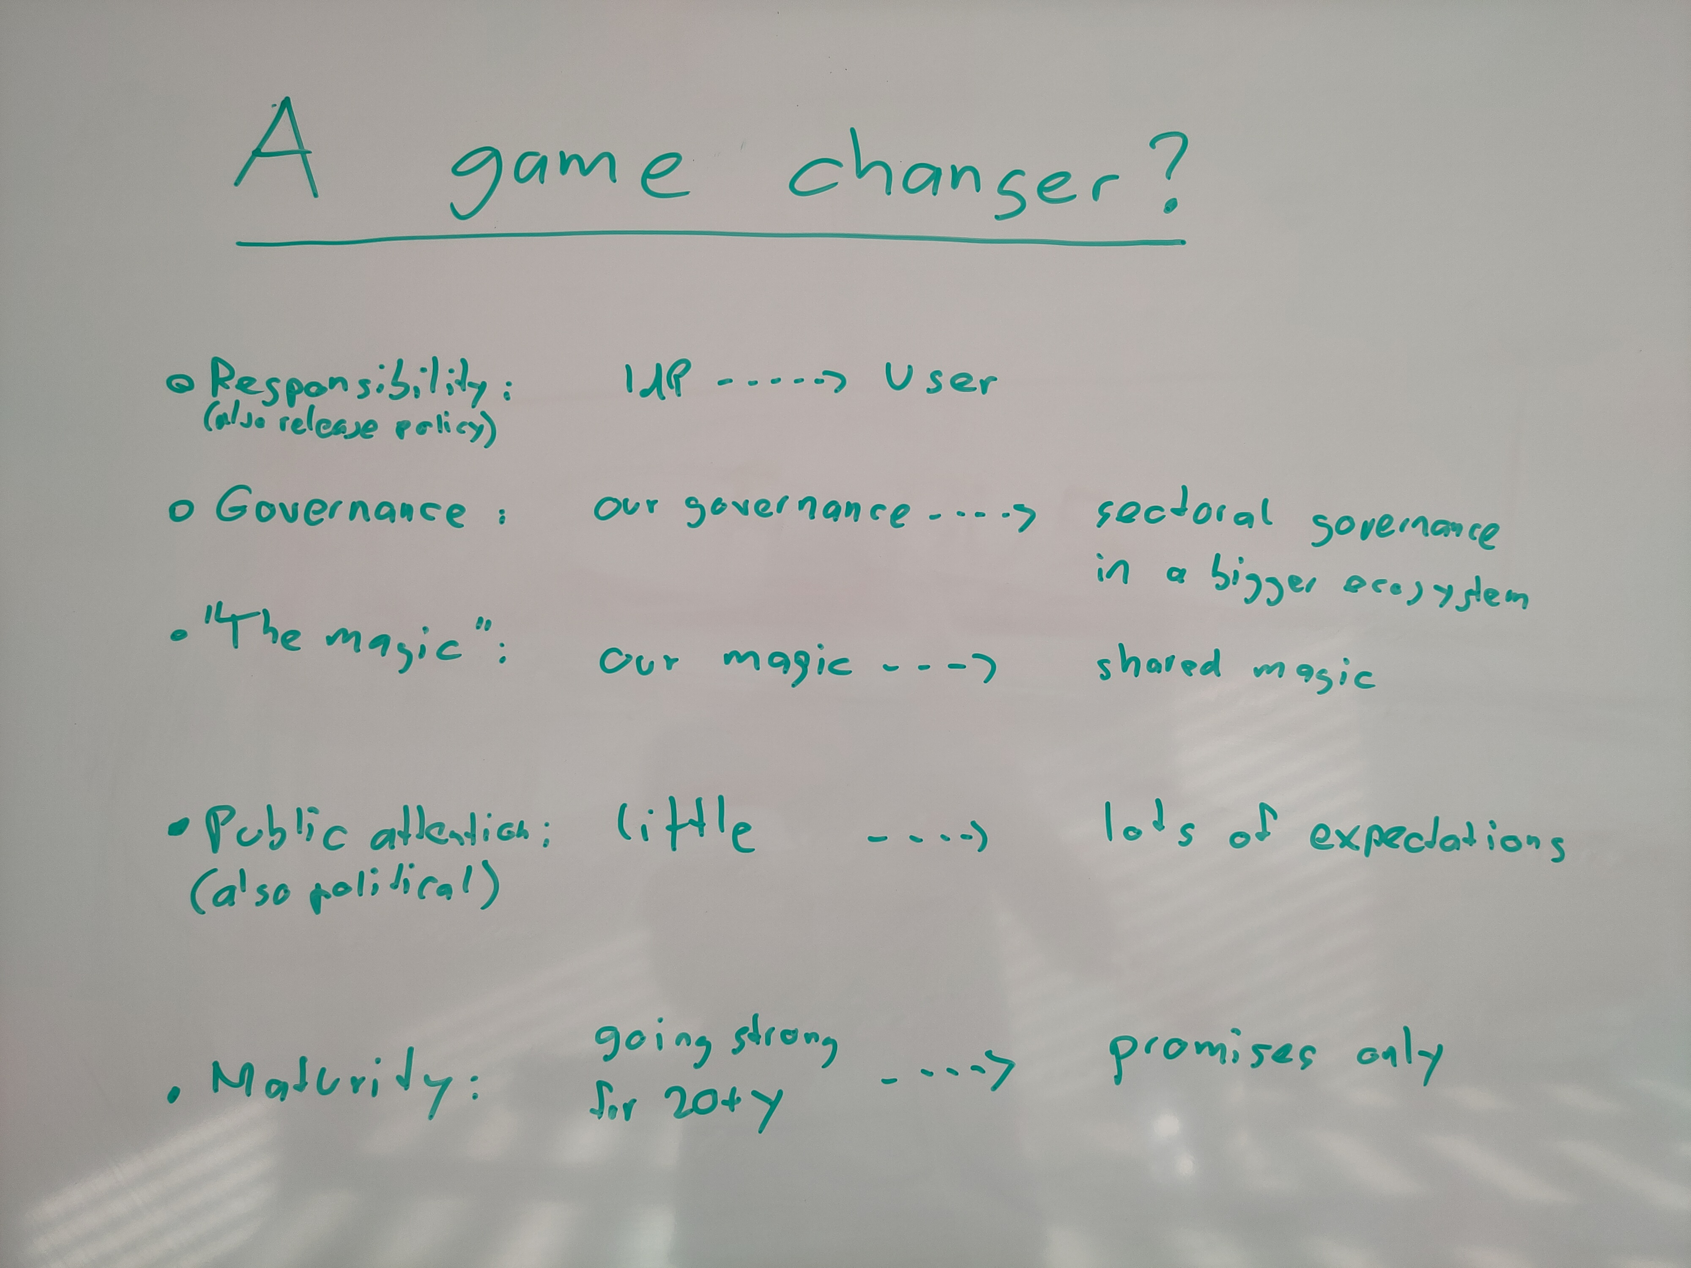

Slide 8
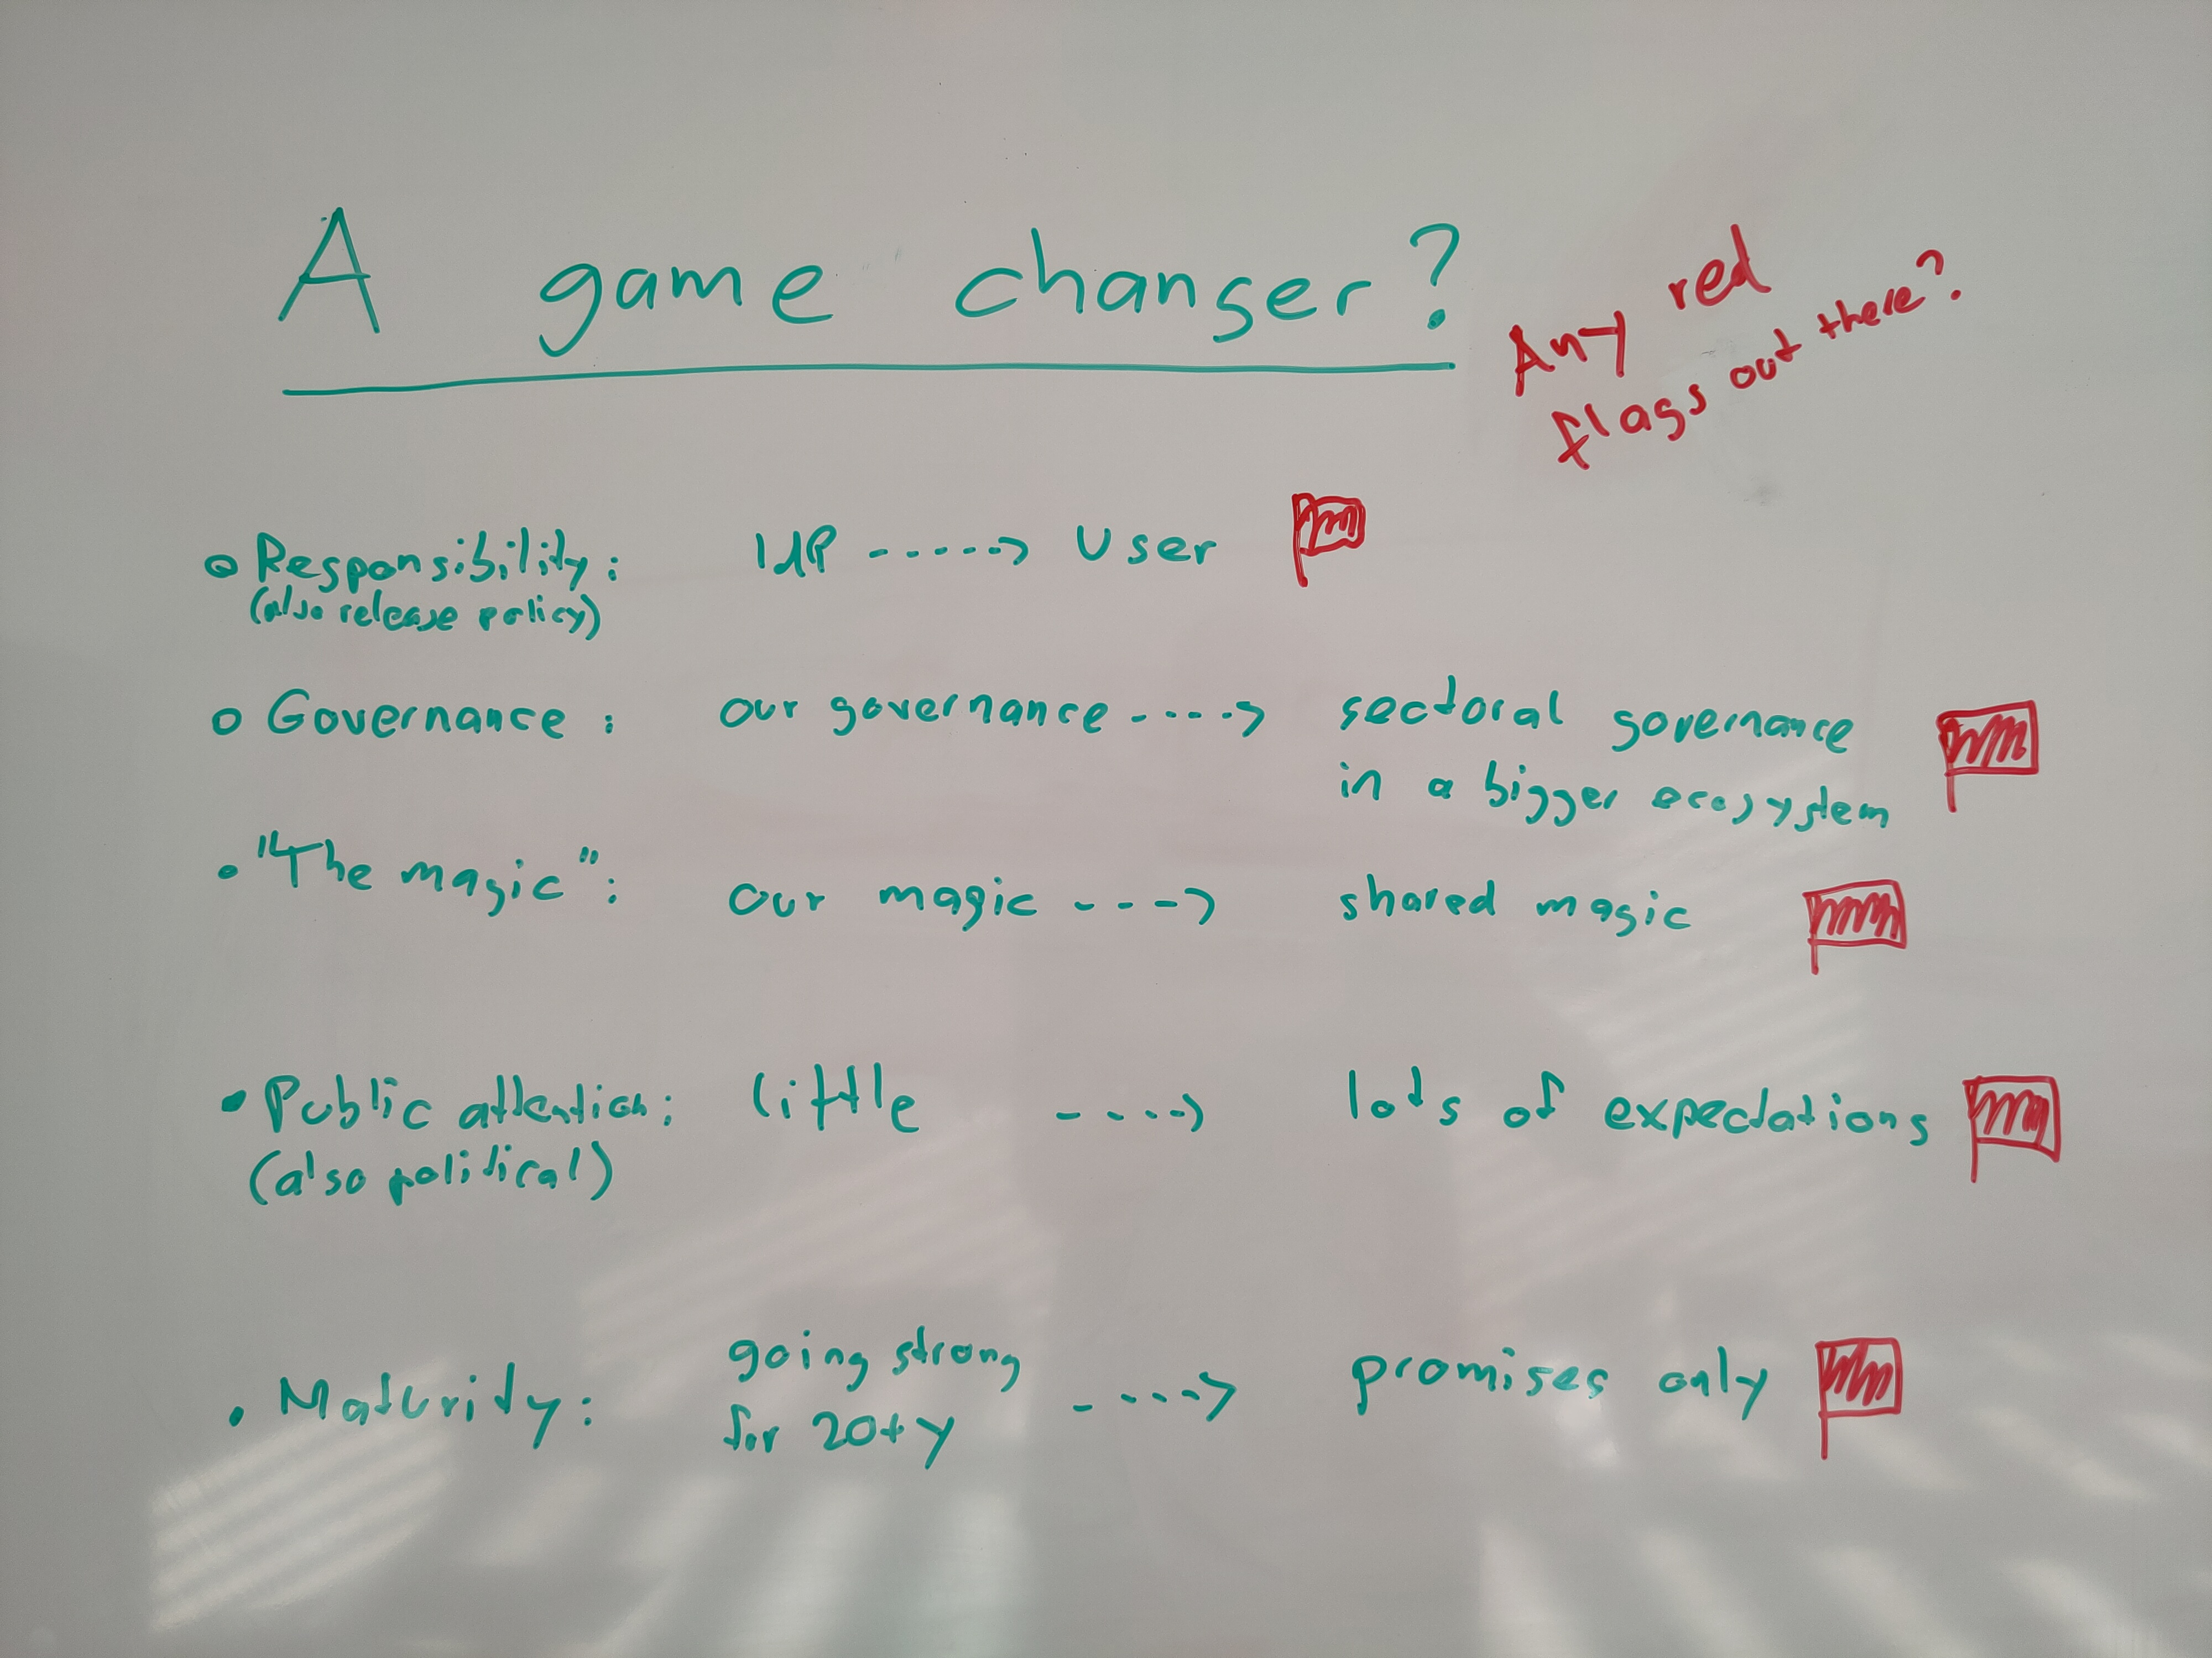

Slide 9








The EU approach towards SSI
Sectoral ecosystems
per member state
Sectoral governance
Per member state
Is there a similar role for GÉANT?
Mobility
Telco
Finance
Education
eIDs issued by member states
eGov
Health
EBSI
(European Blockchain Service Infrastructure), regulated centrally, run decentrally
Decentralised infrastructure for digital proofs
Bund als Regulator

Slide 10
EU Strategy for Universities: https://education.ec.europa.eu/sites/default/files/2022-01/communication-european-strategy-for-universities.pdf
"Excellent and inclusive universities are a condition and foundation for open, democratic, fair and sustainable societies as well as sustained growth, entrepreneurship and employment."

Slide 11
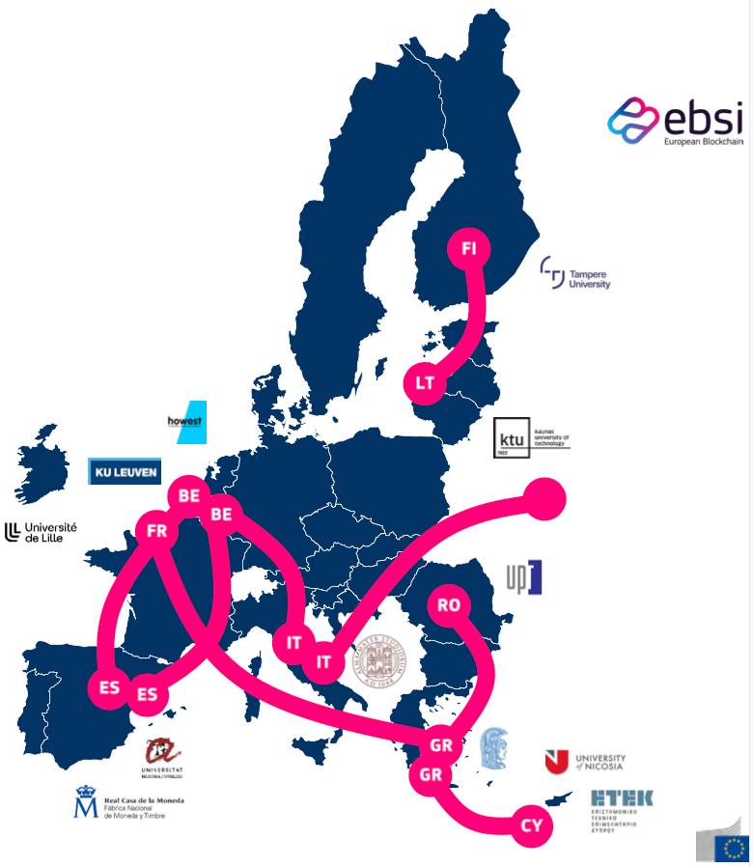
EU “Flagship” Activities to Implement the Strategy for Universities
ERASMUS+
  Student mobility to become a standard requirement for all academic (and other?) curricula
A legal statute for alliances of higher education institutions
  “European University” stands for an alliance (one of more than 100)
Joint European degrees
  “European Degrees” are from “European Universities” (i.e. alliances)
European Student Card initiative
  It features the ESI – The European Student Identifier
EBSI multi-university-pilots

Slide 12
Risk assessment
T7 internal expert assessment with different backgrounds
Focus on high-level risks
It’s the «mid-2024 statement» in a VUCA world
The «mid-2025 statement» will likely look differently

Slide 13
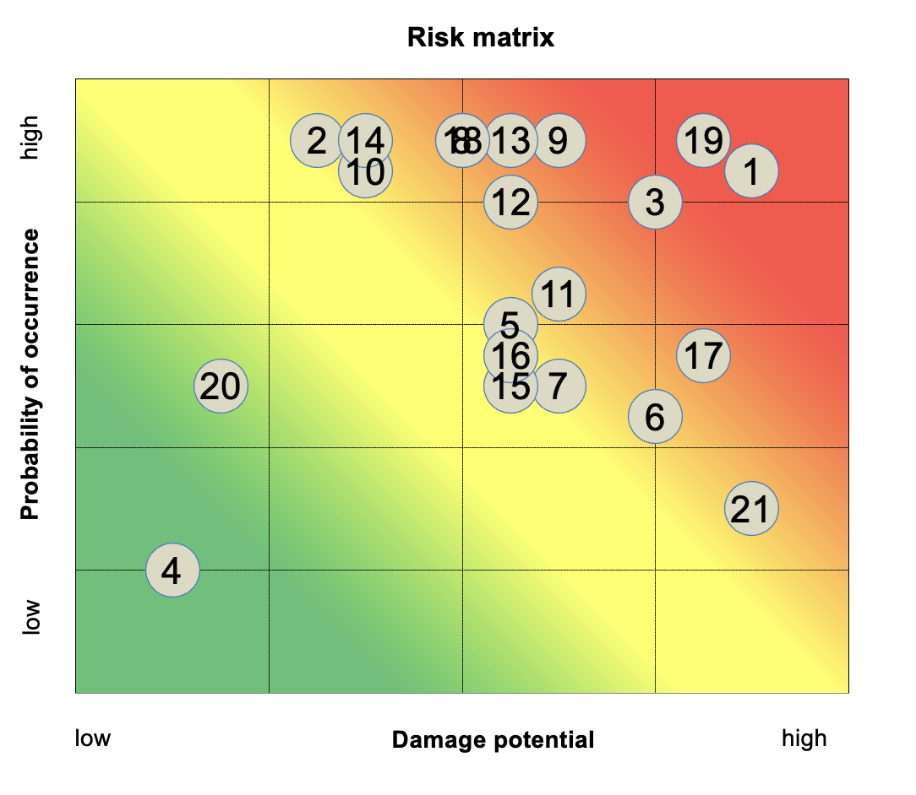
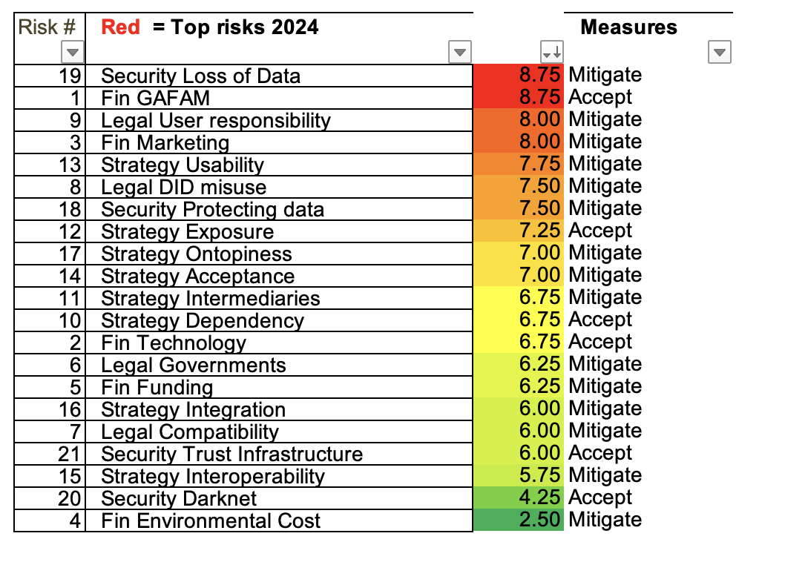

Slide 14
Conclusions on

