Slide 1
Introduction to Wallets
Trust and Identity Infoshare for NRENs
Christoph Graf, Switch
Tasklead GN5-1/WP5/T7
GÉANT Infoshare
23 September 2024
Project Participants Sensitive (SEN)

Slide 2


Overview
Our T&I genes – and what came out of them
The bigger picture – and new expectations
Enter “Wallets” – so what?
Next steps – either with, or without us

Slide 3
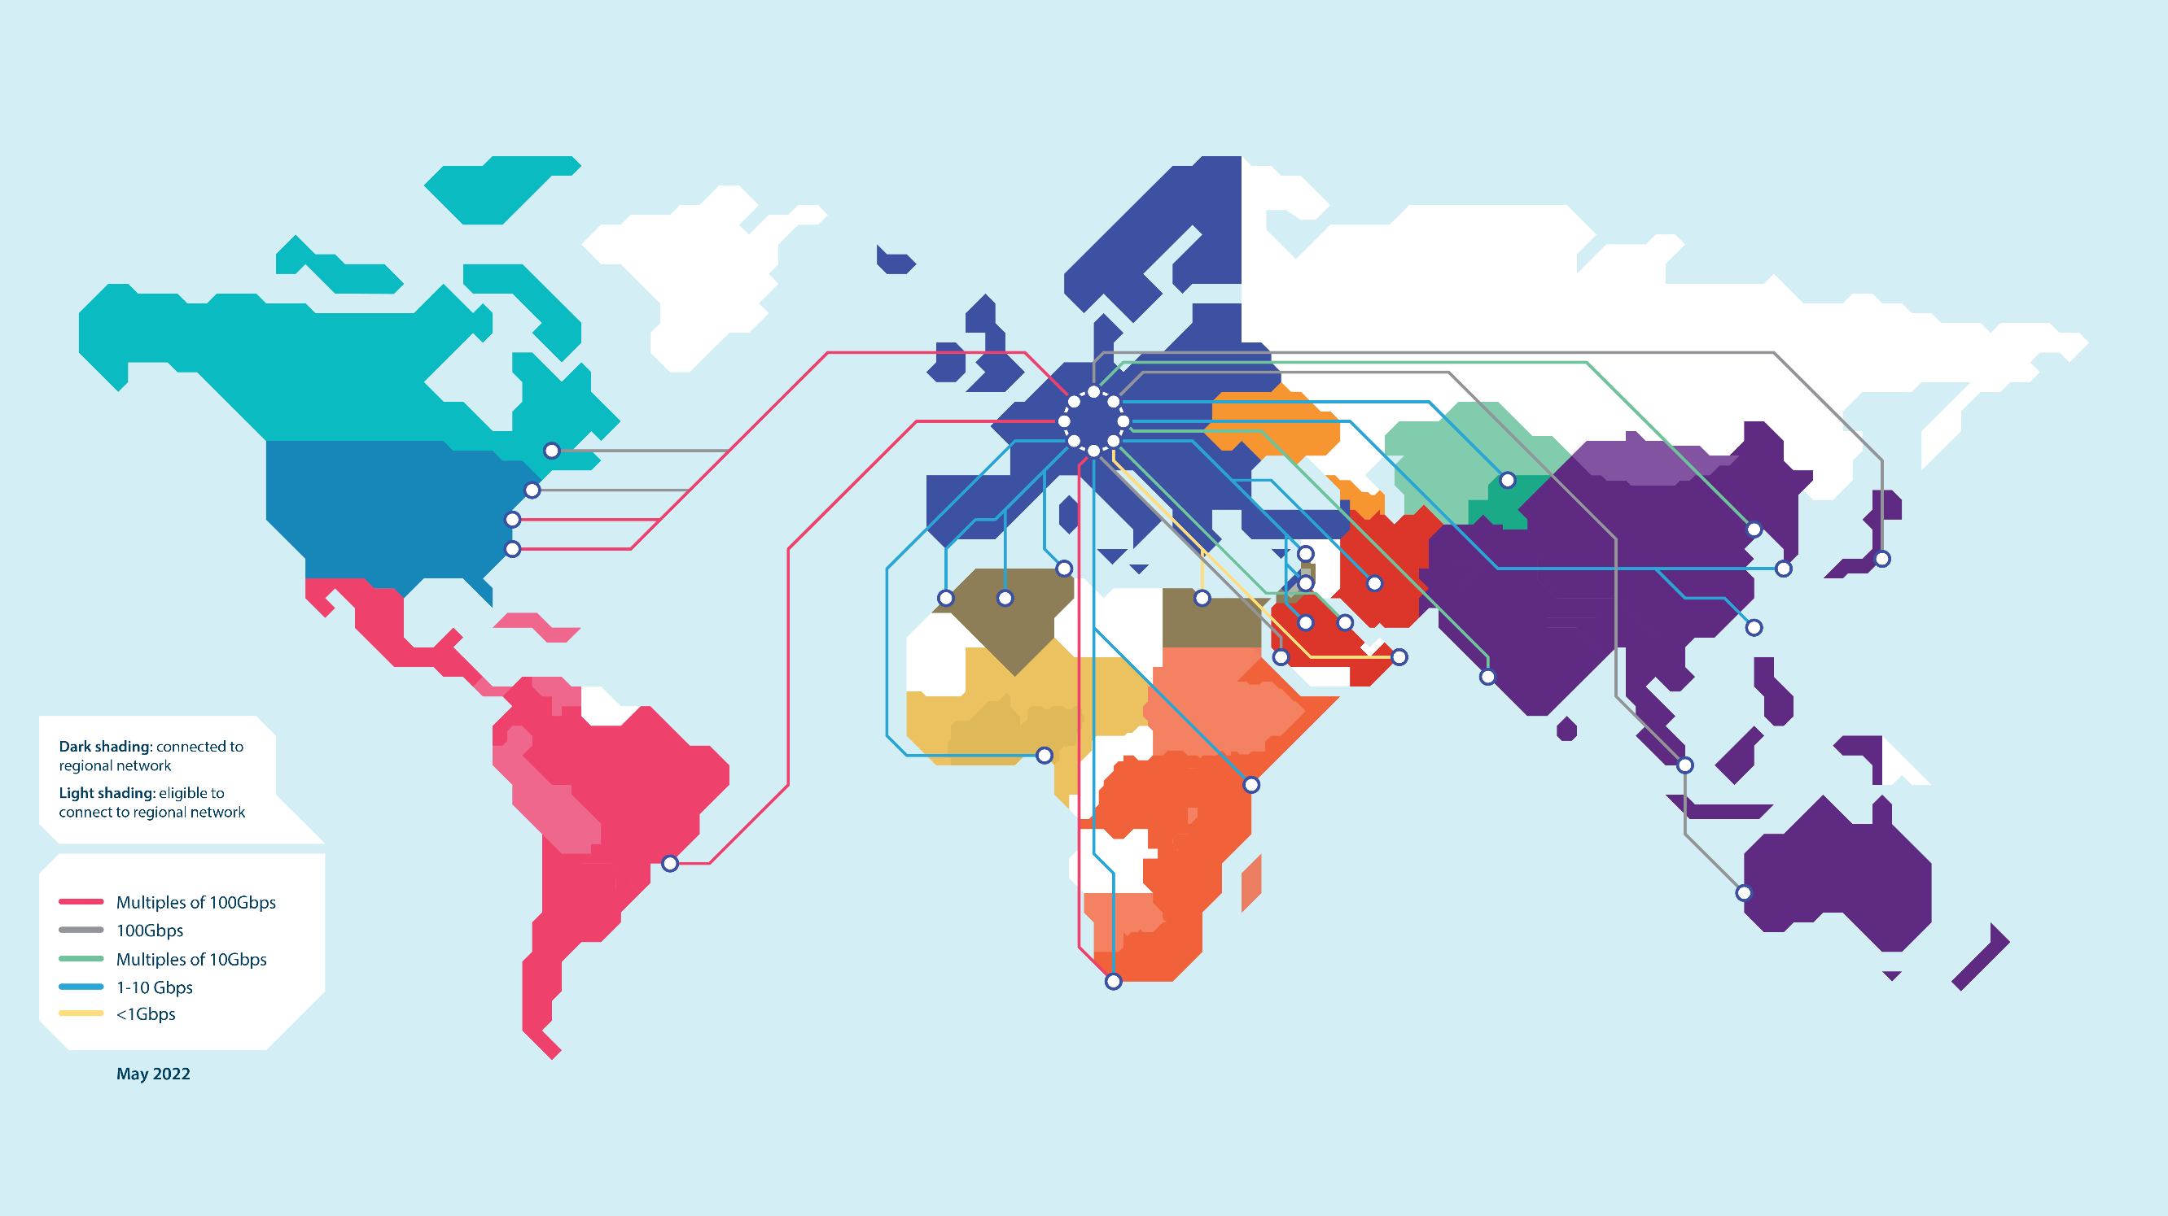
At the heart of global research and education networking
Did you know that GÉANT is at the heart of another global research and education network?
Where we are neither counting links nor Gbps, but users, services and organisations

Slide 4
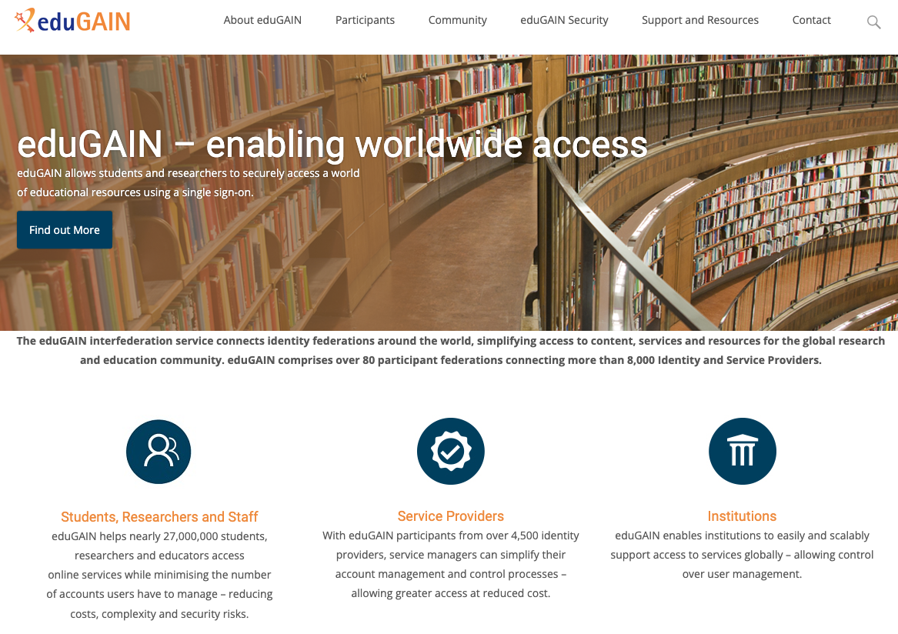

Slide 5



Worldwide access: what is it all about?
I want to use «Cool service»
Me
Reputable university
Cool service
I know something about you
OK, but only if trustworthy sources tell me enough about you

Slide 6
Our well-established workhorse eduGAIN is solving this problem
Me
Please let me in
Tell them it’s me!
Who are you?
Our technical magic
Reputable university (members only)
Cool service
(members only)
I vouch for him or her
Membership information
Our governance
Membership information
«centre of the universe»
Approves/denies user-to-service connections
Decides on user data release to services

Slide 7
EU Strategy for Universities: https://education.ec.europa.eu/sites/default/files/2022-01/communication-european-strategy-for-universities.pdf
"Excellent and inclusive universities are a condition and foundation for open, democratic, fair and sustainable societies as well as sustained growth, entrepreneurship and employment."

Slide 8

EU values
EU Policy measures
Strategy for universities
Digital education hub
Europass, ELM, ESCO,…
… and much more
eIDAS v2
EUDI wallet
ERASMUS+
Implementing acts
“European universities”
Architecture reference framework
Role of
NRENs?
Role of
GÉANT?
“European degrees”
Large Scale Pilots
European student card
EBSI/
EUROPEUM-EDIC
Universities

Slide 9


Going wallets: how does the picture change?
Me
Please let me in
Please confirm it’s me!
Who are you?
Our new technical magic
It’s me
I confirm it’s you
Reputable university
Cool service
Membership information
Our governance
Membership information
«centre of the universe»
Establishes user-to-service connections
Decides on user data released to service

Slide 10
Scale-out with wallets: how does the picture change?
Me
Shared technical magic
Reputable organisations
Cool services
Our governance
Shared governance
framework
Our sector governance
Other sector’s governance
Our governance

Slide 11
T7 contribution: risk assessment
T7 internal expert assessment with different backgrounds
Focus on high-level risks
It’s the «mid-2024 statement» in a VUCA world
(Volatility, Uncertainty, Complexity, Ambiguity)
The «mid-2025 statement» will likely look different

Slide 12
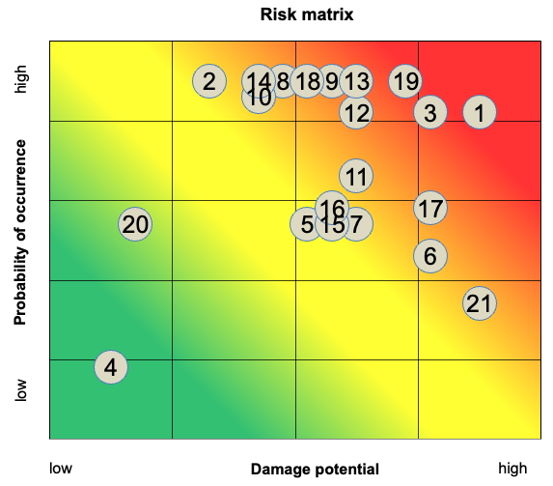
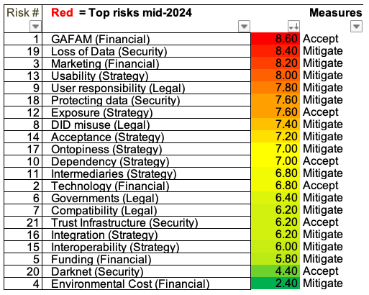

Slide 13
Top risks summary
GAFAM
(Financial)
The role, power and unpredictability of the GAFAMs
Loss of data
(Security)
Missing recovery concepts and processes: lost or broken devices, device or wallet changes, data migration, etc.
Marketing
(Financial)
Much stronger market exposure compared to our current niche
Usability
(Strategy)
Usability of the new solutions with respect to user expectations
User res-ponsibility
(Legal)
Responsibilities in a user-centric environment: relation organisations to services, replacing the protection so far delivered by IdPs, loss of organisational control, data leaks

Slide 14
T7: Intermediate recommendations for next steps
Monitoring
keep up with developments: update risk assessment, identify and assess relevant activities
→ GN5-2 WP5 T6
Dissemination
Periodic infoshares, envisage other channels like a SIG
→ GN5-2 WP5 T6
Consensus building
Establish, agree on and maintain a dynamic wallet roadmap
Participation
“Get your hands dirty”: Engage in activities relevant to our stakeholders
DC4EU (Stefan)
Standardisation work
Represent the interests of our community: leverage 20+ years of experience in IAM in our community
OID Federations (Davide)
Leverage existing federation infrastructure
Evolution and revolution – the right mix of it: bridging the worlds
MyAcademicID for education credentials (Christos)

Slide 15
T7: Intermediate recommendations for next steps (Proposal Marina)
Monitoring
Keep up with developments: update risk assessment, identify and assess relevant activities
→ GN5-2 WP5 T6
Dissemination and consensus building
Periodic infoshares, envisage other channels like a SIG
→ GN5-2 WP5 T6
Contribution to the standards, collaboration with global R&E
→ OID (Davide will talk), IETF etc.
→ GN5-2 WP5 T6
“Get your hands dirty”: Engage in activities relevant to our stakeholders
→ DC4EU (Stefan will talk)
→ GN5-2 WP5 T5 (Incubator)
Interoperability
Builds and trials for new technologies
Evolution and revolution – the right mix of it: bridging the worlds
→ MyAcademicID for education credentials (Christos will talk)
→ OID Federation for eduGAIN (Davide will talk)
NRENs have different roles in national activities depending on the mandate given
Federations will need to participate on OID adoption
Leverage existing federation infrastructure
National activities
Notes:
- Represent the interests of our community: leverage 20+ years of experience in IAM in our community

Slide 16
Thank You

