Slide 1
Introduction to Wallets
Trust and Identity Infoshare for NRENs
Christoph Graf, Switch
Tasklead GN5-1/WP5/T7
GÉANT Infoshare
23 September 2024
Project Participants Sensitive (SEN)

Slide 2


Overview
Our T&I genes – and what came out of them
The bigger picture – and new expectations
Enter “Wallets” – so what?
Next steps – either with, or without us

Slide 3


IDENTITY FEDERATION
NETWORK
COMMUNITY
Network Services
Cloud
Security
Trust & Identity

Slide 4
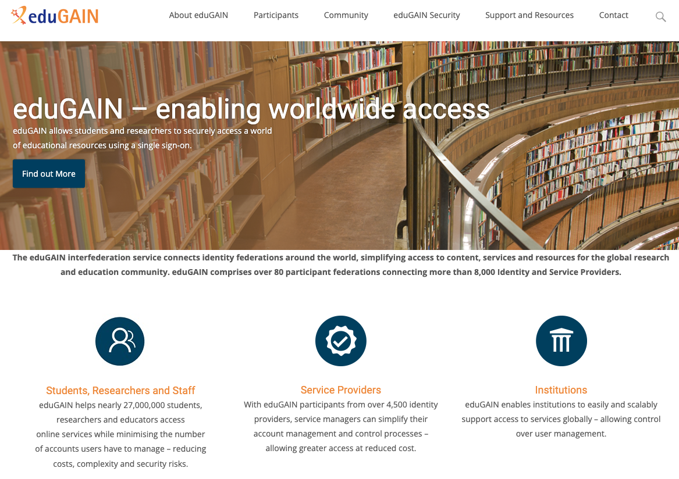

Slide 5



Worldwide access: what is it all about?
I want to use «Cool service»
Me
Reputable university
Cool service
I know something about you
OK, but only if trustworthy sources tell me enough about you

Slide 6
Our well-established workhorse eduGAIN is solving this problem
Me
Please let me in
Tell them it’s me!
Who are you?
Our technical magic
Reputable university (members only)
Cool service
(members only)
I vouch for him or her
Membership information
Our governance
Membership information
«centre of the universe»
Approves/denies user-to-service connections
Decides on user data release to services

Slide 7
EU Strategy for Universities: https://education.ec.europa.eu/sites/default/files/2022-01/communication-european-strategy-for-universities.pdf
"Excellent and inclusive universities are a condition and foundation for open, democratic, fair and sustainable societies as well as sustained growth, entrepreneurship and employment."

Slide 8

EU values
EU Policy measures & money
Strategy for universities
EOSC, GAIA-X, data spaces
Europass, ELM, ESCO,…
… and much more
eIDAS v2
EUDI wallet
ERASMUS+
Implementing acts
“European universities”
Architecture reference framework
Role of
NRENs?
Role of
GÉANT?
“European degrees”
Large Scale Pilots
European student card
EBSI/
EUROPEUM-EDIC
Universities

Slide 9


Going wallets: how does the picture change? And the terminology?
Me → Holder
Please let me in
Please confirm it’s me!
Who are you?
Our new technical magic
It’s me
I confirm it’s you
Reputable university
→ Issuer
Cool service
→ Verifier
Membership information
Our governance
Membership information
«centre of the universe»
Establishes user-to-service connections
Decides on user data released to service

Slide 10
Scale-out with wallets: how does the picture change?
Me
Shared technical magic
Reputable organisations
Cool services
Our governance
Governance
framework
Our sector governance
Other sector’s governance
Our governance

Slide 11
Opportunities and risks
GAFAM
The role, power and unpredictability of the GAFAMs
EU seed money only lasts as wallets are still novel enough
Money available NOW
Usability
New solutions might not meet user expectations
Benefit of being part of a larger ecosystem
Cross sector use cases
Global community
EU policies might not scale well beyond EU borders
Synergies by using cross-sectorial solutions
We’re no longer alone
User res-ponsibility
User-centrism challenges: organisation to service relationship, protection offered by IdPs, organisational control, data leaks

Slide 12
Community activities
Monitoring
Keep up with developments: update risk assessment, identify and assess relevant activities
→ GN5-2
“Get your hands dirty”: Engage in activities relevant to our stakeholders
→ DC4EU (Stefan will talk)
→ GN5-2 (T&I Incubator)
Builds and trials for new technologies
Contribution to the standards, collaboration with global R&E
→ OID (Davide will talk), IETF etc.
→ GN5-2
→ AARC tree
Interoperability
Dissemination and consensus building
Periodic infoshares or SIG, community consultation e.g. AEGIS
→ GN5-2
→ AARC tree
→ EOSC Ass. taskforce
Leverage existing federation infrastructure
Evolution and revolution – the right mix of it: bridging the worlds
→ MyAcademicID for education credentials (Christos will talk)
→ OID Federation for eduGAIN (Davide will talk)
National activities
NRENs have different roles in national activities depending on the mandate given
Federations will need to participate on OID adoption
Notes:
- Represent the interests of our community: leverage 20+ years of experience in IAM in our community

Slide 13
Thank You

