Slide 1
Driving Agility with Automated Service Orchestration
Sonja Filiposka
JRA2T2 TL, MARnet/UKIM
SIG-PMV, NORDUnet
28th & 29th October 2017

Slide 2
JRA2T2: Service provider architecture
a formal model of how service providers define services, implement and manage those services, and announce them so that other entities can learn of and solicit available services.
streamline the development, introduction and delivery of new services by standardizing the OSS/BSS components and APIs

Slide 3
Goals
Pilot implementation of the base SPA framework
Pave the way for future needed agility
  SDN & NFV API based programmable networks
Provide interoperability using common open APIs

Slide 4
SPA based service transformation
Service 1
Service 2
Service 3
Service 1
Service 2
Service 3
inventory
monitoring
users
portal
Network

Slide 5
TMF Frameworx
http://casewise.tmforum.org/evolve/statics/frameworx/index.html

Slide 6
SPA design
TMF compliant
  SID / TAM modularity
  Free open-source components
  API wrappers using ESB
SOA + EDA
  Microservices
  eTOM based orchestration

Slide 7

ESB
Self-service portal
BPM
CRM
Ordering
Catalogue
Problems
R & S
Inventory
Activation
(T1)
Monitoring
(T4)
Faults
TMF API
Network

Slide 8
Customer centric processes
Focus on service fulfilment and assurance

Slide 9
Benefits ~ Challenges
Customer facing vs Resource facing services
  Unified approach to services and processes
Consistent yet distributed information
  E.g. common resource inventory, dynamic catalogue
No data duplication
  E.g. single user database, PMV framework
Focus on development of service specific modules
  Faster service design
…

Slide 10
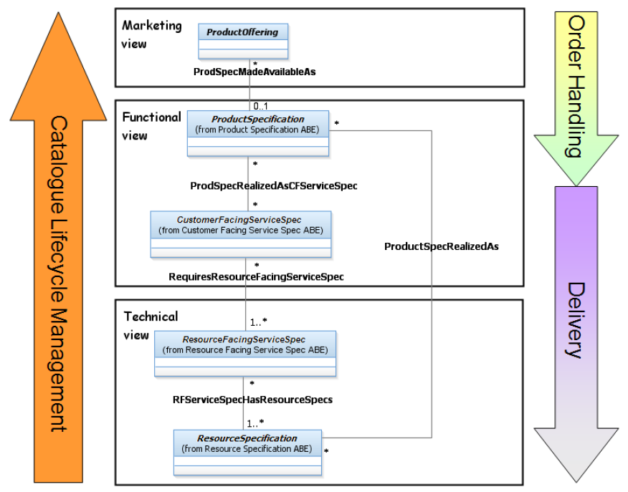

Slide 11
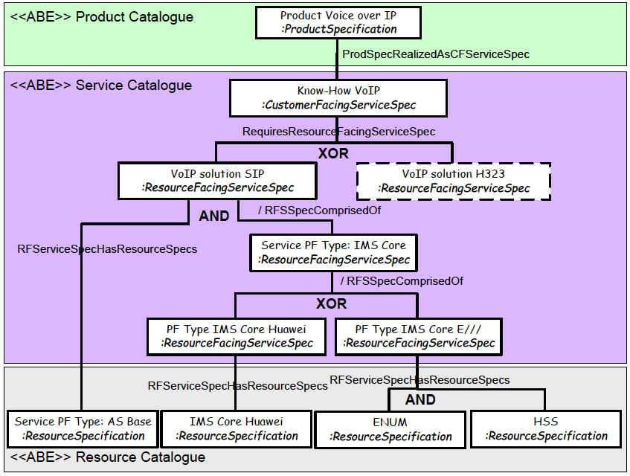

Slide 12
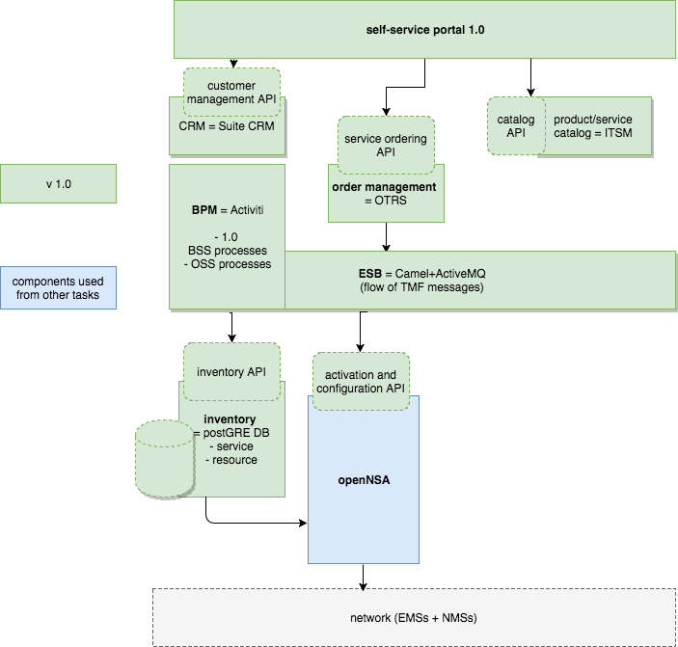
SPA implementation v1.0
E-line service example

Slide 13
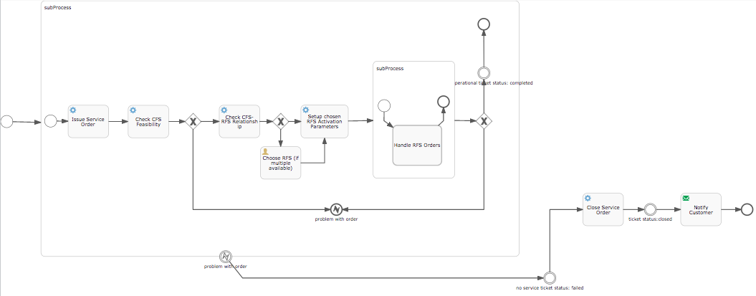
Order-to-activation orchestration example

Slide 14
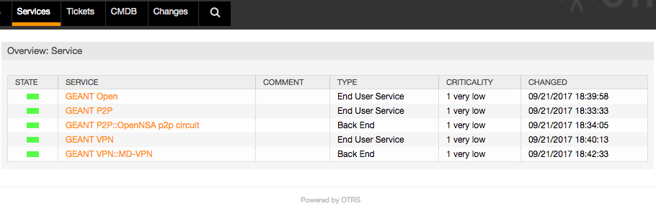
Catalogue – OTRS ITSM

Slide 15
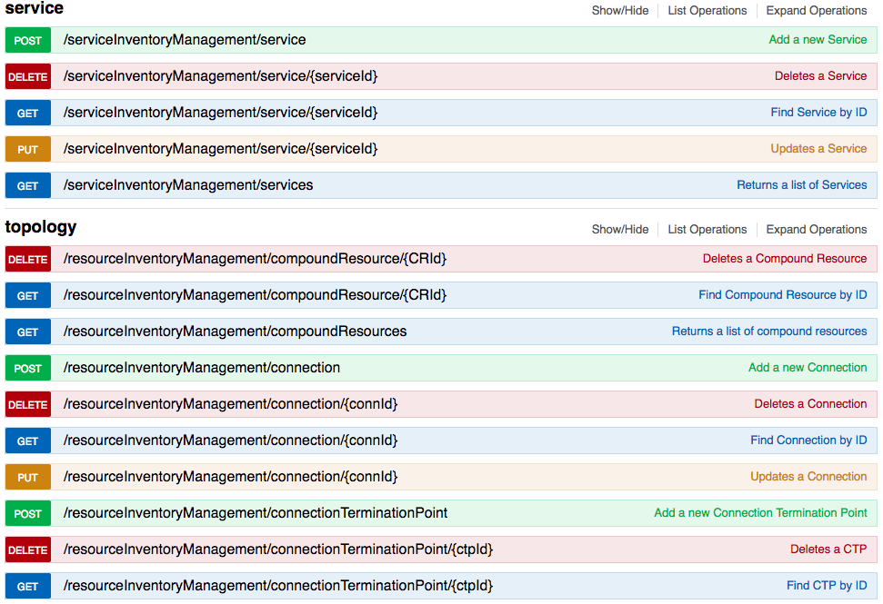
Inventory API example

Slide 16
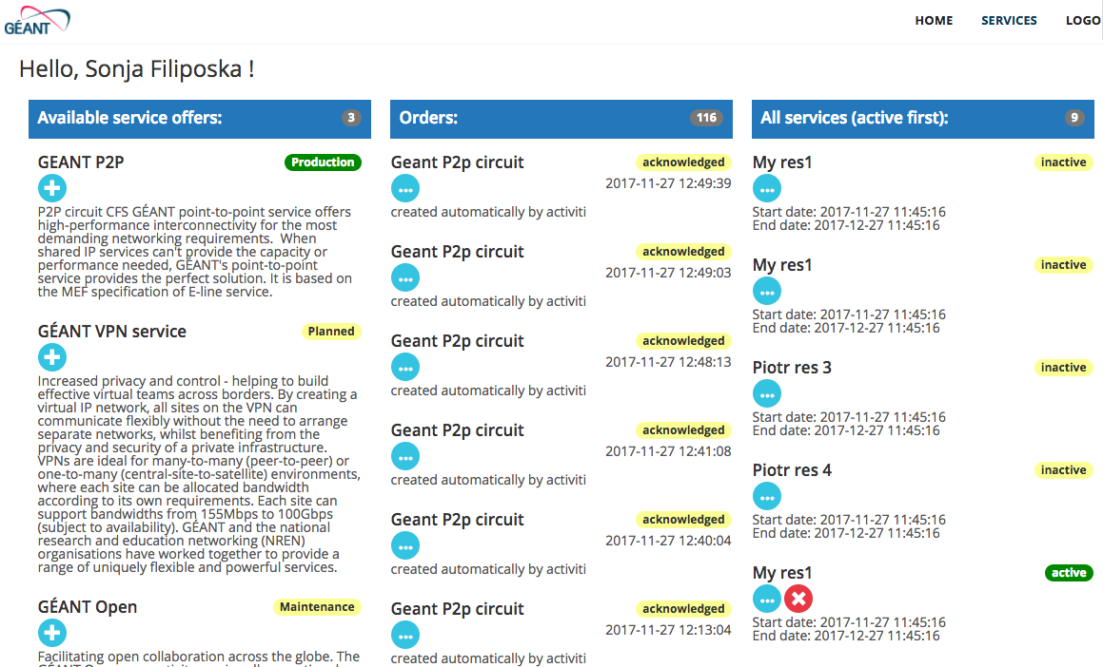
SSP – customer view

Slide 17
Demo

Slide 18
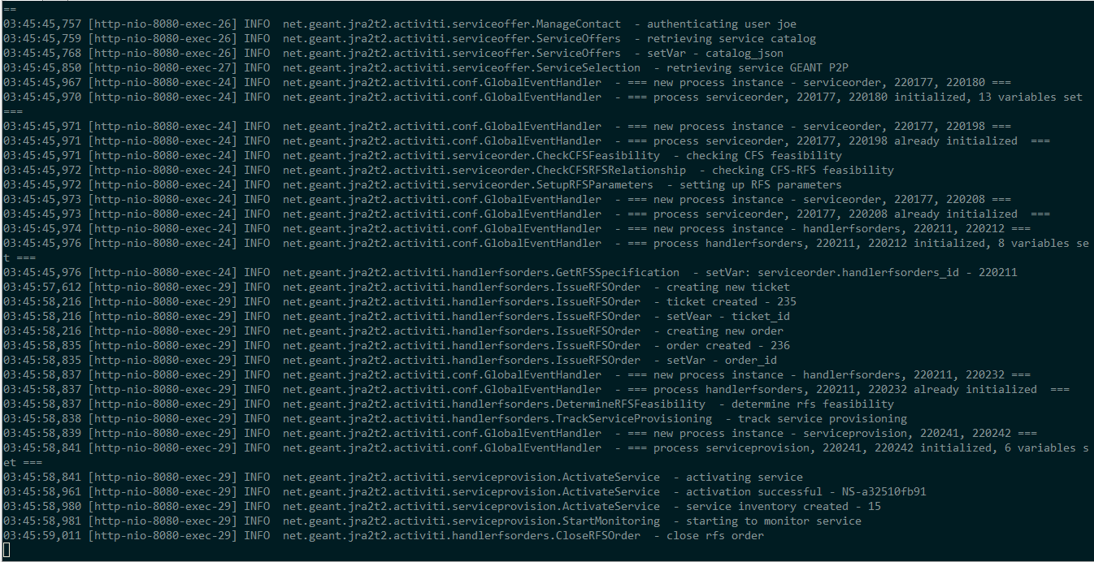
Background execution – ordering process

Slide 19
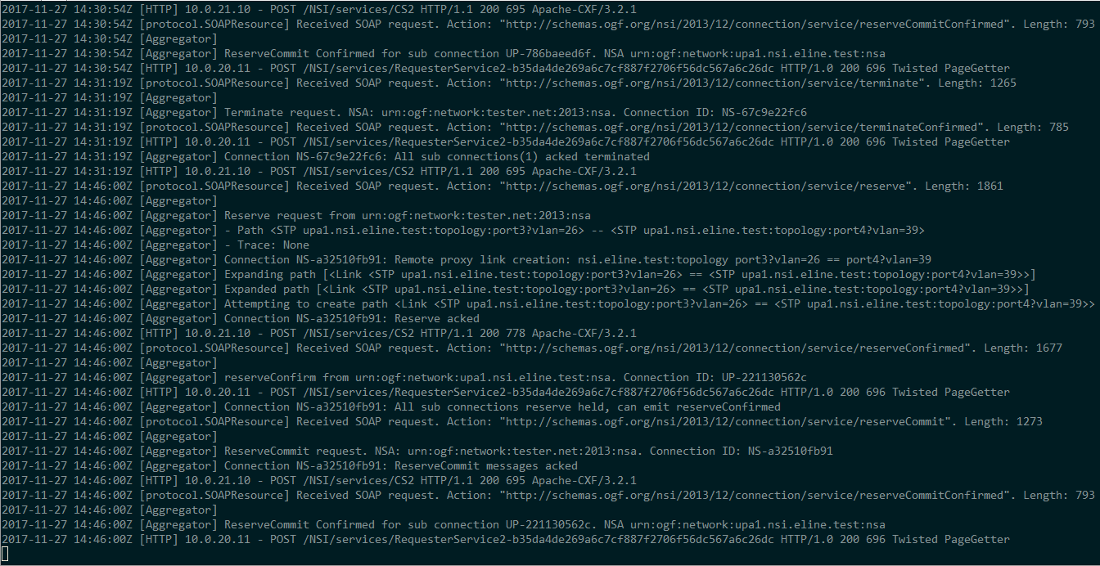
Behind the scene - OpenNSA

Slide 20
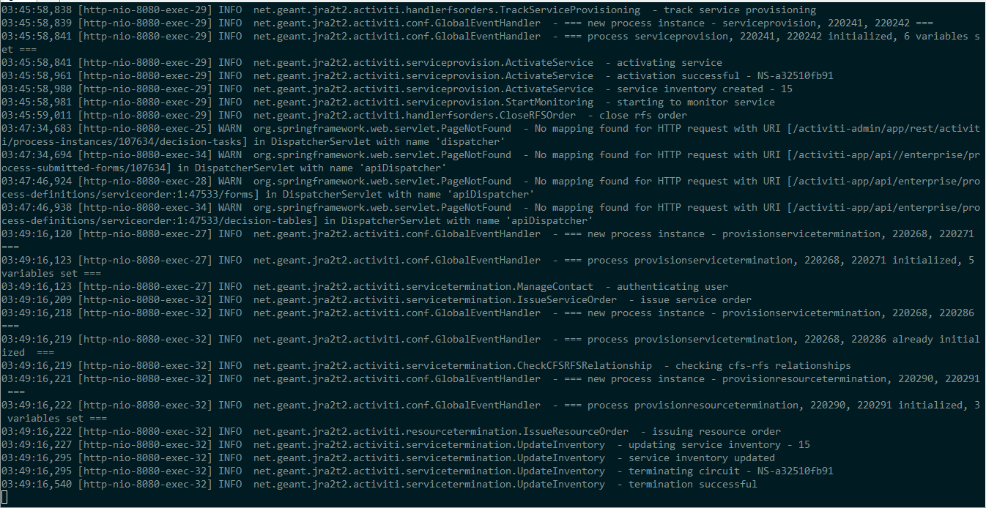
Background execution - termination

Slide 21
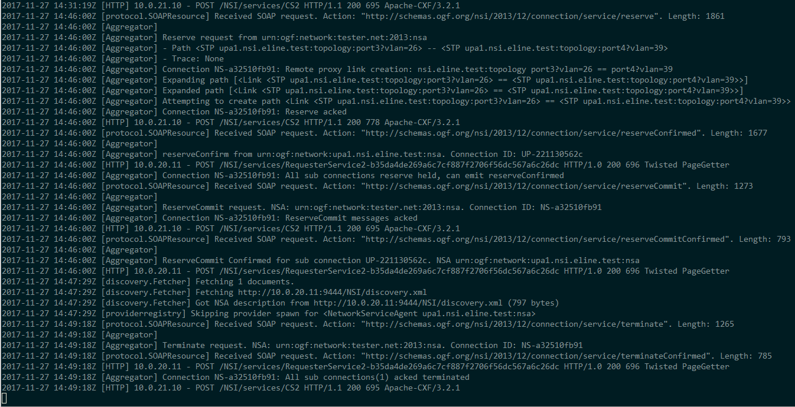
Behind the scene- OpenNSA

Slide 22
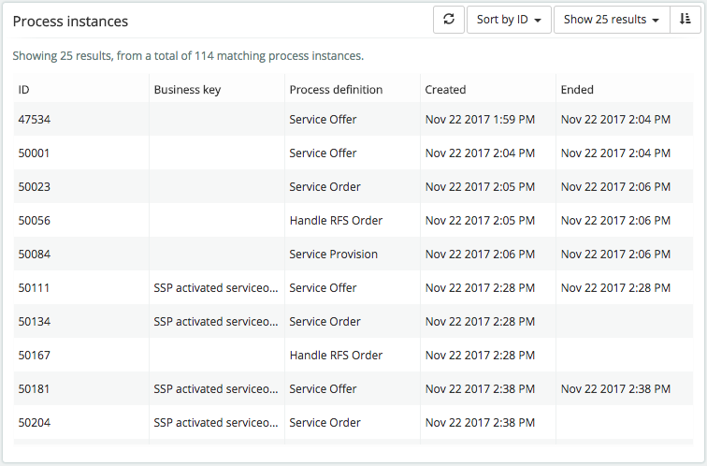
Orchestration KPIs

Slide 23
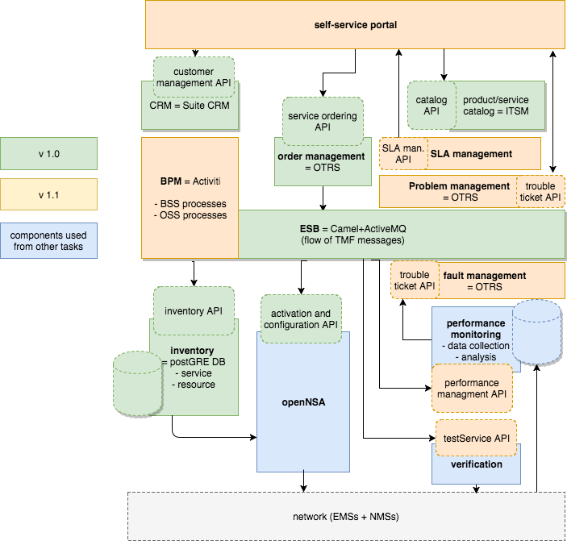
SPA implementation v1.1
E-line service example

Slide 24
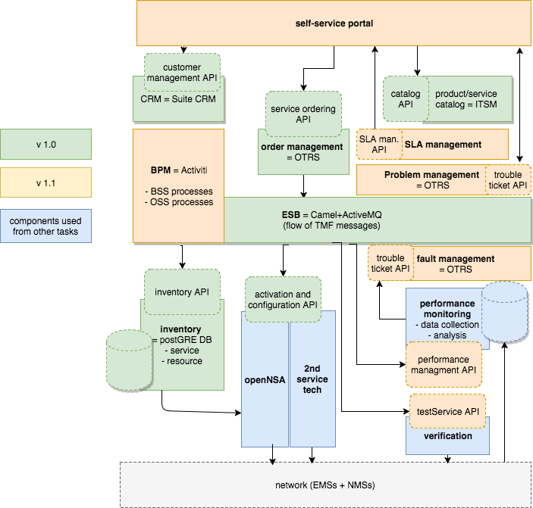
SPA implementation v2.0
Second service example

Slide 25
T4 PMV – T2 SPA integration
Performance
Performance
Fault
Quality
Problem
Customer
Service
Resource
SLA
Problem
TAM components

Slide 26
Service Test Management
Defines metrics, capture period, threshold rules and consequences
Used via Service test API
Defined calls
  Verifying service during activation - automated
  Regular service monitoring - automated

Slide 27
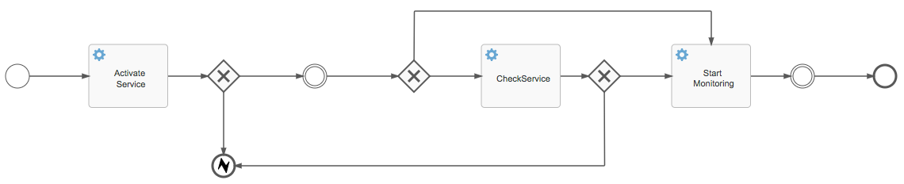
T4 PMV – T2 SPA integration phase 1

Slide 28
T4 PMV – T2 SPA integration phase 2
Adding:
  Service Test Management API
    To check service quality in case of complaint – on demand
Trouble Ticket API for Fault Management

Slide 29
T4 PMV – T2 SPA integration phase 3
Looking into:
Service Quality Management API
  Define Service Level Specifications
  Associated Service Level Objectives (SLO)
    Parameters, Conformance/tolerance period
  Consequences
SLA Management API
  SLA configuration, SLA operations, SLA reporting
TMF spec not finalized, inconsistencies discovered

Slide 30
Conclusions
SPA
  Entails many challenges
  Brings many opportunities for building agile environments
  Microservices development lifecycle
Collaborative effort
  expertise is needed for all specific components and their internal working
  Using open APIs that are clearly defined helps building a growing dynamic environment that supports all services in a uniform fashion
Complex actions
  Efficient orchestration using automated processes is key

Slide 31
Any Questions ?
sonja.filiposka@finki.ukim.mk

