Slide 1
Data Transfer Node Performance GÉANT & AENEAS

Slide 2
Agenda
Environment – HW and Topology
Tuning
UDP & TCP using the Kernel Stack
  Achievable UDP throughput vs packet spacing
  Achievable UDP throughput vs packet size
  Achievable TCP throughput and use of CPU cores, application, NIC ring buffer
  Achievable TCP throughput ConnectX-4 and ConnectX-5 – multiple flows
RDMA using the Kernel Stack
  RDMA RC Observed Protocol and Packet size
  RDMA RC throughput vs message size
  RDMA RC throughput vs packet spacing
Kernel bypass with libvma
  Achievable UDP throughput vs packet size
  Achievable UDP throughput vs packet spacing
  TCP throughput

Slide 3
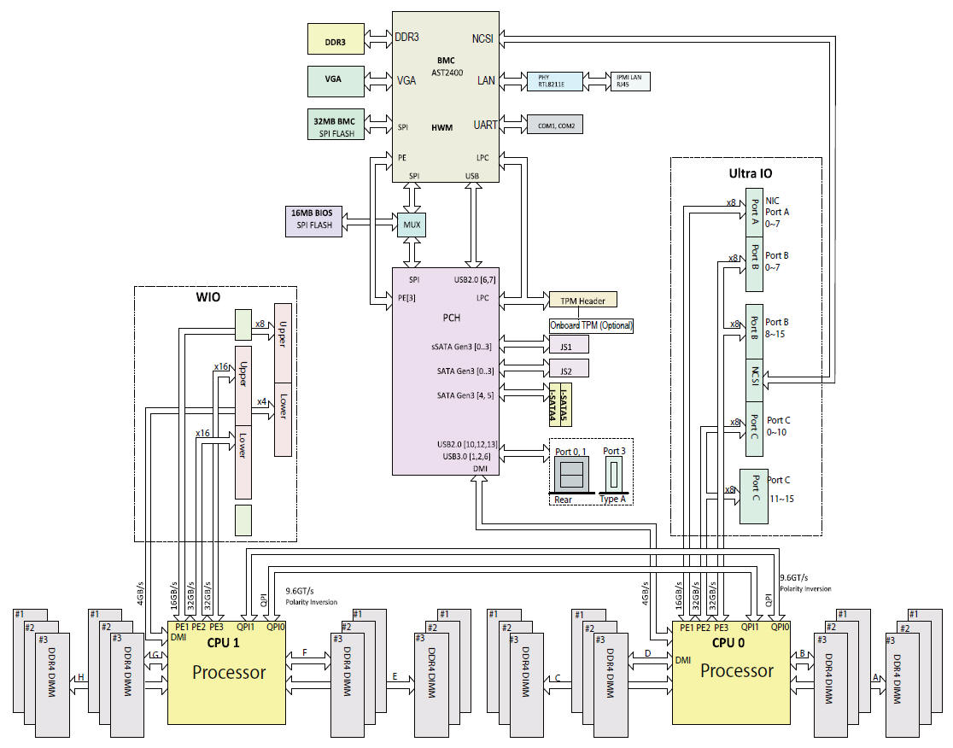
The GÉANT DTN Hardware
A lot of help from Boston Labs (London UK)
Mellanox (UK & Israel )
Supermicro X10DRT-i+
motherboard
Two 6 core 3.40GHz
Xeon E5-2643 v3 processors,
Mellanox ConnectX-4/5 100 GE NIC
  16 lane PCI-e
  As many interrupts as cores
  Driver
  MLNX_OFED_LINUX-4.0-2.0.0.1
NVME SSD
  Set 8 lane PCI-e
Fedora 23 with the
4.4.6-300.fc23.x86_64 kernel
NVME
NIC
Notes:
QPI Intel QuickPath Interconnect 9.6 GT/s
16 lane 32 GB/s

Slide 4
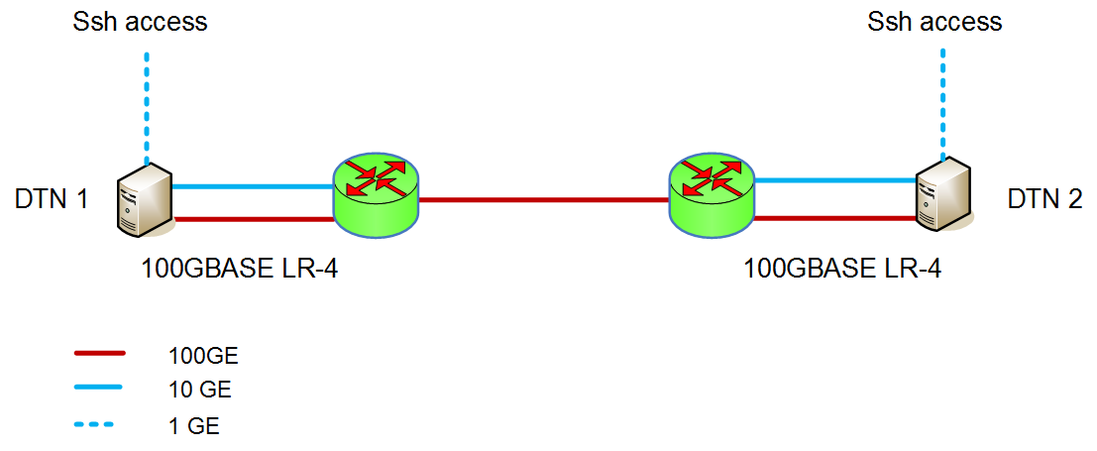
DTN Topology 1
Back to Back, Active Cable, 100GBASE SR-4, 100GBASE LR-4
DTN Qualification in the GÉANT Lab
Juniper MX
Juniper MX

Slide 5
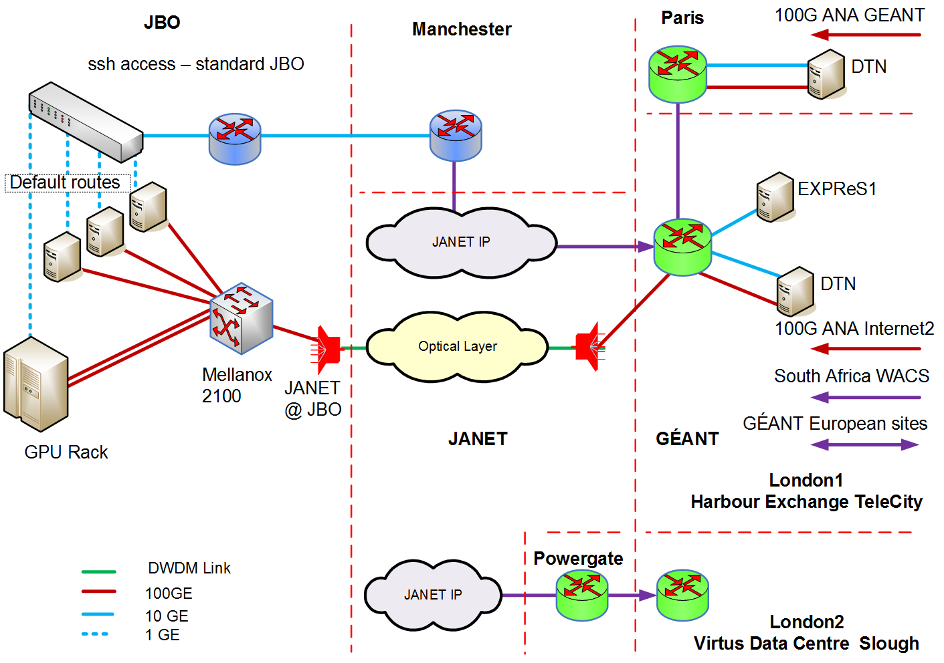
DTN Topology 2
GÉANT DTNs in London & Paris AENEAS DTNs in Jodrell Bank

Slide 6
Network Tuning for 100 Gigabit Ethernet
Hyper threading Turn OFF
Wait states Disable
Power saving Core Frequency Set governor “performance”
Set max CPU frequency
NUMA Select correct CPU cores
IRQs Turn off the irqbalance
Use correct cores for NIC IRQs
Interface parameters Interrupt coalescence, Xsum offload, Ring buffer
MTU Set IP MTU 9000 Bytes
Queues Set txqueuelen, netdev_max_backlog
Kernel parameters r(w)mem_max, tcp_r(w)mem, tcp_mem, …
Firewalls
Better to choose fewer higher speed cores

Slide 7
udpmon: UDP Achievable Throughput Ideal shape
Flat portions
Limited by capacity of link
Available BW on a loaded link
Shape follows 1/t
Packet spacing most important.
Cannot send packets back-2-back
End host: NIC setup time on PCI / context switches

Slide 8
udpmon: Achievable Throughput & Packet loss
Move IRQs from core 6, set affinity to lock udpmon to core 6 node 1.
Interrupt coalescence on (16us)
NIC: ConnectX-4
50 Gbit/s
Jumbo size packet should be highest !
96% kernel sending
Swapping between user and kernel mode
37% kernel recv.
Also lost packets in the receiving host
Notes:
Recv CPU % idle ??

Slide 9
udpmon_send: How fast can I transmit?
Sending Rate as a Function of Packet Size
Move IRQs from core 6, set affinity to lock udpmon to core 6 node 1.
Drop 14.5 Gbit/s from 43 Gbit/s
Step 0.75 µs
Collaborate with Mellanox
Not driver but the kernel
Step occurs 7813 – 7814 bytes user data
Drop 3.6 Gbit/s
Step 0.29 µs
Notes:
50 ps / byte 8 bytes 0.4 ns/64 bits
Install and tested
Centos 7 kernel 3.10.0-327.el7.x86_64
Centos 6.7 kernel 2.6.32-573.e16.x86_64 Boston Labs OK

Slide 10
udpmon: Size of Rx Ring Buffer
ConnectX-5, set affinity of udpmon to core 6 node 1.
Use ethtool -S <enp131s0f0> look at rx_out_of_buffer
RX ring 1024
RX ring ≥4096
51 Gbit/s
To 8% packet loss
No packet loss

Slide 11
iperf3: TCP throughput and use of cores
Firewalls OFF, TCP offload on, TCP cubic stack
Rises smoothly to the plateau – except for the peak
Throughput 0.7MByte:
  80 Gbit/s both Send & Receive on node 1
  35 Gbit/s Send on node 0 Receive on node 1
  28 Gbit/s both Send & Receive on node 0
Very few TCP re-transmitted segments observed

Slide 12
TCP Throughput iperf2 & iperf3
ConnectX-5, NIC rx buffer 4096, iperf Core6 – core6
While transmitting at 80 Gbit/s the CPU was 98% in kernel mode.
iperf3 iperf2

Slide 13
TCP Throughput iperf2 effect of Rx Ring Buffer
ConnectX-5, iperf Core6 – core6
Correlation of low throughput and re-transmits for Rx ring 1024

Slide 14
iperf: TCP throughput multiple flows
Distribute IRQs on node 1
Run iperf on cores 6-11
for both send & receive
Firewalls ON, TCP offload on,
TCP cubic
Total throughput:
increase 60 → 90 1 → 2 flows
>95 Gbit/s for 3 & 4 flows
Re-transmission
  10⁻⁴ % 3 flows
  10⁻³ 10⁻⁵ % 4 flows
  10⁻² % 8, 10 flows

Slide 15
Inside a RDMA Application
App design places Work Requests on Send Queue or Recv Queue
Need to check the Completion Queue – cannot over fill a Queue
Deal with low level memory allocation – like for NIC “ring buffers”
USER
CHANNEL ADAPTER
WIRE
allocate
virtual
memory
register
send queue
post_send()
metadata
. . .
Activity
blocked
control
data packets
completion queue
status
. . .
poll_cq()
ACK
access
Robert D. Russell
Notes:
RoCE v2 UDP/ IP

Slide 16
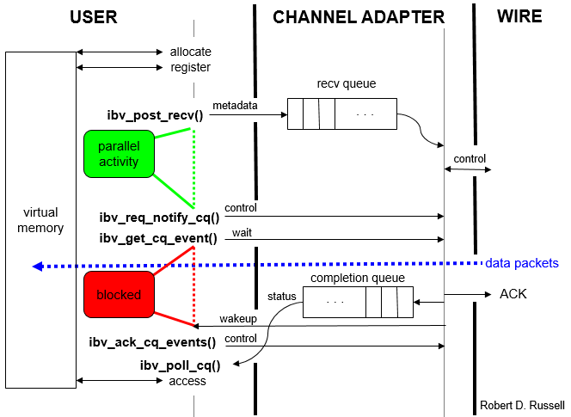
Inside a RDMA Application
Fill Recv Queue with Work Requests & ask for notification
Wait for event – packet arrival – then poll for status
Loop on RecvQ, use data, issue new Recv Work Request
Notes:
RoCE v2 UDP/ IP

Slide 17
RDMA RC
Max packet size 4096 Bytes,
Every message is acknowledged
Core6 – core6
the CPU was 90% in user mode.
App design takes care of ring buffers
poll CompQ every 64 packets
Notes:
RoCE v2 UDP/ IP

Slide 18
RDMA RC Throughput as a function of msg size
Reasonably smooth increase with mssage size
~ 80 Gbit/s for Jumbo frame messages
>90 Gbit/s for 30k Byte messages
Not clear what small messages take so long.

Slide 19
libvma user mode kernel bypass
UDP Throughput as a function of msg size
Modify libvma to fragment correctly
  Fed back to Mellanox & into the distribution.
udpmon unmodified run core6 – core6
Firewalls ON
Smooth increase
UDP > 90 Gbit/s for Jumbo packets

Slide 20
libvma UDP Performance
Core6 – core 6
Throughput >98 Gbit/s
No packet loss
Jitter excellent

Slide 21
libvma TCP Performance
Core6 – core 6
TCP iperf kernel 57.7 Gbit/s
TCP iperf libvma 13.6 Gbit/s
libvma does not seem to trap iperf3 system calls.

Slide 22


Questions ?
Thanks to Richard Hughes-Jones

Slide 23
Progress & Status Task 4.1:
Evaluation of existing data transfer protocols, storage sub-systems and applications
Test hosts set up at Onsala, JBO, GÉANT Cam & Lon, Jülich
Low-level protocol – end host measurements
  UDP, TCP, RDMA RoCEv2, kernel bypass libvma
Good performance with careful tuning single flows 60 – 95 Gbit/s
Technical Note started
Notes:
Tests on local sites
Different hardware and OS versions

Slide 24
iperf: TCP throughput multiple flows
Distribute IRQs over all cores on node 1
Run iperf on cores 6-11
for both receive and sending
Firewalls ON, TCP offload on,
TCP cubic
Total throughput:
increase 60 → 86 2 → 3 flows
98 Gbit/s for 4 & 5 flows
then starts to fall
10⁻⁴ - 10⁻⁵ % re-tx 2, 3 flows
10⁻⁴ % re-tx 4, 5 flows
10⁻³ % re-tx 8, 10 flows
Individual flows can vary
by ± 5 Gbit/s

Slide 25
Network Tuning for 100 Gigabit Ethernet
Hyper threading
  Turn off in the BIOS
Wait states
  Disable / minimise use of c-states. Use the BIOS or at boot time
  Power saving Core Frequency
  Set governor “performance”
  Set cpufreq to maximum
  Depends on scaling_driver:
  acpi-cpufreq allows setting cpuinfo_cur_freq to max
  intel_pstate does not but seems fast anyway
NUMA
  Check and select CPU cores in the node with the Ethernet interfaces attached
Read the current settings
$cat /sys/devices/system/cpu/cpu*/cpufreq/*
$cat /sys/devices/system/cpu/cpu*/cpufreq/scaling_governor
Set
$echo “performance” > /sys/devices/system/cpu/cpu*/cpufreq/scaling_governor
$numactl –H
$cat /sys/devices/system/node/node*/cpulist
$lspci –tv
$cat /sys/class/net/*/device/uevent

Slide 26
Network Tuning for 100 Gigabit Ethernet
IRQs
  Turn off the irqbalance service
  – prevents balancer from changing the affinity scheme.
  Set affinity of the NIC IRQs to use CPU cores on the node with PCIe
    1 per CPU.
    For UDP seems best NOT to use the CPU cores used by the apps.
Interface parameters
  Ensure interrupt coalescence is ON – 3 μs, 16 μs, more ?
  Ensure Rx & Tx checksum offload is ON
  Ensure tcp-segmentation-offload is ON
  Set the Tx Rx ring buffer size
MTU
  Set IP MTU 9000 Bytes
#systemctl stop irqbalance.service
#cat /proc/irq/<irq>/smp_affinity
#echo 400 > /proc/irq/183/smp_affinity
#/usr/sbin/set_irq_affinity_cpulist.sh 8-11 enp131s0f0
#ethtool –C <i/f> rx-usecs 8
#ethtool –K <i/f> rx on tx on
#ethtool –K <i/f> tso on
#ethtool –G <i/f> rx 8192
#ethtool –G <i/f> tx 8192
Best set in files eg ifcfg_ethx
mtu=9000

Slide 27
Network Tuning for 100 Gigabit Ethernet
Queues
  Set txqueuelen
  – transmit Q (I used 1000 but 10,000 recommended)
  Set netdev_max_backlog – say 250000
  – Q between interface and IP stack
Kernel parameters
  net.core.rmem_max net.core.wmem_max
  net.ipv4.tcp_rmem net.ipv4.tcp_wmem (min / default / max)
  net.ipv4.tcp_mtu_probing (jumbo frames)
  net.ipv4.tcp_congestion_control (htcp, cubic)
  net.ipv4.tcp_mem (set the max to cover rmem/wmem max)
Better to choose fewer high speed cores
  http://www.mellanox.com/related-docs/prod_software/Performance_Tuning_Guide_for_Mellanox_Network_Adapters.pdf
  Esnet FasterData https://fasterdata.es.net/network-tuning/
Best in file /etc/sysctl.conf
Notes:
Interface parameters – reduce CPU load

