Slide 1

Network Function Verification using Open Source Solutions
3rd SIG-PMV @ NORDUnet, Copenhagen, 2017-11-28
Notes:
Thanks for having me
Presenting past ~year of research, which sets the scene for future work
Gathering the tools, researching the problems, exploring how to test them

Slide 2
What: Open Source Network Function Validation
Open source, synthetic, in-band, network function validation and performance testing:
Open Source: Specifically OSS runs on Linux (happy to pay but not to compromise on scale/features/security/standards compliance)
Synthetic: This means the ability to simulate production traffic (or replay it) to provide reliable A/B testing
In-Band: Focus on the data plane level (many operators are solving ctrl/mgmt plane using CI/CD processes)
Notes:
Bit of a mouth full!
We want to experience the network exactly as the end user/application does
In-band, within the same LSP for example

Slide 3
What: Open Source Network Function Validation
Network Functions: Not all traffic passes through the same set of network functions when using NFV or SR:
  Load-balancing e.g. (un)-ECMP/LAG/Geo/Session
  Fast-reconvergence e.g. IP FRR (r)LFA/MPLS-TE FRR/BGP PIC
  Traffic filtering e.g. BUM filters (Ethernet)/uRPF (IP & MPLS)
Notes:
NFs create abstracted/strictly defined versions of these well known functions
RFC4364 - BGP/MPLS IP Virtual Private Networks (VPNs)
IOS + “mpls ip”

Slide 4
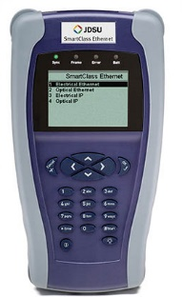

Why: Fail-safe and assume it doesn’t work
Secret routing magic happens here
Frame Tx
Frame Rx
Traffic flow
Traffic flow
?
Schrodinger’s Router
Was the exact same frame received that was sent?
http://www.testequipmentdepot.com/viavi/images/csc-ethernet.jpg
Notes:
No reference to JDSU, just a generic tester image!
Open source is key
Traffic types: PPPoE being supported over L2VPN was undocumented
Test types: RFC2544 (1999) isn’t a strict definition, ITU-T Y.1564 is “better”

Slide 5
Why: Fail-safe and assume it doesn’t work
Testing in general:
“If you haven’t tested it, it doesn’t work!”
Black box vendor devices with undocumented behaviour
Troubleshooting might require TAC assistance and/or hidden commands
Currently black box vendor devices being tested with black box testers
“We can’t test every possibility in the lab”
Notes:
Open source is key
Cisco undocumented behaviour caused an outage
Juniper denied me access to packet-via-dmem and ttrace / IOS-XE Bash shell required TAC authentication token
Vendors aren’t bad, happy to pay for support but I don’t want to depend on it

Slide 6
Where: Ideally in the lab
Mainly testing physical devices in the lab (sometimes in production)
However, we’re exacerbating the issue with the rise of NFV and COTS (SD-WAN, vCPE, vPE, vRR, vBNG)
We’re running black box virtual network functions!
  Obvious issue: COTS is by definition not task optimised
  Less obvious issue: how many additional variables COTS introduces
NFV is an interesting area for open source (OVS+DPDK, VPP)
Caveat: white box hardware is not open source hardware
Notes:
One vendor provides us an “all-in-one” image for COTS
Intel Management Engine security issues

Slide 7
Where: Physical network devices
Historically only expensive hardware testers could test high bandwidth links
Initially testing layers 2/2.5 (Ethernet/MPLS) and moving into layer 2/2.5 VNFs
Both lack security, MPLS is for transport and has no encapsulation support:
  E.g. does it even work? Hashing on Broken Assumptions
  E.g. ECMP with L2 and L3 VPNs is inherently flawed due to a heuristic methodology. Old problem BCP128 (2007), still an issue draft-ietf-pals-ethernet-cw-00.txt (2017!)
Notes:
Multiple iPerf flows with different DSCP values for QoS testing isn’t new

Slide 8
Where: Virtualisation paths
Traditional vs. modern VNF network path on Linux:
Virtual Router
(secret routing magic)
Virtual Router
(secret routing magic)
Virtio F/E
Virtio F/E
vNIC
vNIC
Virtio B/E
Hypervisor
Hypervisor
Virtio B/E
TAP
TAP
Bridge
Bridge
VF
VF
Host OS
Host OS
NIC
NIC
PF
PF
Notes:
In the case of Service Chaining the “chain” varies by user/flow

Slide 9
When: Ad-hoc not continuous
Staging and soak testing phases for individual network functions
A localised approach, device-by-device, feature-by-feature
Support automated benchmarking and CI/CD processes with data-plan testing in virtual-labs
Notes:
Draft In-situ OAM provides continuous in-band monitoring with packet headers

Slide 10
How: Linux & OSS PMV Tooling
Passive, synthetic, in-band traffic generation (or replay)
A localised approach, device-by-device, feature-by-feature
Traffic volume (bandwidth) is rarely an issue the focus is more on functionality, but still in scope to fully move away from black box hardware testers
Prefer open source to maximise on features/distribution/support/bug fixes etc.

Slide 11
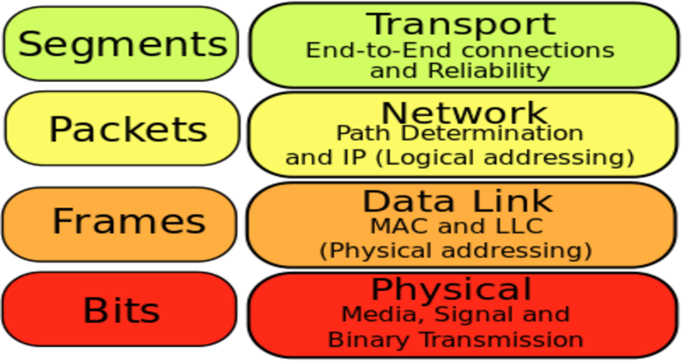
How: Linux & OSS PMV Tooling
iPerf, Trex, Scapy
MoonGen, Pktgen
Pktgen, MoonGen, Etherate
CRC/FCS, ECC
https://commons.wikimedia.org/wiki/File:Osi-model-jb.svg

Slide 12
How: Linux & OSS PMV
No transport layer testing:
Including the end-user/end-device networking stack is like Russian roulette
i.e. TCP OS implementations are too varied and too complicated
iPerf3 in UDP mode, only of if you have to
Recent Improvements in UDP Packet Processing: UDP throughput went from 1.2 Mpps in Kernel 4.9 to ~2.25 Mpps in Kernel 4.13
Two raw socket applications on Linux aren’t even the same
Notes:
4.9 > 4.13 is circa one year
RX timestamping can be configured per-socket in Linux

Slide 13


How: Linux & OSS PMV
Etherate: Raw socket based Ethernet and MPLS packet generator
  Any layer 2/2.5 header value (load packet-as-hex fall back)
  Constraint based testing (time/speed/volume)
  Easy CLI usage (no API / not scriptable)
  Hardware agnostic
  Lowest performance
  Stateless
https://commons.wikimedia.org/wiki/File:Green_tick_pointed.svg
https://commons.wikimedia.org/wiki/File:Red_X.svg
Notes:
It’s fun to give your self a green tick
EtherateMT is in the pipeline for higher throughput and testing different Linux syscalls

Slide 14
How: Linux & OSS PMV
Pktgen: DPDK based packet generator using LuaJIT
  Most layer 2-4 header options (load PCAP as fall back)
  “Range” and “sequence” native features
  All options in CLI and Lua API (scriptable)
  Highest performance
  Requires DPDK supported NIC
  Stateless
Notes:
Not the Kernel module of the same name!
Supports Ethernet/QinQ/MPLS/IPv4/TCP/UDP/ICMP/GRE
Higher performance then MoonGen on my Intel X710
Only “rate” constraint exists natively

Slide 15
How: Linux & OSS PMV
MoonGen: DPDK based packet generator using LuaJIT
  Any layer 2-4 header options
  No CLI options, scripted tests only (Lua API)
  Partially stateful
  High(er) performance
  Requires DPDK support NIC
  DPDK EAL settings are hidden
Notes:
No MPLS support
Supports Ethernet/ARP/IPv4/IPv6/TCP/UDP/ICMP/ESP/AH/PTP
Can’t see NICs before test starts or configure CPU mask etc.

Slide 16
How: Tooling Comparisons
Etherate assumes two difference devices are being used.
MoonGen & Pktgen assume the Tx and Rx hosts are the same device.
Etherate can be used to test a physical device or link at layers 2/2.5.
Pktgen & MoonGen can be used to test a physical device or link at layers 2-4 for high performing metrics (high throughput or low latency)
Etherate can also test the raw socket path within the Kernel networking stack.
PktGgen & MoonGen can also provide some low level NIC stats.

Slide 17
Examples: NF Verification using OSS
Example resources/guides:
Evolving document: Linux and NFV Testing and Tuning
Example MoonGen Lua script: generate every Ethertype (0x0000-0xFFFF)
“We can test every possibility in the lab”

Slide 18
Examples: BUM filter accuracy
NIC: Intel I350 1G, DUT: Cisco 2960, Test: Etherate broadcast test
2960#show storm-control fa0/15
Interface Filter State Upper Lower Current
--------- ------------- ----------- ----------- ----------
Fa0/15 Forwarding 0.25% 0.25% 0.24%
$ sudo ./etherate -i eno2 -g -G -d FF:FF:FF:FF:FF:FF -M 250000
Seconds Mbps Tx MBs Tx FrmTx/s Frames Tx
1 0.24 0 20 20
2 0.24 0 20 40
Notes:
Etherate frame pacing feature should provide different results?

Slide 19
Examples: Every Ethertype value
NIC: Intel I350 1G, DUT: Cisco 2960, Test: MoonGen “setType” ethertype
Rx NIC drops ~1400 frames, from etype 0x2F to 0x5DC, 0x8100, and 0x888e
Random missing Ethertype chosen and retested, 0x2F == 100% lost
Random working Ethertype chosen and retested, 0x2E == 100% received
0x2E-0x5DC are length values for 802.3 Ethernet + LLC/SNAP (802.2) framing
0x8100 (802.1q VLAN tag): 0 packets input, 65536 runts
0x888e (802.1X EAP): 65536 packets input, 0 errors/drops/runs/discards
“switchport mode access” / No 802.1X configured
Notes:
Ethertypes are supposed to start from 0x600 (1536)

Slide 20
Examples: Every Ethertype value
NIC: Intel X710 10G, DUT: ASR9001, Test: MoonGen “setType” ethertype
Rx NIC drops ~8500 Ethertypes
0x8808 (802.3x “pause”) 0 packets input, no NP counters
0x88a8 (802.1ad QinQ/PB), 0x9100 and 0x9200 (802.1q QinQ):
NP Counter: PARSE_DROP_IN_UIDB_TCAM_MISS
Notes:
ASR9000s support multiple VLAN etypes; 8100, 88A8, 9100, 9200

Slide 21
Examples: Every Ethertype value
NIC: Intel X710 10G, DUT: ASR9001, Test: Pktgen performance/size distribution
Pktgen:/> set 0 size 247
Pktgen:/> start 0
NP Counters:
PARSE_TOP_LOOP_RECEIVE_CNT 5987587286 6742449
MDF_PIPE_LPBK 5987589832 6742451
MDF_PIPE_LPBK_BUFFER_PREFETCH 2963853909 3371225
Notes:
CSCvf44769 specifies a 33% throughput reduction
Easily detectable using RFC2544

Slide 22
Example: In-flight bit errors
MPLS is a transport protocol, not an encapsulation protocol:
CRC
Checksum
DATA
TCP
Checksum
CRC
CRC
Checksum
DATA
Checksum
DATA
IP
TCP
Ethernet
TCP
Checksum
IP
MPLS
Checksum
IP
Ethernet
Ethernet
Ethernet
CPE1
PE1
PE2
CPE2
https://commons.wikimedia.org/wiki/File:Router.svg
Notes:
Drawing in PP isn’t fun
CRC will only detects errors
CRC covers the entire frame but only over the link

Slide 23
Example: In-flight bit errors
Some vendors have NPU counters (which are exposed via SNMP):
  E.g. Cisco ASR9K: PARSE_DROP_IPV4_CHECKSUM_ERROR
  E.g. Juniper: bad-IPv4-hdr
No known tooling to test this end to end
Protected
Unprotected
Protected
Unprotected
Protected
CPE2
CPE1
PE1
PE2
https://commons.wikimedia.org/wiki/File:Router.svg
Notes:
ECC memory detect and often recover
Not all aspects of network devices use ECC memory

Slide 24
Example: NFV and COTS
Host VNF Paths | VNF Considerations
NAT: slow and inflexible (L3/L4 only) | These techniques are mostly agnostic to the guest VM/application however the Linux native networking stack is slow(-ish)
Linux bridging: slow but flexible
PCI-PT: fast and flexible, but costly
SR-IOV: fast, flexible, cost efficient (not perfect yet, e.g. VLANs/Multicast) | Requires VM/application support
Kernel-Bypass (DPDK/Snabb/NetMap); fast, flexible, cost efficient | Proven technologies, limited commercial support adoption
XDP and/or rDMA; native support for Virtio on the horizon | Bleeding edge, immature for now
Notes:
Mellanox eSwitch for SR-IOV
Snabb used on Deutsche Telekom’s TeraStream
DPDK used in VPP/vMX/ASR9Kv

Slide 25
Example: NFV and COTS
Even with close source solutions we can peak into their performance:
  Open Process Counter Monitor – Intel focused CPU/NUMA/PCI/RAM/Power performance profiling
  Perf “perf_events” – Kernel and application performance using Kernel tracepoints and kropes/uprobes (and more!)
  SystemTap – Kernel and application performance profiling using Kernel tracepoints and function calls/returns (and more!)
Notes:
Valgrind / cachegrind / callgrind are essential if you write your own tester
SystemTap regularly used for histograms

Slide 26
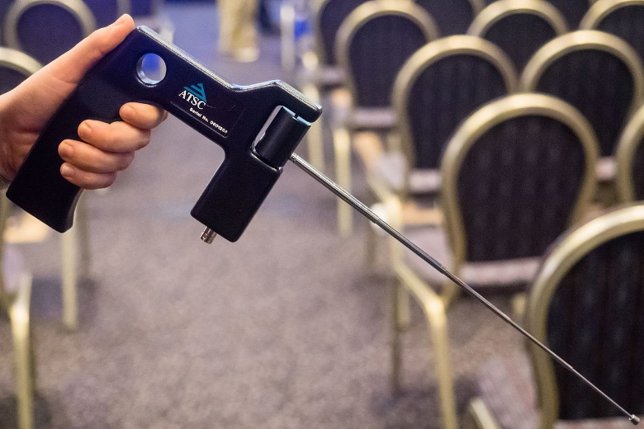
Future: Recap of work until now
Research from the past ~year has been presented
  Researched the existing problems (currently using ADE 651!)
  Evaluated the existing open source toolset
  Defining tests to detect known issues
  Trying to fill some gaps in test features
Combine all of the above into an open guide
for low level testing.
https://en.wikipedia.org/wiki/ADE_651#/media/File:ADE_651_at_QEDcon_2016_01.jpg
Notes:
The ADE 651 is a fake bomb detector

Slide 27
Future: Next steps / key takeaway points
Evolving document: Linux and NFV Testing and Tuning
Etherate; frame pacing, bit fiddling, frame checksums
EtherateMT; coming soon for faster kernel path testing
MoonGen & Pktgen: Fix RFC2544 test scripts and/or implement ITU-T Y.1564
Document SystemTap, perf and OPCM examples

Slide 28
Future: Next steps (long term)
Better equipped and experienced to implement and profile NFV and COTS
Replace P nodes with VPP+FRR (or equivalent) on COTS for “quick win”
P4 FPGA for reliable open source hardware tester replacement?
Notes:
Fully open source hardware and software testers

Slide 29
Questions?
Contact me using these details:
Email: jwbensley@gmail.com / james.bensley@updata.net
Slack: http://networktocode.slack.com/
Skype: jameswbensley

Slide 30
Extra: Background
James Bensley / Platform Architect / SP NetEng + Linux + coding
Updata Infrastructure (Capita Networking Services)
Originally formed in 2003, CNS-WAN has 500+ employees today
ISP and Managed WAN Provider
UK based LLU provider (CLEC)
Present in 1200 exchanges UK wide
Business, Local Gov, Edu, Health Care, Fire & Rescue, Police
Notes:
~12% UK Schools connected
National Air Traffic Services (low bandwidth, low latency, very high resilience)
Health and Social Care Network (high bandwidth, filtered Internet)

Slide 31
Extra: Easily testable bugs
Example bugs which could have been easily caught with better testing:
PPPoE unsupported over L2VPN (undocumented ASR920 core encapsulation)
Interop LDP PWE3 label request (IOS-XR CSCux80490)
LPTS denying OSPFv3 incorrectly (IOS-XR CSCui29635)
NPU cache misses causes 33% performance drop (IOS-XR CSCvf44769)

Slide 32
Extra: Tooling Comparisons
Trex
MoonGen
Pktgen
Etherate
Complexity
Granularity

Slide 33
Extra: SIG-PMV overlap with IETF
IETF: Benchmarking Methodology Working Group:
“…the BMWG is limited to the characterization of implementations of various internetworking technologies using controlled stimuli in a laboratory environment. Said differently, the BMWG does not attempt to produce benchmarks for live, operational Networks…”
https://datatracker.ietf.org/wg/bmwg/about/
Notes:
Recently expanded scope to include SDN and NFV

Slide 34
Future: Expanding the scope
Linux already supports: IPv6 Segment Routing, VRFs, EVPN, MPLS, LDP
Linux native improvements:
XDP and eBPF is already being used to provide fast packet processing
SR-IOV switchdev could be used for routing?
~50-60ns IPv4 lookups (single core / DDR) barely supports 10Gbps
~450ns IPv6 lookups (single core / DDR)

Slide 35
Extra: Outline
Who: My background
What: Initial research on open source network function testing
Why: If you haven’t tested it, it doesn’t work
When: Ad-hoc not continuous, soak testing/break-fix
Where: Production WANs and lab environments
How: Simulate network traffic using open source software
Examples: My findings and lessons learnt (so far)
Future work: Planned areas of testing and tooling development

