Slide 1

GÉANT OER
BRANDING
NELSON DIAS | 2015

Slide 2


Slide 3


Slide 4
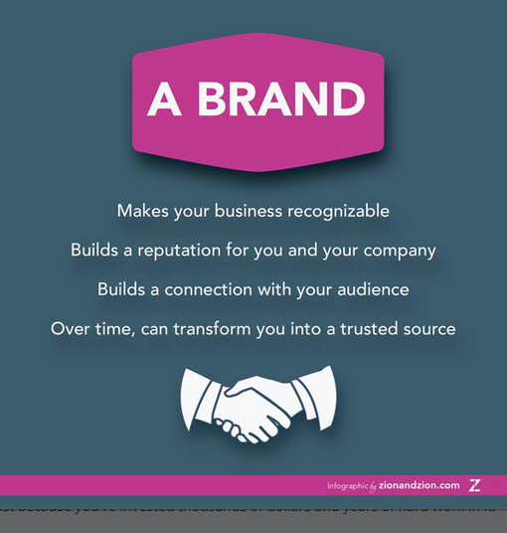
A BRAND…
Makes your business recognizable
Builds a reputation for you and your company
Builds a connection with your audience
Over time, can transform you into a trusted source
Notes:
Some quotes

Slide 5

BRAND IDENTITY
Name
Slogan
Typography
Color
Logo
Visual Identity /mood /spirit/

Slide 6
SERVICE NAME
“Géant OER”
“?”

Slide 7
SLOGAN
Examples:
“Use, re-use & remix”
“Search, find & re-use”
“Knowledge to everyone”
“Click and learn in Europe”
“Click and learn @Europe”
“Education for all”
More.....

Slide 8

Education
Open content
LOM
Multimedia
Knowledge
Learning
Teaching
Search
Find
Use
Re-use
Remix

Slide 9

SYMBOLIC ELEMENTS
Book (knowledge)
Media (content)
Hand (search, interactivity)
Repository/Portal (knowledge)
Lupe (search, interactivity)
More .....

Slide 10

VISUAL IDENTITY
Simple
Appealing
Modern
Tecnological

Slide 11
STYLE
Consistent
  Design
  Aesthetics
Digital content
  Photography
  Illustration
  Graphic elements

Slide 12

COLOR
  Blue
  Peaceful and calm
  Trust and integrity
  Technology
  Inovation

Slide 13
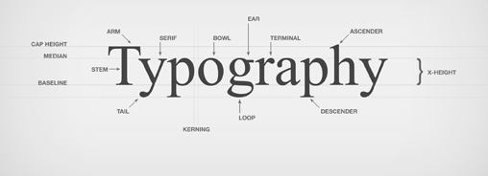
TYPOGRAPHY
ARIAL BOLD
Arial
LATO REGULAR
Lato light
ROCKWELL
Rockwell regular

Slide 14

LOGO PROTOTYPE

