Slide 1

SA8 T1 – Real-time Applications (eduCONF)
Operations Support Training for eduCONF
Tim Boundy, Task Leader
GN4 Phase 1 - SA8 T1
Bartlomiej Idzikowski, Task Leader
GN4 Phase 2 – JRA4 T5
13 April 2016
educonf.geant.org

Slide 2
Agenda
12:30 to 14:15
Part 1 – Service Description
15 min Break
Part 2 – Service Support
2

Slide 3
Agenda
Part 1
eduCONF background and recent developments
Key services walk through and demo
Technical architecture and software (Bartek)
Next steps in GN4 -2 (Bartek)
Key teams and their responsibilities and Support level
3

Slide 4
Agenda
Part 2
Migration to GEANT Servers and Operations
Testing recommend following changes
Managing User and VC systems
Common Issues encountered
FAQs
Directory Sharing
4

Slide 5
eduCONF background and
recent developments

Slide 6

eduCONF
Task 6 Challenges
Everyone thinks they know what eduCONF is/should be
  End user VC
  Centralised MCU
  High end, high quality
  Unnecessary market duplication
  Procurement vehicle
eduCONF fills a specific niche
  Support confidence in VC and interoperability
  Enable the requirements to be met by NRENs or Institutions, not meet them directly

Slide 7
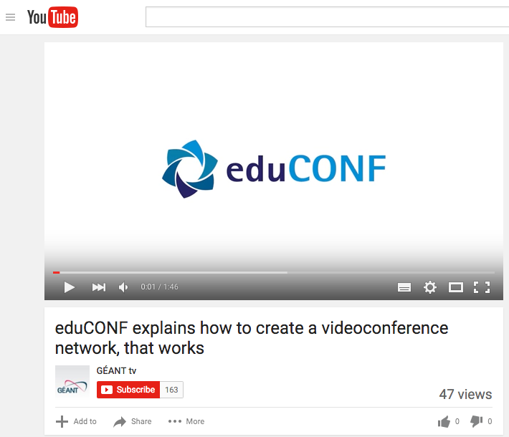
eduCONF – cheesy marketing video
Existing Services
<iframe width="560" height="315" src="https://www.youtube.com/embed/F9yiJx5vtu0" frameborder="0" allowfullscreen></iframe>

Slide 8

eduCONF
Existing Services
eduCONF Directory
eduCONF Test
GDS Monitoring

Slide 9
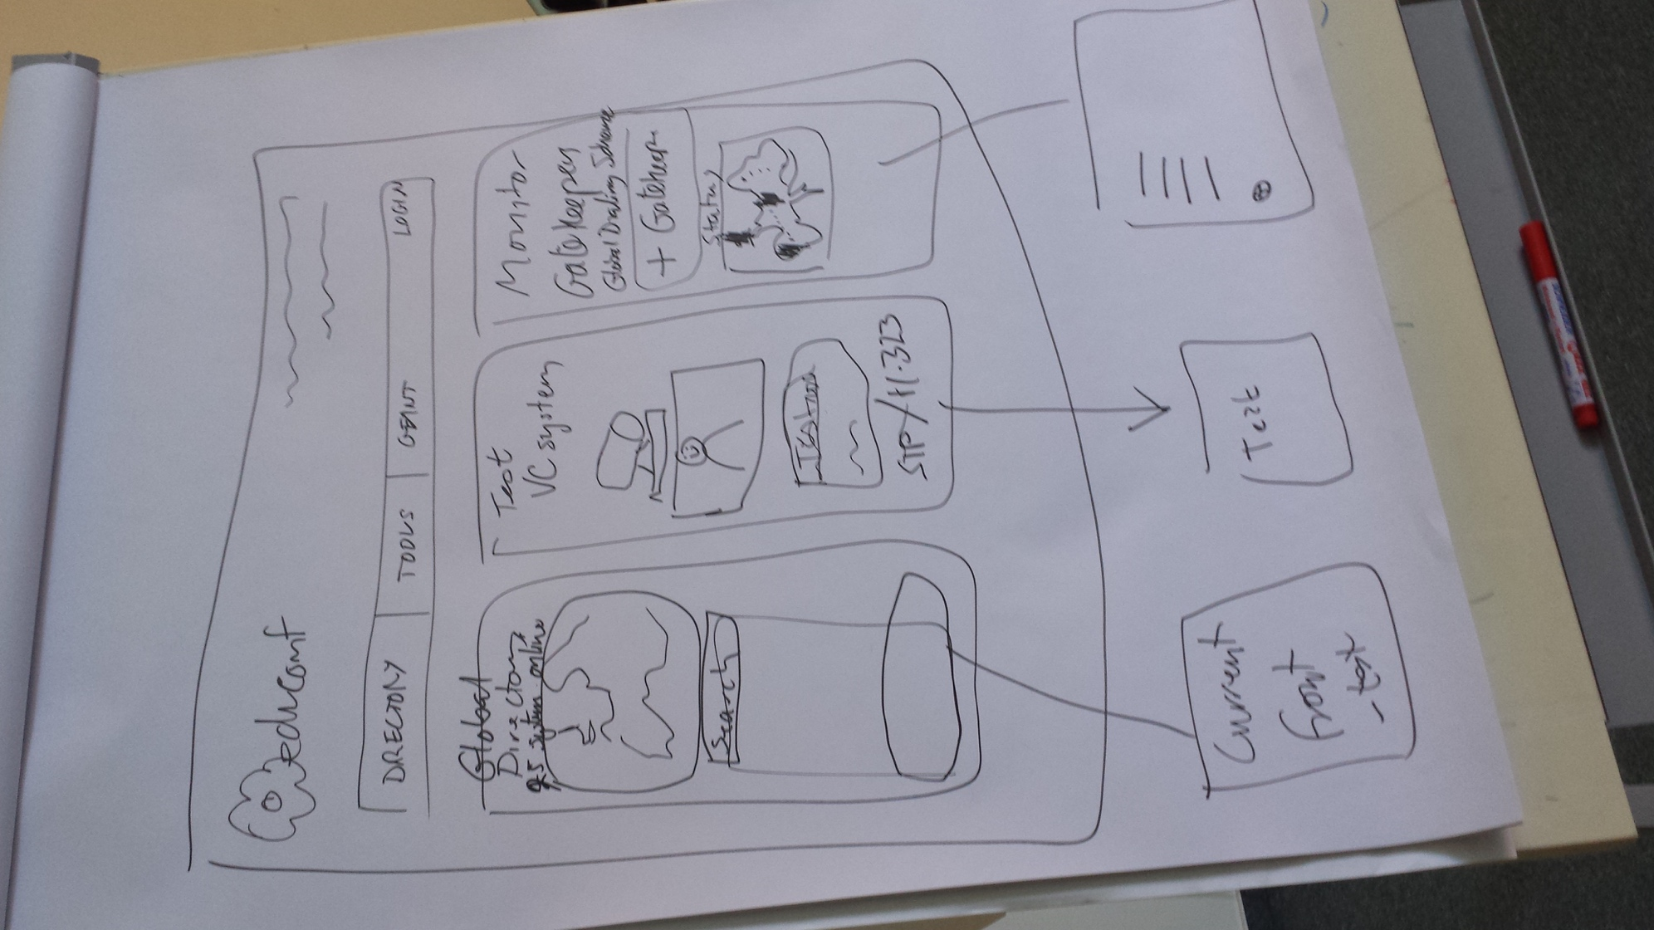
Prague Sept 2015:
Simplified 3 column design to highlight the 3 main features

Slide 10
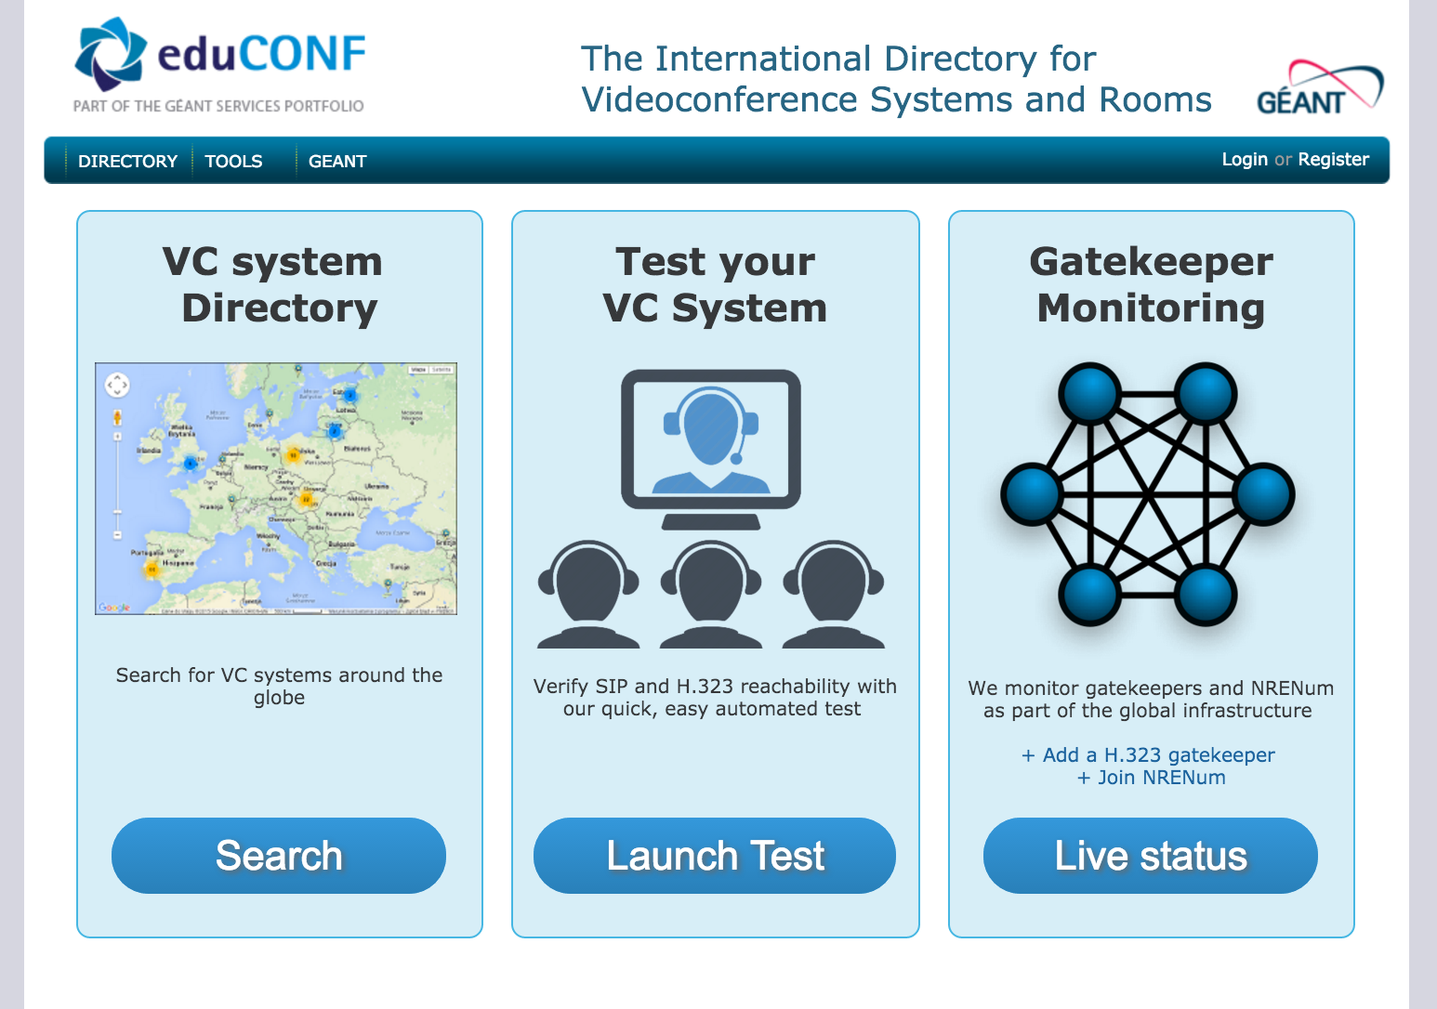

Slide 11
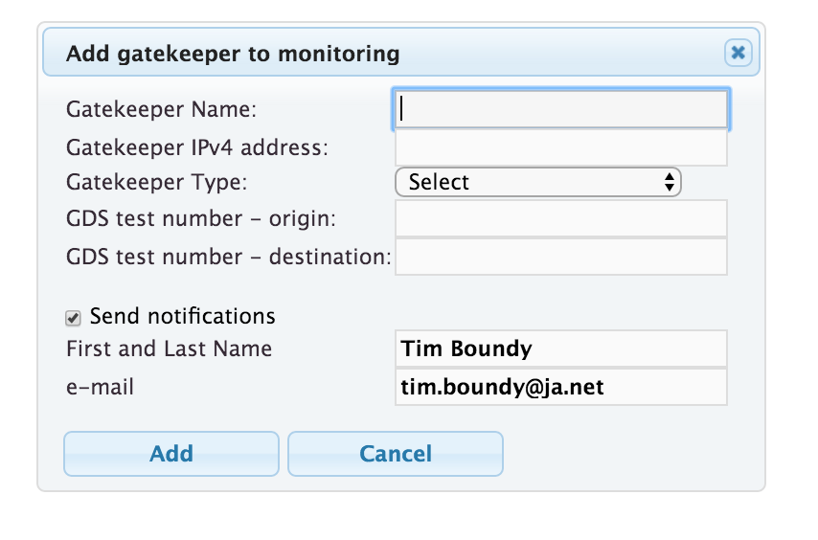
Interface Improvements
Redesign front page to stress the three main services
Additional FAQs and information
Usability review of Gatekeeper Monitoring
11

Slide 12
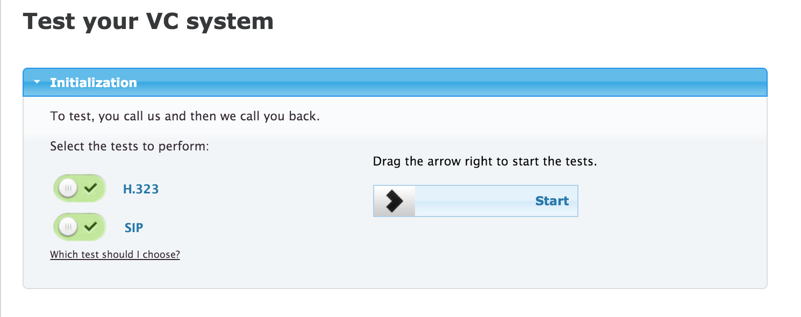
Interface Improvements
12

Slide 13
Live Demo!!!!

Slide 14
https://educonf.geant.org

Slide 15
Technical Architecture
Infrastructure and Software

Slide 16
Standby whilst we transfer to Barts Slides…..

Slide 17
Key people and responsibilities

Slide 18
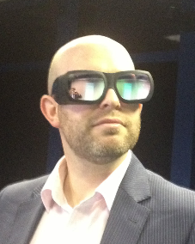
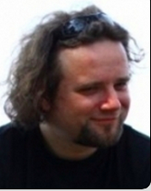
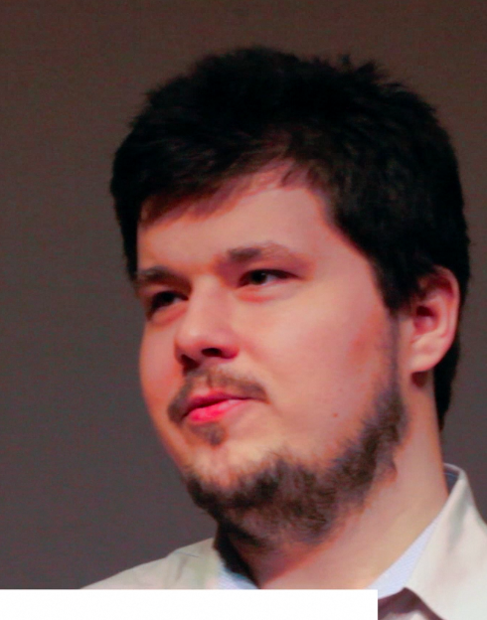




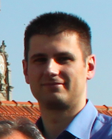
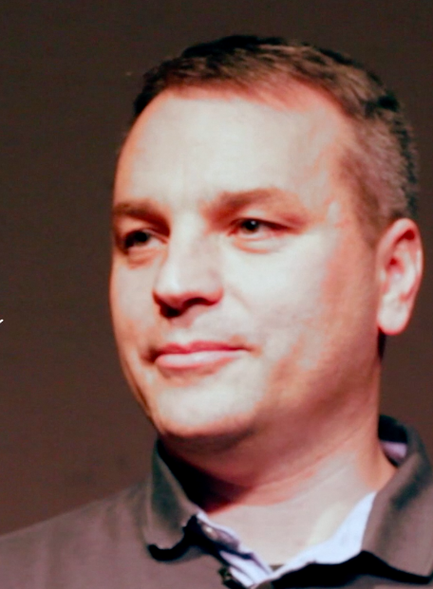
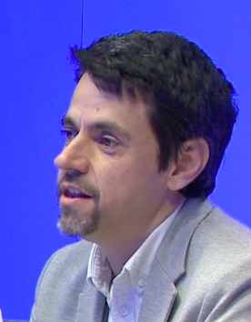



GN4-1, SA8, Task 1: Real Time Applications
Meet the team
Tim Boundy
Bartłomiej Idzikowski
Piotr Skałecki
Jan Ruzicka
Mihaly Meszaros
Sasa Davidovic
Rui Ribeiro
Notes:
I want to somehow represent that T3, 4 and 5 work very closely together.
Last year I colour coded related tasks – I’ve tried to do that here with various shades of blue.

Slide 19
GN4-2, JRA4, Task 4: Cloud delivery of real-time communication services. Led by Peter Szegedi from GÉANT,
Tim Boundy
Bartłomiej Idzikowski
Piotr Skałecki
Jan Ruzicka
Mihaly Meszaros
Sasa Davidovic
Rui Ribeiro
Notes:
I want to somehow represent that T3, 4 and 5 work very closely together.
Last year I colour coded related tasks – I’ve tried to do that here with various shades of blue.

Slide 20
GN4-2, JRA4, Task 4: Cloud delivery of real-time communication services. Led by Peter Szegedi from GÉANT,
GN4-2, JRA4, Task 5: Real-time communication services infrastructure support. Led by Bartlomiej Idzikowski from PSNC.
Tim Boundy
Bartłomiej Idzikowski
Piotr Skałecki
Jan Ruzicka
Mihaly Meszaros
Sasa Davidovic
Rui Ribeiro
3rd line support and subject specialists
Notes:
I want to somehow represent that T3, 4 and 5 work very closely together.
Last year I colour coded related tasks – I’ve tried to do that here with various shades of blue.

Slide 21
Break

Slide 22
Migration to GEANT Operations

Slide 23
Migration to GÉANT Operations
Server migration – complete (pending IPv6 issue)
Operations Level Agreement – Pending sign-off
Training - today
Specialist support - agreed
Communications channels– email address pending.
23

Slide 24
GÉANT Operations VM deployment
eduCONF service current production system:
Gatekeeper , monitoring & back-office services, directory web (service frontend)
2 x 3VMs, synced, in fail over mode (hosted by CARNet)
Secondary gatekeeper (hosted by PSNC )
Provided by GÉANT Operations:
3VMs (Test, UAT, Production) → all services on one VM
Test - for developing and testing. Restricted access.
UAT - (User Acceptance Test), 2nd level test → auto-migration from Test. Restricted access.
Production → Completely finished and tested code. Accessible by internet
24

Slide 25
Testing recommend following changes

Slide 26
Recommended Testing post updates
Registering users and Logging in
Registering a new user
Use any email address you can access to register a new user account. Join GEANT Org
Check email was received – confirm email.
Login new user
Edit account info
Request account upgrade
Check account upgrade email
Upgrade account
Login as eduCONF admin
Delete user.
VC System Test
Logged out.
Prepare VC system and launch a H.323 test and a SIP test.
Adding new room and Login after test
Edit room data and verify a positon on map to check GoogleMaps API.
Download certificate and verify data
Log out
Search and Map
Search room (any room) on the map
Check map zoom and check search filters by the map
Gatekeeper monitoring
Logged out
Add new test gatekeeper detail for new country
Check status and map "NRENs within eduCONF"
Remove test gatekeeper
Useful Management Links
Users
https://educonf-directory.geant.net/user.php?action=list
VC Systems
https://educonf-directory.geant.net/room.php?action=list
26

Slide 27
Managing User and VC systems

Slide 28
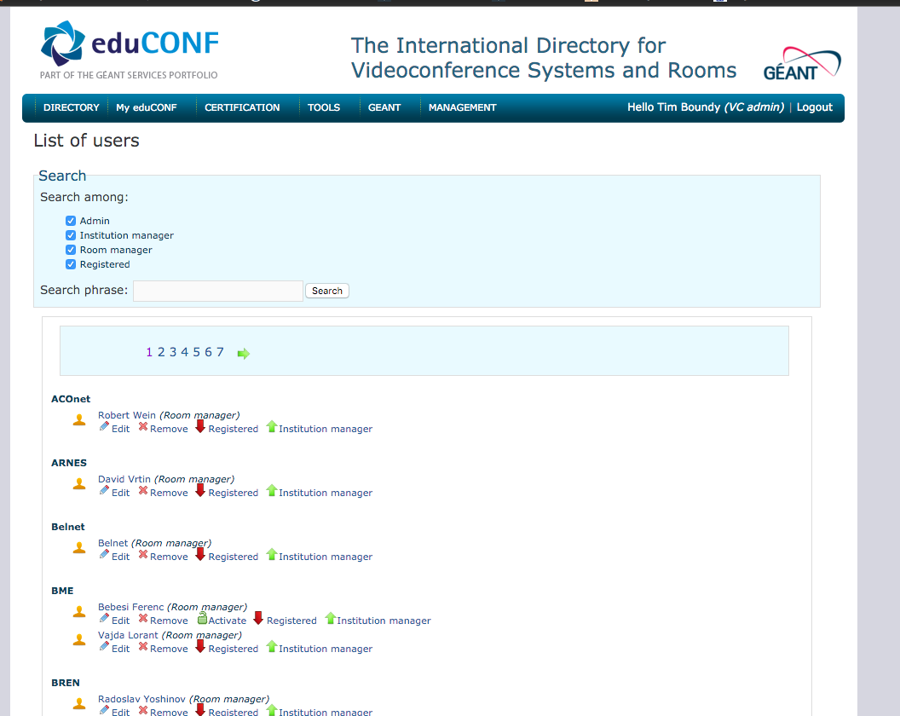
Managing Users
Direct link to :
Activate account
Upgrade/downgrade
Delete
Edit
https://educonf-directory.geant.net/user.php?action=list

Slide 29
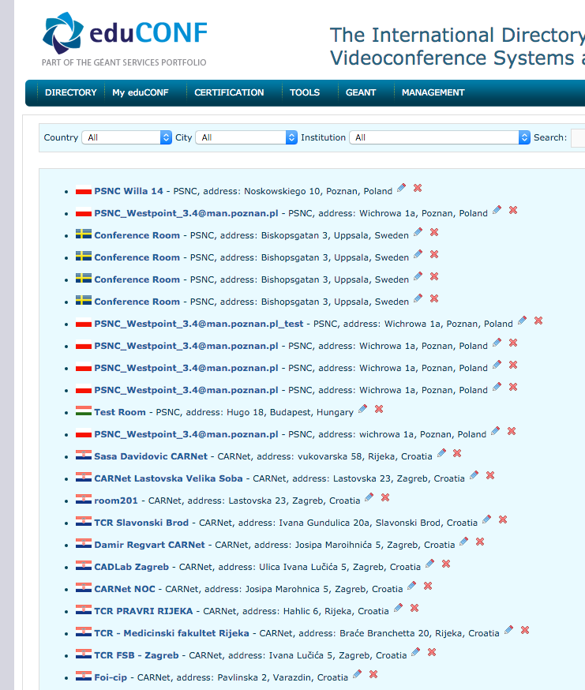
Managing Rooms / VC systems
Direct link to :
Delete
Edit
https://educonf-directory.geant.net/room.php?action=list

Slide 30
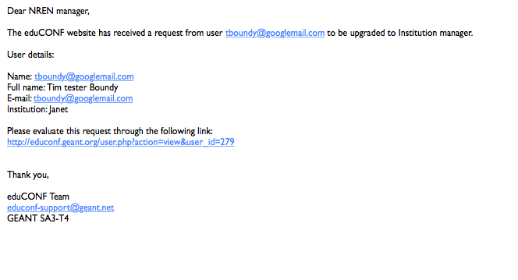
Email sent to Institution manager and NREN manager,
Process:
User Request upgrade to Institution Manager
Admins get email.
Confirm with Existing Institutional manager
Upgrade

Slide 31
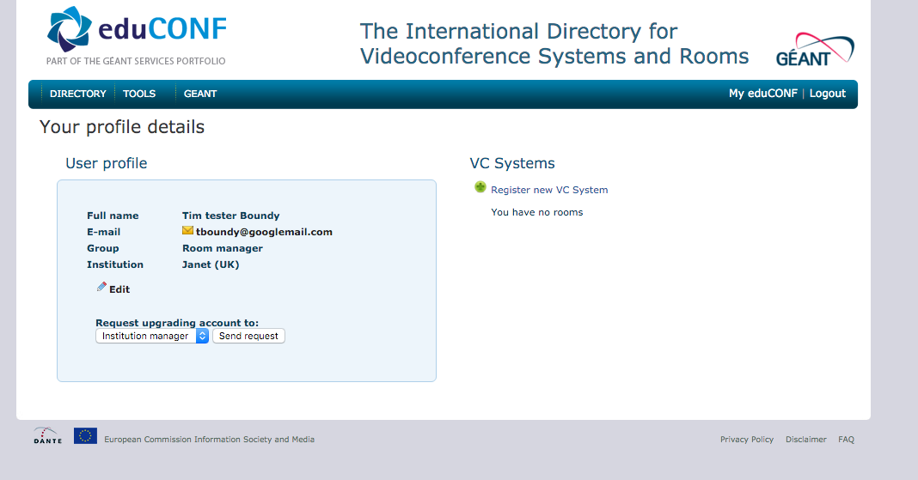
Upgrading a user
Process:
User Request upgrade to Institution Manager
Admins get email.
Confirm with existing Institutional manager
Upgrade via User pages or email URL

Slide 32
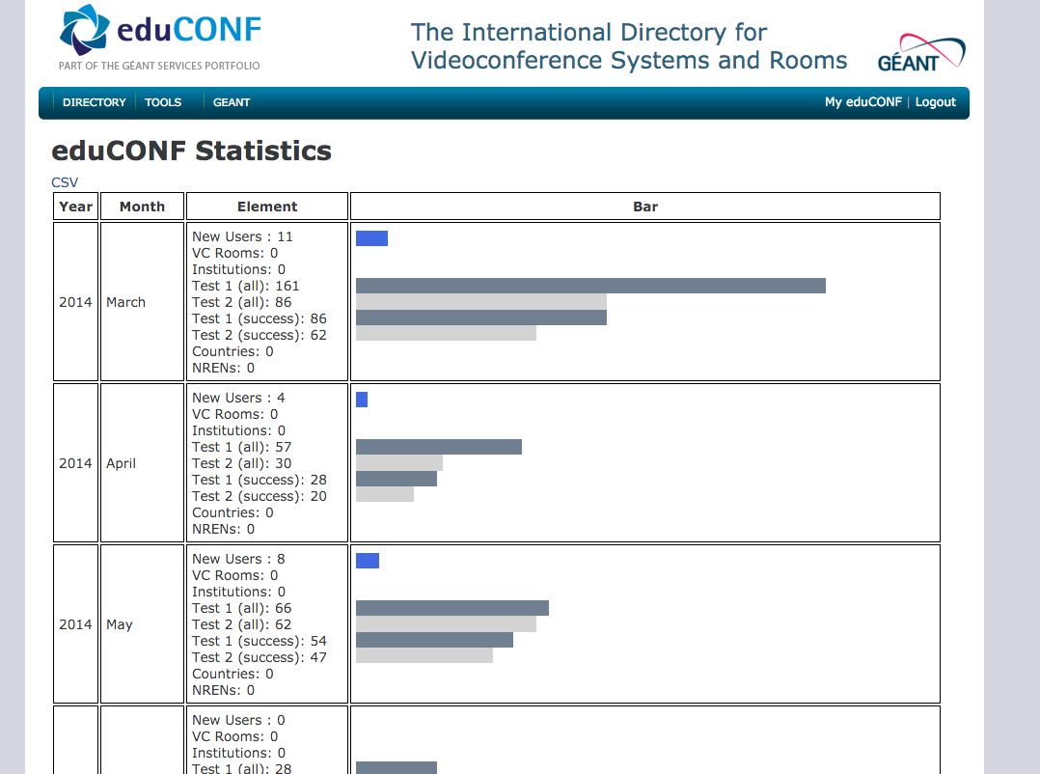
Viewing Statistics
Stats pages
Current errors due to transition
Figure should settle in wo months.
No reporting responsibilities at current time.
https://educonf.geant.org/ecstats.php

Slide 33
Common Issues encountered

Slide 34
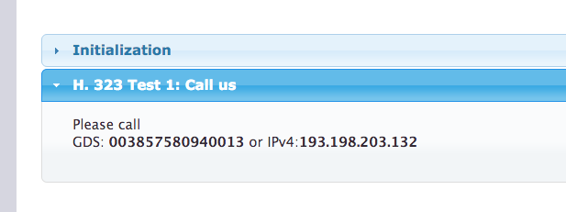
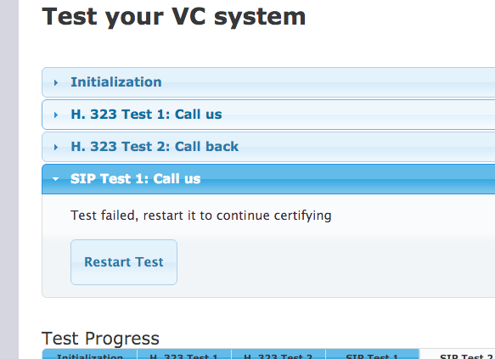
Video Tests
Common Issues
User cannot call out
Call not returned
Confusion on dialling numbers
Wrong locations on map
User cannot dial SIP URI

Slide 35
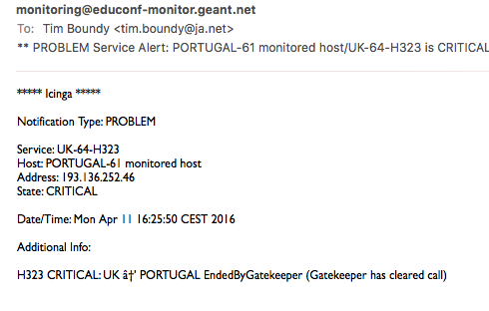
Gatekeeper Monitoring
Common Issues
Too many emails from Monitoring.
Cannot identify monitoring issues.
Country not appearing on Map.

Slide 36
FAQs

Slide 37
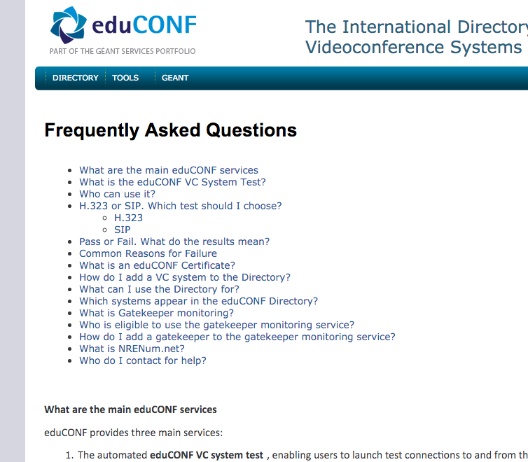
FAQs
To edit or add please contact the 3rd line expert support and request answers or suggest text.

Slide 38
DIRECTORY SHARING

Slide 39
Directory Sharing
Objectives
Enable Video systems and services to share common data on
  VC systems / Rooms / Users events
Enable users to view information from other Directories / services whilst still using their own choice.
Consider eventual resource sharing and scheduling
Prepare a proof of concept
Provide services for WebRTC development in GN4-2
39

Slide 40



Directory Sharing Trial– GN4 Phase 1
Users
Distributed directory API modules and centralised policy exchange hub.
SIVIC
Directory
Adaptor
MODULE
eduCONF Website
Update
DATA
Certification
Policy hub
DATA
Update
MODULE
eduCONF
Directory
Update
End-point Testing
Venues
Adaptor
Users
DATA
MODULE
+1
Directory
Adaptor
GK Monitoring
fixes

Slide 41
Directory Sharing Trial– GN4 Phase 1
Users
Distributed directory API modules and centralised policy and data exchange hub.
SIVIC
Directory
Adaptor
MODULE
eduCONF Website
Update
Certification
DATA
Policy and data hub
DATA
Update
MODULE
eduCONF
Directory
Update
Venues
Adaptor
Users
End-point Testing
DATA
MODULE
+1
Directory
Adaptor
GK Monitoring
fixes

Slide 42
Directory Sharing
Progress
Comparison of Directories data schema
Common data model agreed
XML Schema produced
Proof of concept launched (RedCLARA)
Early decisions
Centralised infrastructure
Data model and update model
Data protection policy alignment (all users must be asked)
Unbalance sharing options
Devolved responsibility for data translation
42

Slide 43
Summary
Rights to manage all users and VC systems
FAQs
Support from GN4-2, JRA4, Task 5
Check list process for testing
43

Slide 44
tim.boundy@jisc.ac.uk
educonf.geant.org

