Slide 1
GÉANT TURN Pilot
Roadmap

Slide 2
Roadmap 2017
Task 4
Task 5
Q1: Introduce the TURN pilot into PLM
  Support global extension of the pilot
Q2: On-premises procurement results
  NREN take-up ➔ Task 3
Q3: Support NREN Vconf back-end deployments
Q1: Pilot back-end: turn.geant.org
  Strawman document
Q2: Monitoring for the TURN pilot
Q3: Pilot front-end: webrtc.geant.org
  Basic native WebRTC service
Q4: Pilot GÉANT WebRTC service with branded/custom front-ends and optional back-end plugins procured by NRENs
  All supported by TURN + monitoring

Slide 3
Roadmap 2018
Task 4
Task 5
Q1: Tendering for Cloud-based SaaS WebRTC
  Task 1/2 ➔ invite NRENs to participate
Q3: Support and marketing of a hybrid model
  WebRTC (NRENs + Cloud)
Q4: Governance and service policy
Q1: Make all service components eduGAIN-enabled
Q2: Production roll-out
  webrtc.geant.org + turn.geant.org
Q3: Service operations and monitoring
Q4: Added features:
  Mobile platforms
  Gateways to all
  Apps

Slide 4
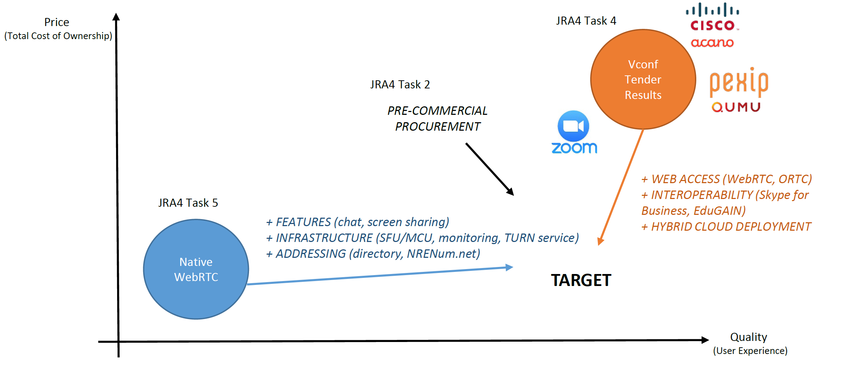
Positioning

Slide 5
Options – do nothing
Vconf tender results
Cisco/Acano
webrtc.geant.org
Pexip
Zoom
turn.geant.org
GÉANT/NRENs Substrate
Access Federations, Networks, Security

Slide 6
Options – STUN/TURN service for Vconf
Vconf tender results
Cisco/Acano
Pexip
Zoom
webrtc.geant.org
turn.geant.org
GÉANT/NRENs Substrate
Access Federations, Networks, Security

Slide 7
Options – STUN/TURN service for all
* Examples
Other App. Services*
Vconf tender results
PCP tender (TBD)*
VoIP
MashMeTV
Cisco/Acano
LoLa
Click2Video
WeSeeDo
Pexip
perfSONAR
Zoom
webrtc.geant.org
webrtc.geant.org
REST API
turn.geant.org
GÉANT/NRENs Substrate
Access Federations, Networks, Security

