Slide 1
GEANT Data protection Code of Conduct 2.0
TF-DPR 27 February 2018
Mikael Linden, mikael.linden@csc.fi
CSC – IT Center for Science
GN4-2 project JRA3 Task 1.1

Slide 2
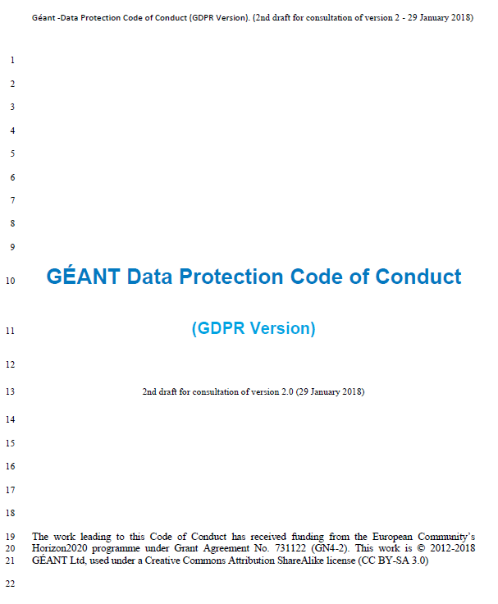
Contents
Problem statement
CoCo 2.0 project
CoCo 2.0 in brief
Next steps
https://wiki.refeds.org/x/QADSAQ

Slide 3
The attribute release problem
Release my attributes to SP X,
I need it to do my job!
Home Organisation (HO):
User
(researcher)
Sorry, to protect your privacy, we cannot release your attributes.
Authenticates
?
Service Provider organisation
Attributes
IdP
SP X
IdP admin

Slide 4
Data Protection Code of Conduct (CoCo) approach
Learn SP’s commitment
GEANT Data protection Code of Conduct
for SPs
Commit to
HO
SP
Learn SP’s commitment
Commit to
HO
SP
HO
Learn SP’s commitment
Commit to
SP
Service Providers (SP) commits to the CoCo
Federations (and eduGAIN) relays SPs’ commitment to Home Organisations (HO)
  Using SAML2 metadata (Entity Category)
HO decides if it feels confident to release attributes to the SP

Slide 5
GEANT CoCo history so far
GEANT CoCo version 1.0
Work started 2011, pilot 2012-2013
published 6/2013
Submitted to data protection authorities (WP29)
WP29 (2015): The CoCo 1.0 doesn’t add value
  The CoCo must explain what the law means in the context of R&E federations
4/2016: GDPR approved
  more power to a code of conduct
CoCo 2.0 project shifts to aim at GDPR
  First public consultation 2-4/2017
CoCo version 1.0, supported by
140 SPs in 16 federations
174 IdPs in 12 federations

Slide 6
Advantages of "approved" Code of Conduct
No obligation to have Code of Conduct approved by regulatory authorities, but ...
if Approved Code of Conduct, there will be some presumption of of compliance with the GDPR:
  Accountability
    Adherence to an approved Code of Conduct "may be used as an element by which to demonstrate compliance with the obligations of the controller and the processor." (art. 24 & art. 28 GDPR)
  DPIA
    Compliance with an approved Code of Conduct "shall be taken into due account in assessing the impact of the processing operations performed by such controllers or processors, in particular for the purposes of a data protection impact assessment (art. 35)
  Data transfers to 3rd countries
    Adherence to an approved Code of Conduct together with binding and enforceable commitments by organisations outside of Europe may be the legal basis for data transfers without requiring any specific authorisation from a DPA" (art.46)

Slide 7
Second public consultation on the GEANT CoCo 2.0
The public consultation on the GEANT Code of Conduct ver 2.0 draft
From 29 January to 28 February 2018
Draft pdf available at https://wiki.refeds.org/x/QADSAQ
  Link to a Google document for filling your comments on the same page
Supplementing Explanatory memorandum (Google doc) on the same page
  You can present your comments directly to the document

Slide 8
Terrotorial scope
SPs in EU and EEA
(EU28 + Norway, Iceland, Liechenstein)
SPs in EC whitelist countries and international organisations
(”providing adequate protection”)
SPs in other countries and international organisations
(Art. 46.2(e): ”together with binding and enforceable commitments”)
Service Provider Home Organisation | In EU/EEA or EC whitelist | Outside EU/EEA or EC whitelist
In EU/EEA or EC whitelist | Yes | Yes (with binding and enforceable commitments)
Outside EU/EEA or EC whitelist | Yes | (Yes)

Slide 9
Functional scope
The CoCo is limited to Attributes which Home Organisations release for enabling access to the Service
SPs (or communities) can agree to apply the CoCo also to other attributes
  E.g. community Attribute Providers (AP)
Out of scope is
  Service content (e.g. research datasets)
  Personal data the service gathers directly from users
Research infrastructure
E-infrastructure
SP
HO
SP
SP
SP
AP

Slide 10
CoCo structure
Principles of the Processing of attributes
Legal compliance
Purpose limitation
Deviating purposes
Data minimization
Information duty towards End User
Information duty towards Home Organisation
Data retention
Security measures
Security breaches
Transfer of personal data to third parties
Transfer of personal data to third countries
End User’s consent
Liability
Governing law and jurisdiction
Eligibility
Termination of the Code of Conduct
Survival of the Code of Conduct
Precedence
Appendices
Appendix 1: Information duty towards End Users
  I. How to develop a Privacy Notice
  II. How the Home Organisation should inform the End User on the Attribute release
Appendix 2: Information Security, technical and organisational guidelines for Service Providers
Appendix 3: Handling non-compliance of service providers
Appendix 4: Glossary of Terms

Slide 11
CoCo obligations to an SP in brief
Purpose of processing: Enabling access to the service
  Deviating purpose: on consent
Data minimisation: attributes adequate, relevant and not excessive
Data retention: delete when no longer needed
Inform duty: Privacy notice template
Security measures: Sirtfi
Security breaches: inform HO
Release to 3rd party: if processor, if committed to CoCo or if user consents
Release to 3rd countries: with adequate safeguards (like CoCo or SCC)
Liability: SP holds the HO harmless
Precedence: bilateral agreement, CoCo, GDPR
Jurisdiction: Dutch law (unless parties agree else)

Slide 12
Appendix 3: SP non-compliance and CoCo monitoring body
If someone (End User, Home Organisation, Federation operator) suspects an SP non-compliance:
Contact the SP and ask them to check and correct
Contact the SP’s Home federation and ask them to contact the SP
Contact the CoCo monitoring body (next slide)
Lodge a complaint with the competent supervisory authority

Slide 13
CoCo monitoring body
Federation operator can nominate. Supervisory authority accredits
  Competent monitoring body follows the SP’s Home federation
Independent
Has powers to mandate the Home Federation to remove the SP’s CoCo tag
Decisions can be appealed to the competent Supervisory authority
Potential for GEANT/NREN co-operation?

Slide 14
Next steps
Legal track
Public consultation closes 28 Feb
Integrate the comments received
Re-iterate, if needed, with the community and authorities
25 May 2018 submit the CoCo to a supervisory authority
  European Data Protection Board provides an opinion on the CoCo
  EC publishes the CoCo
  Technical track
  Issue document URI
  Update the SAML 2.0 metadata profile and Entity Category specification
  Update the CoCo monitor monitor.edugain.org/coco
  Co-ordinate with federation operators for uptake.

Slide 15
Mikael.linden@csc.fi
https://wiki.refeds.org/x/QADSAQ
https://wiki.refeds.org/display/CODE/Code+of+Conduct+ver+2.0+project

Slide 16
Backup slides

Slide 17
Precedence
Law and jurisdiction
Precedence (clause A and R)
Agreement between Home Organisation and Service Provider (if any)
Code of Conduct
GDPR
Applicable law and jurisdiction (clause N)
Dutch law and court (home of GEANT association)
Unless the parties agree else

Slide 18
Purpose of processing
Purpose of processing (clause B)
The SP uses the attributes for enabling access to the service
Deviating purpose (clause C)
Using attributes for other purposes is forbidden except on user consent
Consent (clause L)
freely given, specific, informed and must unambiguously indicate the End User’s wishes

Slide 19
Data minimisation and retention
Data minimisation (clause d)
The SP requests from Home Organisation only Attributes that are adequate, relevant and not excessive for enabling access to the Service
When number of attributes could be used, use the least intrusive
Data retention (clause g)
The SP shall delete or anonymise attributes when no longer needed for enabling access to the service

Slide 20
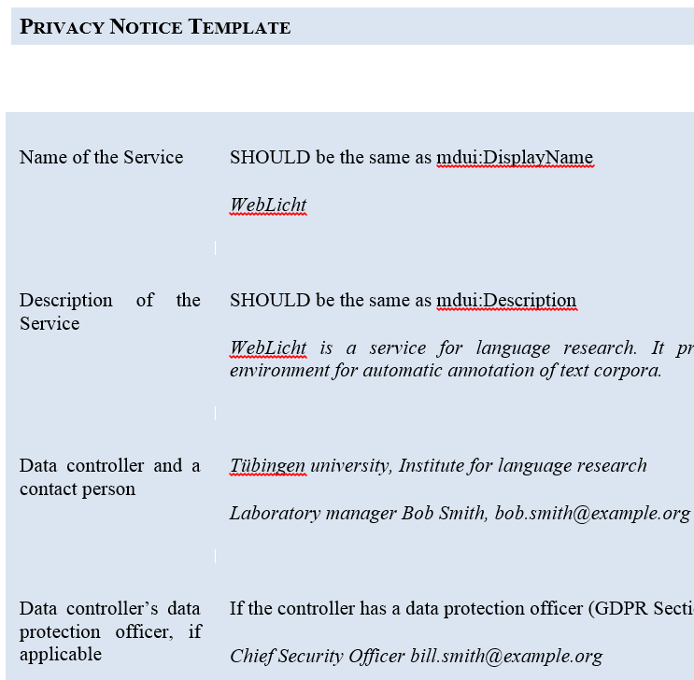
Information duty
Informing the End User (clause e)
The SP provides the End User a privacy notice (template: Appendix I)
Concise, transparent, intelligible and provided in an easily accessible form
Informing the Home Organisation (clause f)
The SP provides to the Home Organisation
  A link to the Privacy Notice (for HO to display to user, see Appendix I)
  Indication of its commitment to the CoCo
  Updates or changes to data protection laws

Slide 21
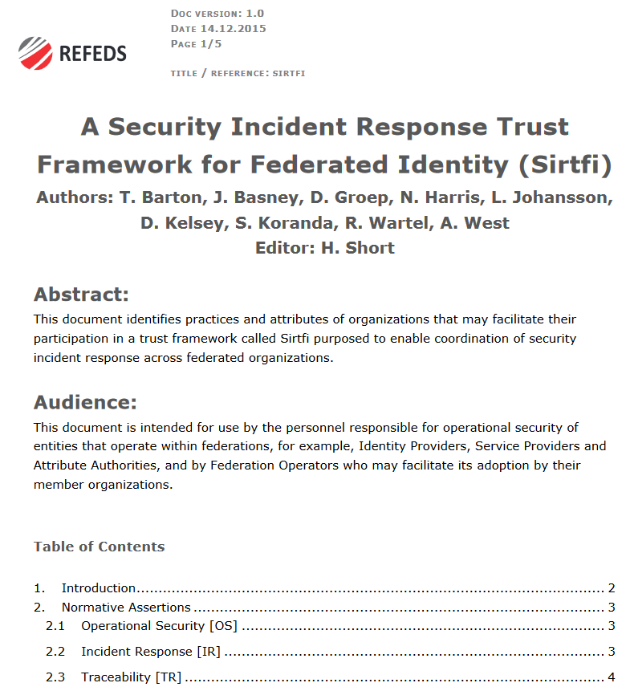
Information security measures and breaches
Security measures (clause h)
SP takes appropriate technical and organisational measures to protect the Attributes
Appendix II: Sirtfi
Security breaches (clause i)
The SP report all suspected privacy or security breaches concerning the Attributes to the Home Organisation

Slide 22
SP transferring Attributes to 3rd parties and countries
SP transferring attributes to 3rd parties (clause j)
Only if
  3rd party is a data processor for the SP, or
  3rd party is committed to the CoCo, or
  User consents to the release
SP transferring attributes to a country without adequate protection (clause k)
Possible if the Attributes are protected by
  The CoCo, or
  Appropriate measures (e.g. EC model contracts, consent)
CoCOSP
HO
CoCO SP
CoCOSP
IdP/SP proxy setup
CoCOSP

Slide 23
Miscellaneous
Liability (clause m)
If the SP violates the CoCo and HO/End User suffers damage, the SP holds it/them harmless
Eligibility (clause o)
The SP’s commitment to CoCo must be carried out by authorised person
Terminaton of CoCo (clause p)
If CoCo replaced by similar
If SP stops the service provisioning or terminates the CoCo

