Slide 1
Helping the universities with GDPR

Slide 2
What is the GDPR?
A new regulation that replaces the existing law(s)
A continuation of the exixting law(s)
Greater focus on compliance
There are consequenses
§

Slide 3
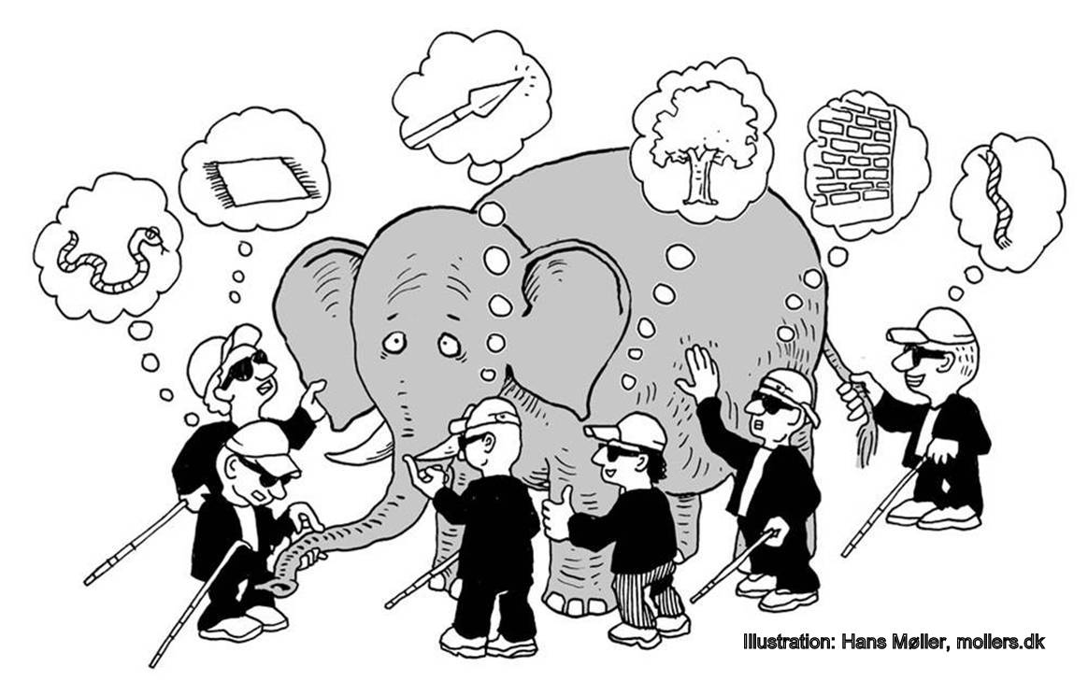
What is it?
It’s an elephant…
But how big is it?
And how do you eat it?

Slide 4
How do we start?
Understand what the GDPR means for you
Leadership buy-in
Classic project setup
Presentations for the leadership
Workshops for the project people

Slide 5
First steps?
Map your data and dataflows
Gap-analysis
Overview of deliverables
Timetable for the deliverables
Assist with mapping your data and dataflows
Help you identify gaps for your Gap-analysis
Help identify deliverables
Help estimating time for the deliverables

Slide 6
Next steps
Assign ressourcer and skills
Prioritze your deliverables
Get a leadership mandate for local ressources
Help identify needed skills
Help prioritize your deliverables
Help estimate ressources required

Slide 7
Understand what is new in the GDPR
Records of processing activities
Data protection impact analysis
Design & Default
Rights of the data subjects
Breach notification and ….
A data protection officer

Slide 8
All public authorities must have a DPO
Shall be appointed based on professional expertice
An undertaking can have a shared DPO
Can be internal or external
Data Protection Officer (DPO)
Notes:
Udpeges på baggrund af faglig ekspertise og evne til at udføre sine opgaver.

Slide 9
The role of the DPO
Ambasssador for the data subjects
Ombudsmand for the data subjects
The business
Law
IT

Slide 10
The DPO in your organization
Must have leadership backing
Can not have a position that determines the purposes and means of processing personal data
Avoid conflicts of interest
§
Can not work under instructions when performing as a DPO
Must have direct access to the leadership
Must be involved in sufficient and timely manner
Must maintain the level of expertice

Slide 11
The jobs of a DPO
Must notify and advise the data controller or data processor
Must monitor compliance with the regulation
§
Must handle inquiries from the data subjects
Must advice regarding the DPIA
Must cooperate with the DPA
Must act as the supervisory authority's contact point
Notes:
Skal underrette og rådgive den dataansvarlige eller databehandleren og de ansatte, der behandler personoplysninger, om deres forpligtelser i henhold til forordningen.
Skal overvåge overholdelsen af forordningen og politikker om beskyttelse af personoplysninger.

Slide 12
The perfect DPO
Expert on the regulation
Understands IT
Experienced project manager
Leadership experience
§
Degree in communications
Process consultant
Experience with leadership communications
Information security expert

Slide 13
GDPR-service
DKCERT GDPR-service
Services for DPO’s
Be the DPO

Slide 14
Service to support local DPO’s
Participate in a DPO-network
Develope GDPR-tools and templates
Advise on the organization and scope of a local DPO
Support the implementation of the GDPR
§
Notes:
Tilbyde deltagelse i et netværk til videndeling og udvikling af DPO-rollen på universiteter.
Udarbejde værktøjer til brug for DPO’er, fx en skabelon for konsekvensanalyser vedrørende databeskyttelse.
Rådgive om etablering af egen DPO-funktion, herunder håndtering af udfordringer i forhold til uafhængighed, interessekonflikt og gennemslagskraft.

Slide 15
GDPR help for organizations that do not want their own local DPO
Be the DPO
Help manage ongoing challenges and dilemmas with personal data
Help design GDPR processes
Supports compliance with the Regulation
Gather knowledge and experience from similar organization and from international task force
§
Notes:
Hjemtage erfaringer og viden fra øvrige europæiske medlemslandes implementering og fortolkning af forordningen

