Slide 1
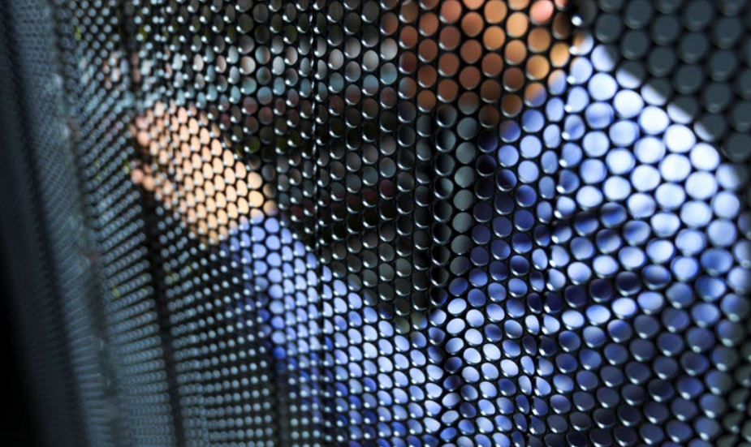
CYBER THREAT ASSESSMENT 2017
education and research SECTORS
WISE @STFC 28-02-2018
Bart.Bosma@surfnet.nl

Slide 2
CYBER THREAT ASSESSMENT 2017
What is its purpose?
Inform Security Officers and board members in our constituency about cyber threats that are relevant for institutions involved in education and research
Enable them to take appropriate measures to mitigate those threats to increase the institutions’ resilience
Provide input for the SURF Standard of Information Security for Higher Education, the de facto standard in the sector education and research in the Netherlands.

Slide 3
CYBER THREAT ASSESSMENT 2017
How did we do it?
Initial version (2014) created by Deloitte based on input from a small group of Security Officers from the SURF membership
Subsequent versions build on the initial version, incorporating feedback from the field and including current trends
  Interview Security Officers of universities and other institutions involved in education or research
  Research public sources
Solicit feedback on draft versions from specialists to improve quality

Slide 4
CYBER THREAT ASSESSMENT 2017
What did we find?
Criminals and state actors continue to constitute the greatest threat and cause the most damage.
The vulnerability of the Internet of Things (IoT) has led to disruptive attacks that clearly illustrate the need for digital resilience to be strengthened.
Resilience of individuals and organisations cannot keep up with the proliferation of the threats. However, educational and research organisations are doing better as a group.
Notes:
Criminals and state actors continue to constitute the greatest threat and cause the
most damage:
According to the NCSC and intelligence agencies, the threat of digital espionage remains at a high level, and other states use such means to try to siphon off information.
The vulnerability of the Internet of Things (IoT) has led to disruptive attacks that
clearly illustrate the need for digital resilience to be strengthened:
The number of IoT devices is set to increase sharply in coming years, potentially reaching a total of 75 billion devices worldwide by 2025. Many of those devices will have vulnerabilities that are secured insufficiently and, in many cases, cannot be patched.
Resilience of individuals and organisations cannot keep up with the proliferation of the threats:
In general, resilience in Dutch organisations is poor, and recent incidents have shown that the impact of such incidents can be huge. Resilience in education and research sectors seems to be better organised.

Slide 5
CYBER THREAT ASSESSMENT 2017
What did we find?
The increasing digitisation of citizens (and therefore of students, teachers, researchers and other staff at education and research institutions) is changing the threat landscape.
Denial-of-service attacks continue, but can be kept under control in our sector.
Malicious parties are still taking advantage of vulnerabilities, including on mobile devices, to gain access to critical systems.
Notes:
The increasing digitisation of citizens (and therefore of students, teachers,
researchers and other staff at education and research institutions) is changing the
threat landscape:
Students, teachers, researchers and other staff at institutions are increasingly making use of mobile devices – in many cases their own smartphones or tablets (BYOD). This is blurring the boundaries between private and company information and making it more difficult to monitor improper access to critical data. When the General Data Protection Regulation enters into effect in mid-2018, organisations will have to put processes in place for the protection of personal data, and the notification of incidents.
Denial-of-service attacks will continue, but can be kept under control.
SURFcert statistics indicate that denial-of-service attacks will continue unabated. It appears that, given their noticeable decrease during holiday periods, many attacks are carried out by students. Together with the organisations concerned, SURFnet has developed adequate solutions to mitigate these attacks, thereby limiting the impact.
Malicious parties are still taking advantage of vulnerabilities, including on mobile
devices, to gain access to critical systems:
Many vulnerabilities, including zero-day vulnerabilities, are either not patched or patched too late. This gives malicious parties ample opportunity to carry out attacks that are difficult to detect.

Slide 6
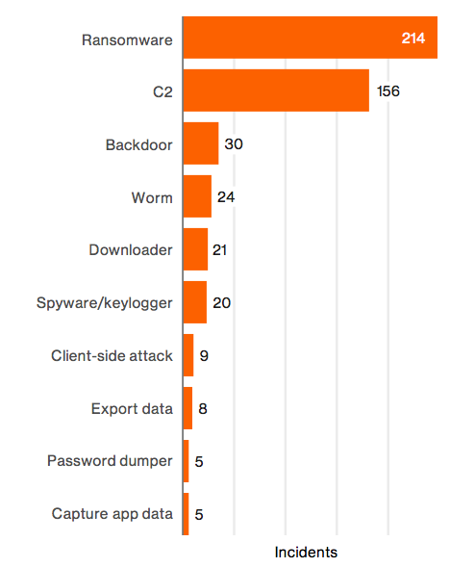
CYBER THREAT ASSESSMENT 2017
Criminals and state actors continue to constitute the greatest threat and cause the most damage.
Notes:
Criminals and state actors continue to constitute the greatest threat and cause the
most damage:
According to the NCSC and intelligence agencies, the threat of digital espionage remains at a high level, and other states use such means to try to siphon off information.
The vulnerability of the Internet of Things (IoT) has led to disruptive attacks that
clearly illustrate the need for digital resilience to be strengthened:
The number of IoT devices is set to increase sharply in coming years, potentially reaching a total of 75 billion devices worldwide by 2025. Many of those devices will have vulnerabilities that are secured insufficiently and, in many cases, cannot be patched.
Resilience of individuals and organisations cannot keep up with the proliferation of the threats:
In general, resilience in Dutch organisations is poor, and recent incidents have shown that the impact of such incidents can be huge. Resilience in education and research sectors seems to be better organised.

Slide 7
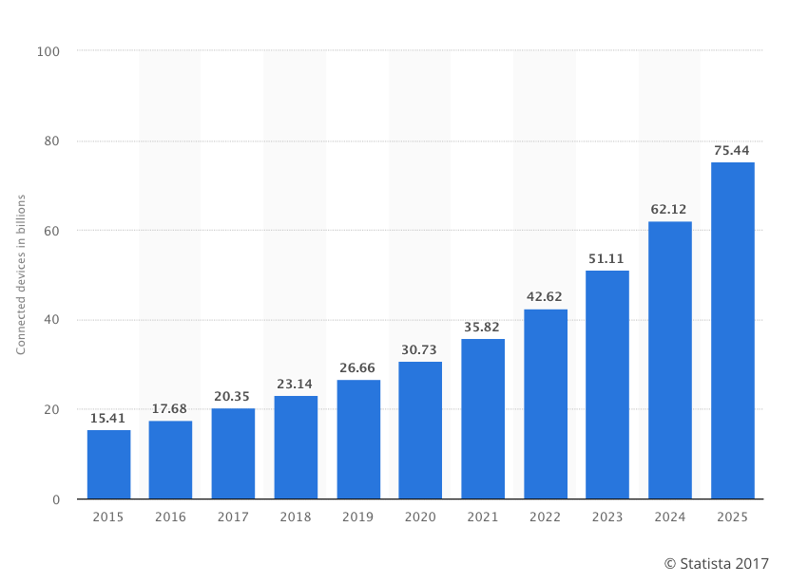
CYBER THREAT ASSESSMENT 2017
The vulnerability of the Internet of Things (IoT) has led to disruptive attacks that clearly illustrate the need for digital resilience to be strengthened.
Notes:
Criminals and state actors continue to constitute the greatest threat and cause the
most damage:
According to the NCSC and intelligence agencies, the threat of digital espionage remains at a high level, and other states use such means to try to siphon off information.
The vulnerability of the Internet of Things (IoT) has led to disruptive attacks that
clearly illustrate the need for digital resilience to be strengthened:
The number of IoT devices is set to increase sharply in coming years, potentially reaching a total of 75 billion devices worldwide by 2025. Many of those devices will have vulnerabilities that are secured insufficiently and, in many cases, cannot be patched.
Resilience of individuals and organisations cannot keep up with the proliferation of the threats:
In general, resilience in Dutch organisations is poor, and recent incidents have shown that the impact of such incidents can be huge. Resilience in education and research sectors seems to be better organised.

Slide 8
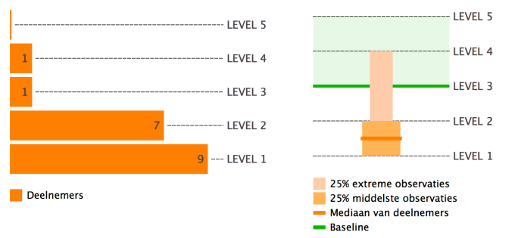
CYBER THREAT ASSESSMENT 2017
Resilience of individuals and organisations cannot keep up with the proliferation of the threats. However, educational and research organisations are doing better as a group.
Notes:
Criminals and state actors continue to constitute the greatest threat and cause the
most damage:
According to the NCSC and intelligence agencies, the threat of digital espionage remains at a high level, and other states use such means to try to siphon off information.
The vulnerability of the Internet of Things (IoT) has led to disruptive attacks that
clearly illustrate the need for digital resilience to be strengthened:
The number of IoT devices is set to increase sharply in coming years, potentially reaching a total of 75 billion devices worldwide by 2025. Many of those devices will have vulnerabilities that are secured insufficiently and, in many cases, cannot be patched.
Resilience of individuals and organisations cannot keep up with the proliferation of the threats:
In general, resilience in Dutch organisations is poor, and recent incidents have shown that the impact of such incidents can be huge. Resilience in education and research sectors seems to be better organised.

Slide 9

CYBER THREAT ASSESSMENT 2017
The increasing digitisation of citizens (and therefore of students, teachers, researchers and other staff at education and research institutions) is changing the threat landscape.
Notes:
The increasing digitisation of citizens (and therefore of students, teachers,
researchers and other staff at education and research institutions) is changing the
threat landscape:
Students, teachers, researchers and other staff at institutions are increasingly making use of mobile devices – in many cases their own smartphones or tablets (BYOD). This is blurring the boundaries between private and company information and making it more difficult to monitor improper access to critical data. When the General Data Protection Regulation enters into effect in mid-2018, organisations will have to put processes in place for the protection of personal data, and the notification of incidents.
Denial-of-service attacks will continue, but can be kept under control.
SURFcert statistics indicate that denial-of-service attacks will continue unabated. It appears that, given their noticeable decrease during holiday periods, many attacks are carried out by students. Together with the organisations concerned, SURFnet has developed adequate solutions to mitigate these attacks, thereby limiting the impact.
Malicious parties are still taking advantage of vulnerabilities, including on mobile
devices, to gain access to critical systems:
Many vulnerabilities, including zero-day vulnerabilities, are either not patched or patched too late. This gives malicious parties ample opportunity to carry out attacks that are difficult to detect.

Slide 10
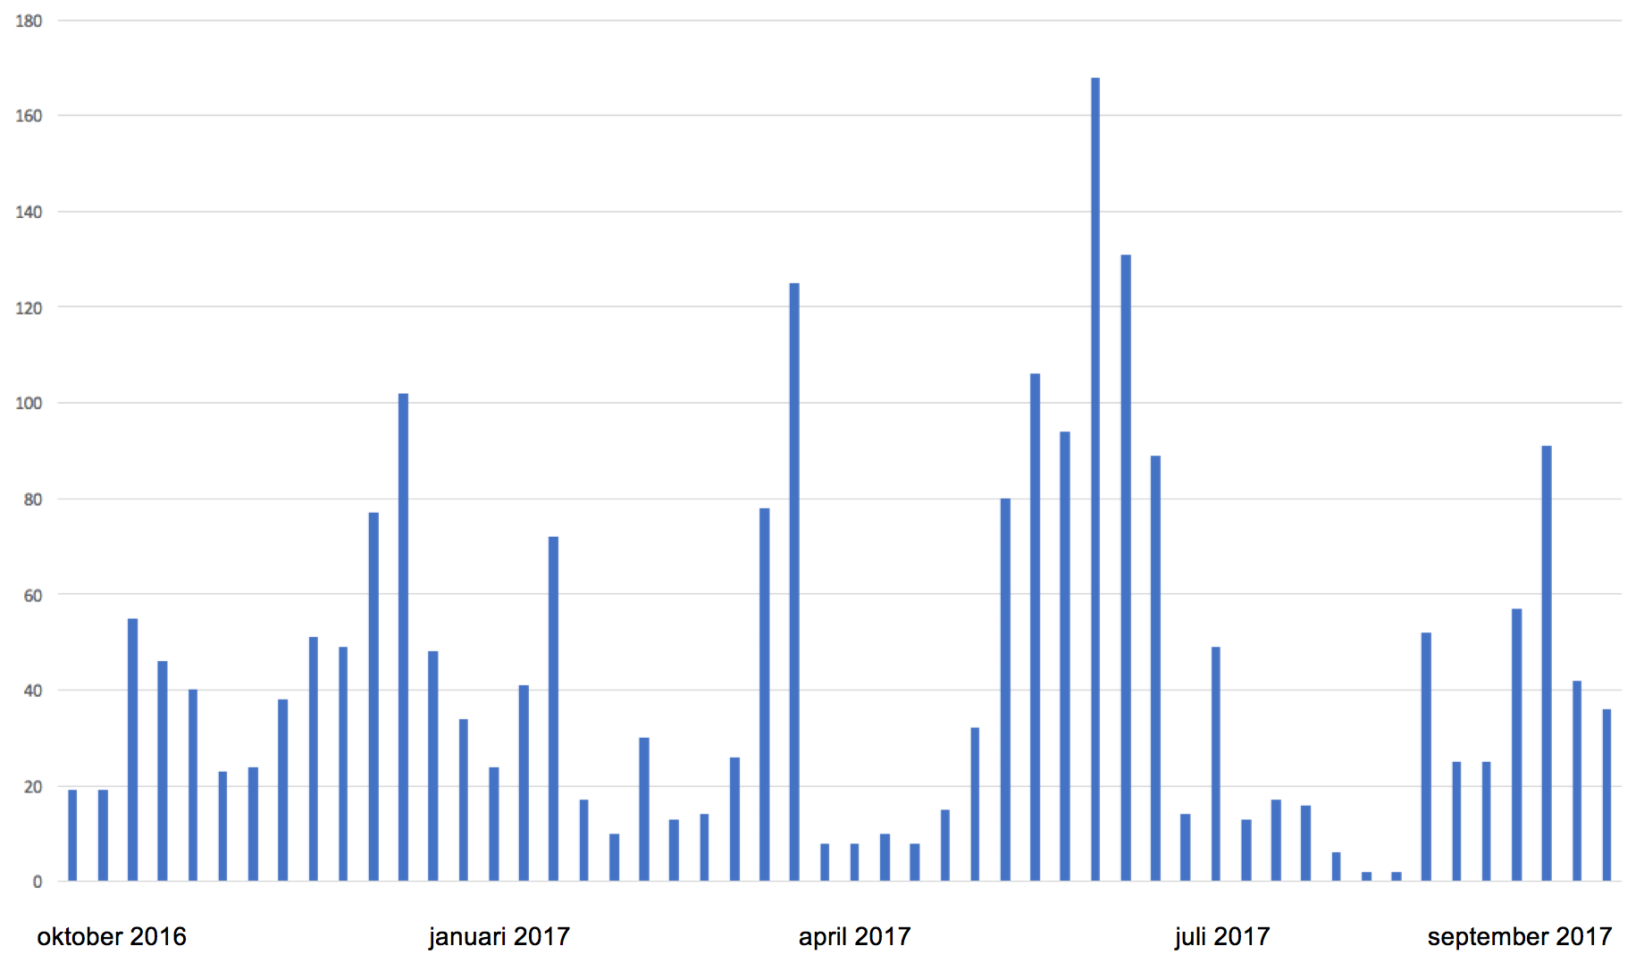
CYBER THREAT ASSESSMENT 2017
Denial-of-service attacks continue, but can be kept under control in our sector.
Notes:
The increasing digitisation of citizens (and therefore of students, teachers,
researchers and other staff at education and research institutions) is changing the
threat landscape:
Students, teachers, researchers and other staff at institutions are increasingly making use of mobile devices – in many cases their own smartphones or tablets (BYOD). This is blurring the boundaries between private and company information and making it more difficult to monitor improper access to critical data. When the General Data Protection Regulation enters into effect in mid-2018, organisations will have to put processes in place for the protection of personal data, and the notification of incidents.
Denial-of-service attacks will continue, but can be kept under control.
SURFcert statistics indicate that denial-of-service attacks will continue unabated. It appears that, given their noticeable decrease during holiday periods, many attacks are carried out by students. Together with the organisations concerned, SURFnet has developed adequate solutions to mitigate these attacks, thereby limiting the impact.
Malicious parties are still taking advantage of vulnerabilities, including on mobile
devices, to gain access to critical systems:
Many vulnerabilities, including zero-day vulnerabilities, are either not patched or patched too late. This gives malicious parties ample opportunity to carry out attacks that are difficult to detect.

Slide 11
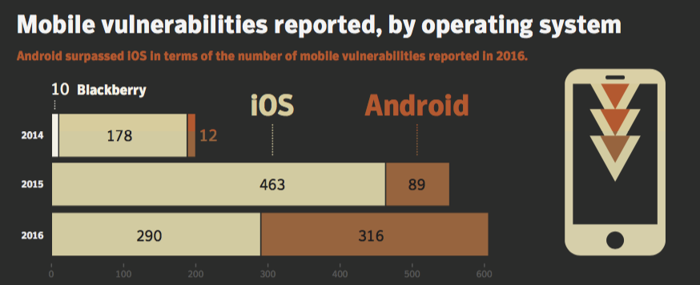
CYBER THREAT ASSESSMENT 2017
Malicious parties are still taking advantage of vulnerabilities, including on mobile devices, to gain access to critical systems.
Notes:
The increasing digitisation of citizens (and therefore of students, teachers,
researchers and other staff at education and research institutions) is changing the
threat landscape:
Students, teachers, researchers and other staff at institutions are increasingly making use of mobile devices – in many cases their own smartphones or tablets (BYOD). This is blurring the boundaries between private and company information and making it more difficult to monitor improper access to critical data. When the General Data Protection Regulation enters into effect in mid-2018, organisations will have to put processes in place for the protection of personal data, and the notification of incidents.
Denial-of-service attacks will continue, but can be kept under control.
SURFcert statistics indicate that denial-of-service attacks will continue unabated. It appears that, given their noticeable decrease during holiday periods, many attacks are carried out by students. Together with the organisations concerned, SURFnet has developed adequate solutions to mitigate these attacks, thereby limiting the impact.
Malicious parties are still taking advantage of vulnerabilities, including on mobile
devices, to gain access to critical systems:
Many vulnerabilities, including zero-day vulnerabilities, are either not patched or patched too late. This gives malicious parties ample opportunity to carry out attacks that are difficult to detect.

Slide 12
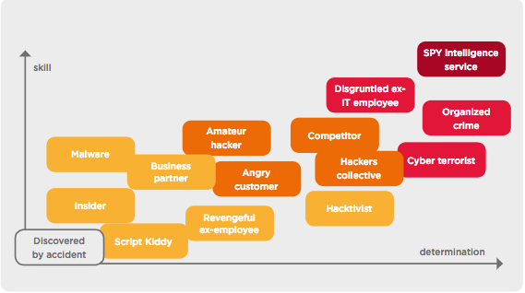





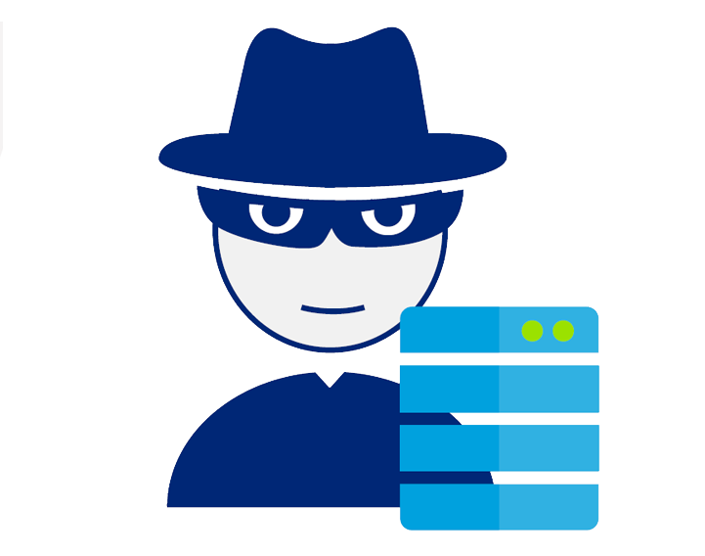
CYBER THREAT ASSESSMENT 2017
Who is responsible?
Employees (low)
Students (low-medium)
Activists and cyber vandals
Competitors (rivals)
Cyber researchers
Criminals and state actors
skill level
Notes:
Six actors play a role in the education and research sectors. These are listed below in
order of skills and motives from low to extremely high:
1. Employees – skill: low
Employees benefit from good evaluations and performance; therefore,
manipulating HR files may be of interest to them. Employees may feel resentment
at the threat of dismissal or reorganisation and be incited to inflict damage. Some
employees are potentially very skilled and have access to systems and networks.
Other employees are often unaware of cyber security threats, which means they
may be careless when handling sensitive information. In some cases, they are
driven by efficiency and convenience rather than cyber security concerns.
2. Students – skill: low to medium
Students benefit from good study progress, so it may be of interest to them to
manipulate their grades. They already have access to many systems and networks,
and some are very skilled. Many students are often unaware of cyber security
threats, which means they may be careless when handling sensitive information.
3. Activists and cyber vandals – skill: low to medium
Activists have decent knowledge and skills that they can use to steal data or
make systems and networks inaccessible. Moreover, it is highly likely that they
will make stolen data public. Cyber vandals are also looking for peer recognition,
and sometimes want a large audience for their actions. Cyber-jihadists are intent
on collecting sensitive data that they will make public for propaganda reasons
subsequently
4. Competitors – skill: low to medium
Commercial parties benefit from obtaining information early from competitors. The
same could be true for rival partner institutions which are interested in each other’s
research data, for example. Although knowledge and skills are available, they will
not be used readily against a fellow institution.
5. Cyber researchers – skill: high
Cyber researchers are in fact hackers, but have no malicious intent. If they
encounter a problem, they will generally warn the institution concerned
(responsible disclosure). They are extremely skilled, and do not always act in
accordance with the institution’s policies.
6. Professional criminals and state actors – skill: high to very high
Professional criminals are driven mainly by financial gain. They sell stolen data
or try to collect a ransom by making data temporarily inaccessible. They are
organising themselves increasingly, making their chances of success much higher.
A great deal of data is collected in the context of anti-terrorism and crime fighting,
but commercial and economic motives (an interest in intellectual property and
innovative knowledge) can also be an incentive for foreign intelligence agencies.

Slide 13
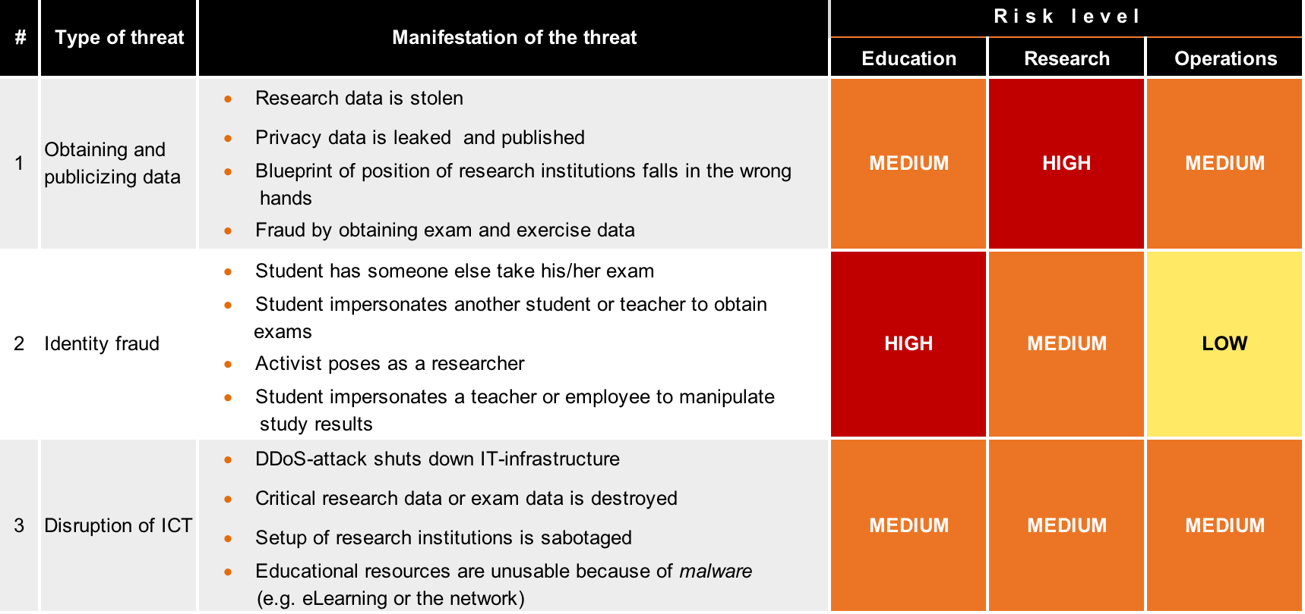
Risk
Notes:
The 7 threats

Slide 14
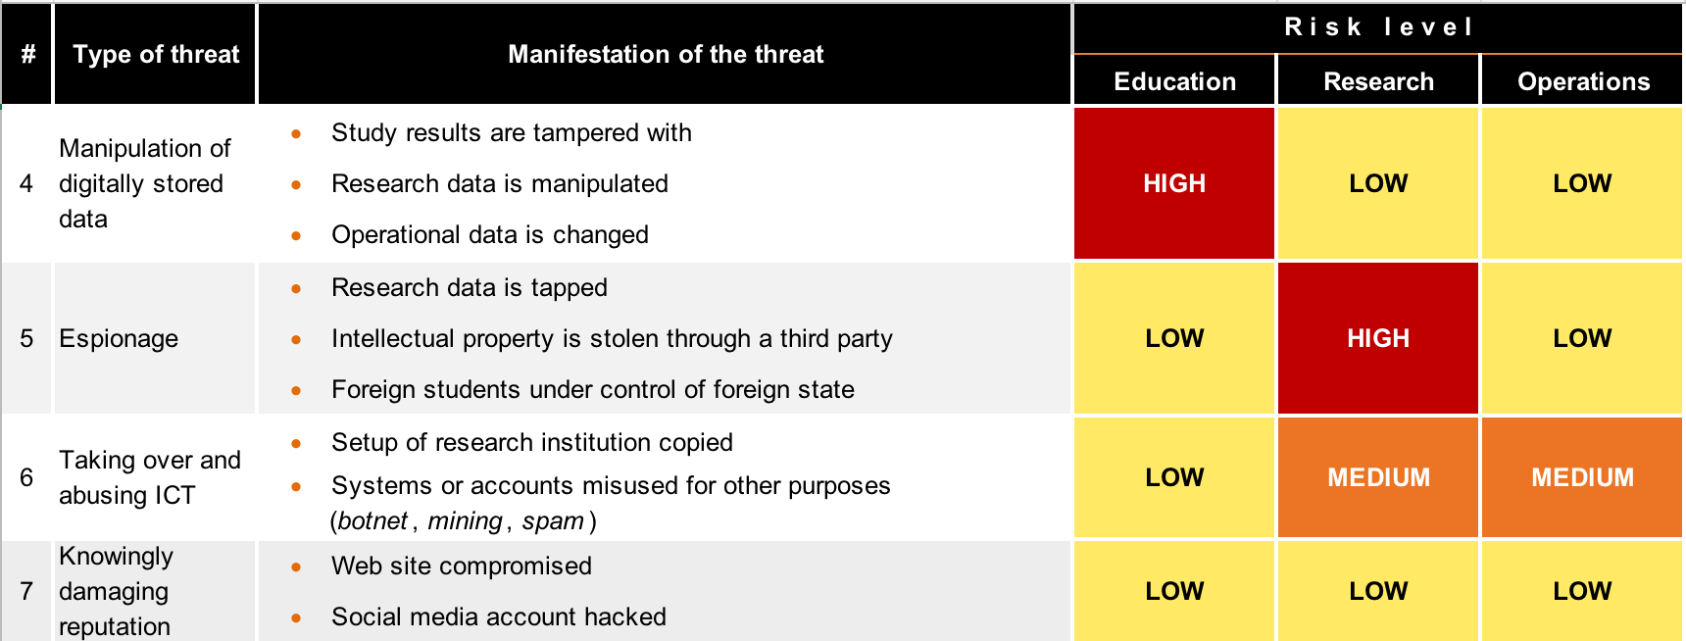
Risk
Notes:
7

Slide 15
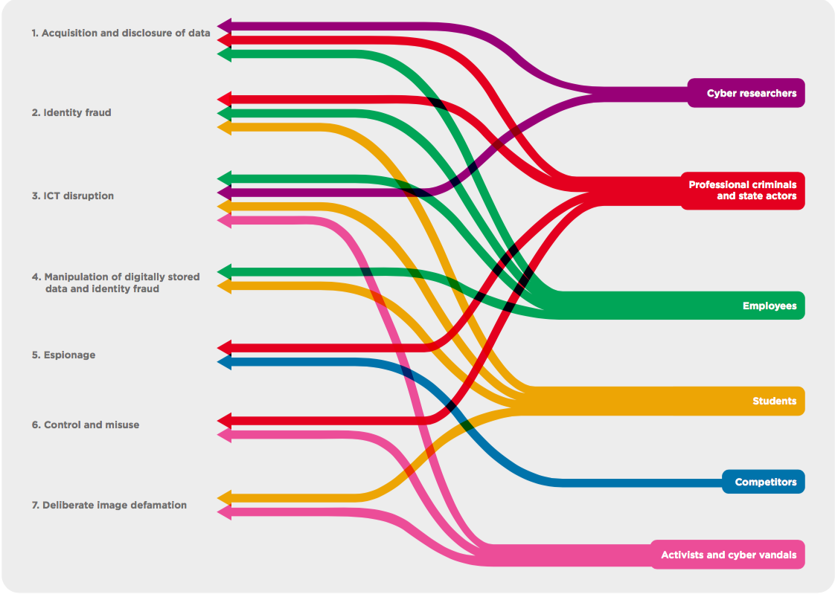
CYBER THREAT ASSESSMENT 2017

Slide 16

CYBER THREAT ASSESSMENT 2017
https://www.surf.nl/en/knowledge-base/2017/cyber-threat-assessment-2017.html

