Slide 1
Helmholtz Data Federation – HDF

Slide 2
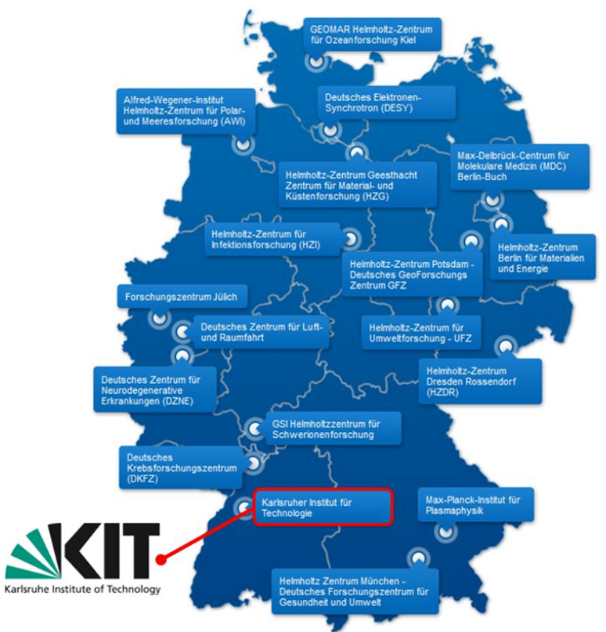
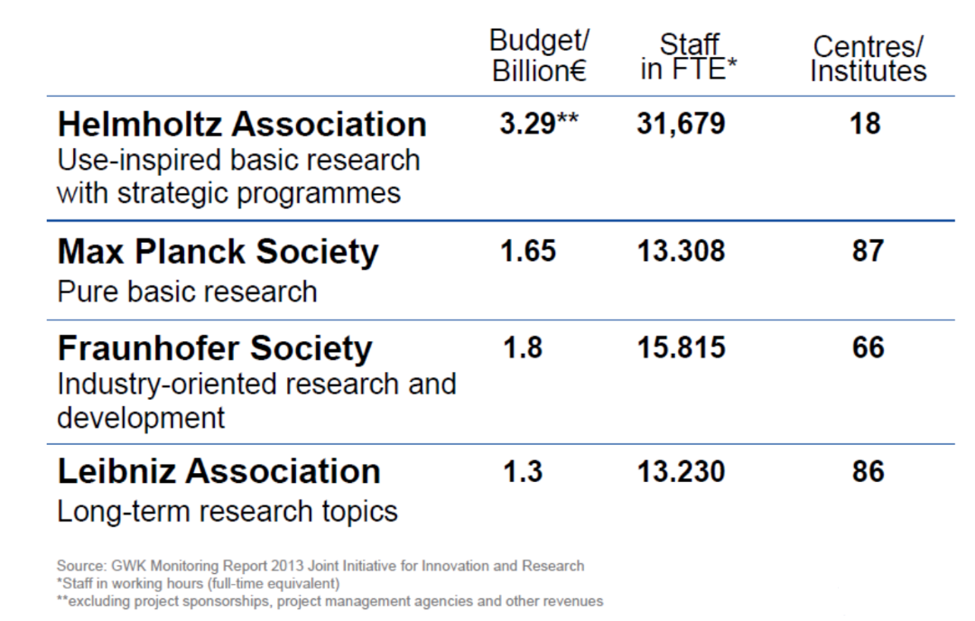
Helmholtz Association
Strategic research for grand challenges with cutting-edge research
  6 research fields: Energy, Earth & Environment, Health, Aeronautics & Space & Transport, Key Technologies, Matter
Developing and operating complex infrastructure and large-scale facilities for the national and international scientific community

Slide 3
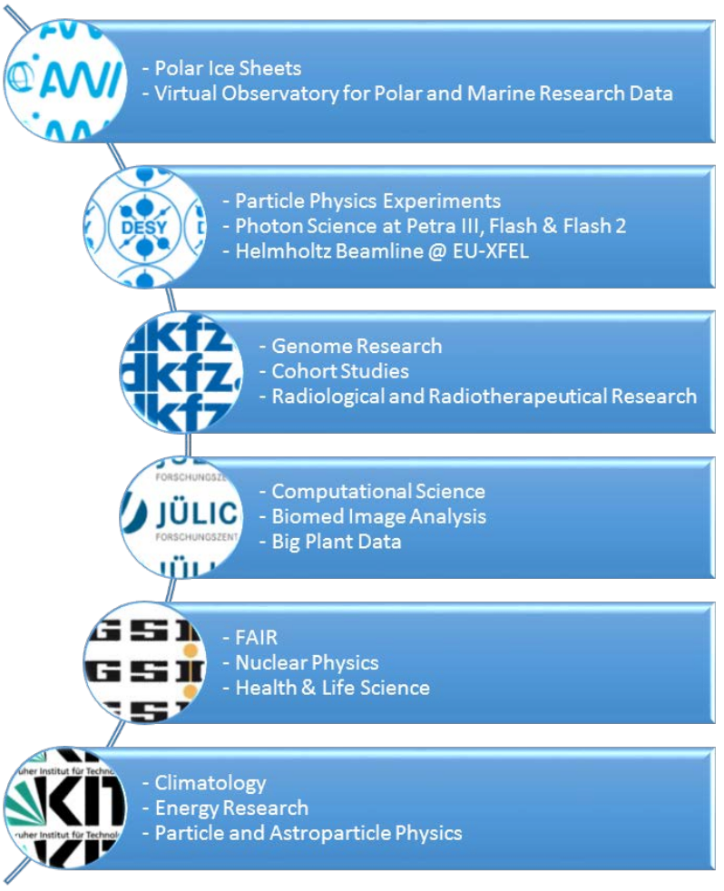

HDF – stated goals
Helmholtz Association is developing a federated research data infrastructure for the benefit of and open to the full German science system
  Finding, accessing, linking, analyzing scientific multi-disciplinary data
  Long-term preservation, curation, availability and usability of research data
  Data ownership remains with communities
  Secure federation of existing data centers with uplinks to EU/Intl.

Slide 4
HDF – stated goals
National building block for the EOSC
Comprising three elements
  Innovative software technologies
  Excellent user support and joint R&D
  Modern storage and analysis hardware
HDF is designated to be an e-infrastructure

Slide 5
Motivation
Learning from CERN, Elixir, Dariah, …:
  Distributed users need/want to
  access and share with peers datasets stored at
  distributed computer centers.
  Analyze datasets
Influential examples:
  Sharing: Principal Investigator (PI) from center A gives user from center B access to data stored at center C
  PIs do not want to talk to any IT to get this done
→The need for federated identity management in HDF

Slide 6
Motivation
Technical and legal demands:
  Provisioning of accounts?
    Deploying an account for a user without any further requirement/action?
    Requirements for the user identification?
    Terms of Use (ToS)?
  Group membership management?
  De-provisioning of accounts?

Slide 7
Challenges
How can we do this legally?
  GDPR influence
  Policy requirements for
    Level of Assurance (LoA) for user identification (credentials/ID vetting)
    Security incidents
    Terms of use / acceptable use policies
How can we do this technically?
  Desired approach:
    Leveraging existing technologies (No development of essential new components)
    Integration into existing infrastructures
    Scalability (integration with future infrastructures)

Slide 8
User info (attributes) considerations
Identity information provided by IdPs
  Non-standard, which LoA info to implement?
Increasing LoA via VOs
  Comes with a burden, limited scalability, LTOS
Develop an interface for the e-Passport (eIDAS)
  Not yet fully deployed, usage still (partially) unclear
Leverage DFN-AAI
  Use existing infrastructure
  IdPs Signal higher levels via attributes in the future (on it’s own/IdP-SP proxy)
    R&S, Sirtfi, id-vetting, ...
    SPs can use the information for filtering/discrimination
  Additional requirements can be added (also new policies)

Slide 9
More details
Start off with DFN AAI and “Low risk services“
Evaluate “tags” for higher quality Assurances
    Identifier uniqueness
    Identity proofing and credential issuance, renewal and replacement
    Authentication
    Attribute quality and freshness
  Use them to introduce “higher risk services” (i.e. more expensive hardware)
Tags must correspond to internationally accepted ones (REFEDS, ...)

Slide 10
An architecture model
Users are (mostly) in SAML
  213 IdPs in Germany
  All Helmholtz centers have one
Services may encounter SAML “limitations”
  SAML was designed for web
  Problems with
    Scalable attribute release
    Commandline access
    API authentication
    Delegation
    Existing services
      SSH
      Grid / X.509
      S3
    Upcoming services
      OpenStack
SAML is excellent for
  Describing users
  Policy modeling
  Privacy awareness
International dimension
  Whatever we do must be interoperable with European initiatives

Slide 11
Architecture design considerations
Use one central SP for whole HDF
  Solves attribute release
This SP acts as an IdP for all SPs in HDF
  SP-IdP Proxy (in line with AARC Blueprint Architectures)
  May expose additional authentication protocols
    OpenID connect
      Solves commandline, API and Delegation
  Allows user-attribute management
    User self management
    Group management
    Use external attribute sources
Include token translation to support additional services
https://aarc-project.eu/architecture/

Slide 12
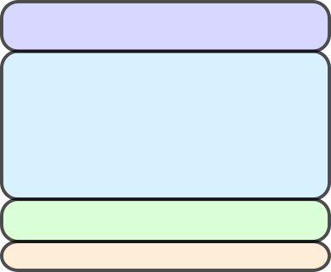
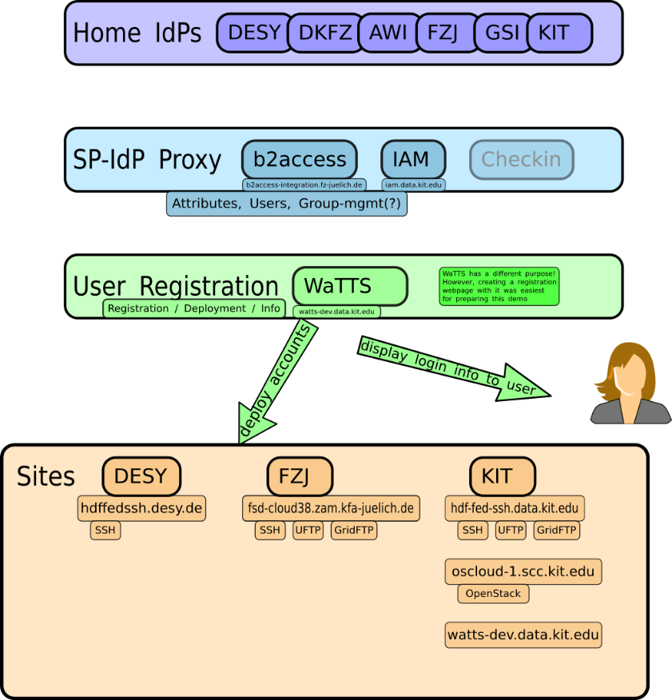
An architecture model
Users use home-accounts via DFN-AAI
  (and maybe even eduGain)
An SP-IdP Proxy:
  Follow AARC Blueprint
  Address SAML issues (attr. release, SP friendliness, ...)
  Manage / collect group membership information
A way for PIs to manage membership
Central place to register an account
  agree to terms, provide user-info, ...
Deployment / provisioning of accounts

Slide 13
HDF – Policy requirements – initial consideration
Data protection – processing of personal data
LoA
Security
Community membership management
Community operations management

Slide 14
HDF – Policy requirements
AUP
Security policies:
  Service operations, etc
Security Traceability and Logging Policy
Security Incident Response Policy
Policy on the Processing of Personal Data
Policy on Acceptable Authentication Assurance
Possible merging of policies in:
Community Membership Management Policy
Community Operations Security Policy
Templates for all these policies (mostly) exists
Most (all) of them are community “vetted”

Slide 15
HDF Policies – next steps
Leverage existing policies and policy development effort
  “Policy Kit”
  AARC
  Community and experts engagement
Imperative goals:
  “It must work”
  Scalability
  Interoperability

Slide 16
Thank you for your time!
Questions?

Slide 17
Data protection – processing of personal data
Reason for processing
GDPR influence
Privacy by design
Documented policies
DPO
Release of attributes
  Minimum attribute release R&S + SIRTFI
Documented processes
Types of data
Accounting, monitoring, logging -

Slide 18
LoA
Minimal requirements (from survey):
  Non-shareable accounts
  Persistent user identifiers
  Documented identity vetting procedure
  Password authentication
  Prompt changes in user’s affiliation
  Self-assessment
Do we need more? Need to identify minimum LoA for our use case
DFN AA- Advanced

Slide 19
Security
Incident response
Risk assessment
Cooperation
CSIRT teams
People, teams, etc?

Slide 20
Policies for community membership management and security
Membership management
  Individual Users
  Community Manager and other roles
  Community
  Protection and processing of Personal Data
  Audit and Traceability Requirements
  Registry and Registration Data
Security Operations
  Providing AUP
  Security contacts
  Compliance with the resource providers security policies, etc.
  Security incidents mitigation policies
  Liabilities, etc.

