Slide 1
EOSC-hub
WP4.4 Security (ISM)
David Kelsey
STFC
WISE meeting
Abingdon – 26 Feb 2018

Slide 2


Slide 3


Slide 4
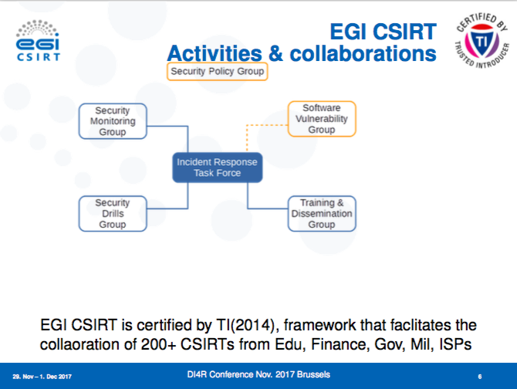

Slide 5
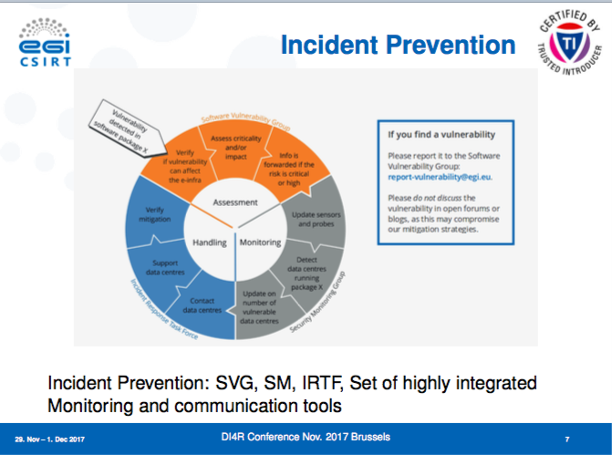

Slide 6
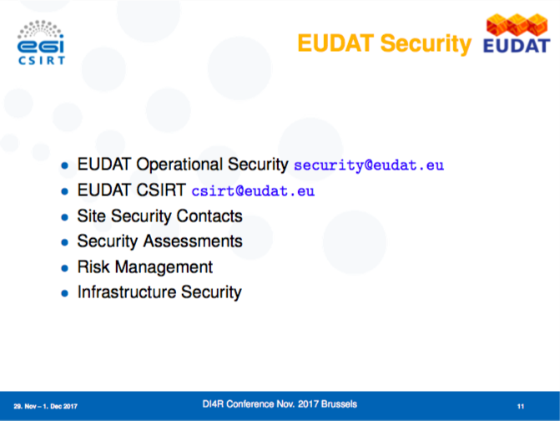

Slide 7
Task 4.4: Information Security Management
Lead STFC; Participants: CSC, JUELICH, CERN, CESNET, Nikhef, GRNET, STFC
  Total amount of effort = 113 PM
This task will develop and implement the policies and procedures to ensure consistent and coordinated security operations across the services provided in the catalogue
Security across distributed service providers will be based on an up‐to‐date policy framework including operational and incident response policies, participant responsibilities, traceability, legal aspects, and the protection of personal data
  These policies and procedures will complement the security best practices implemented by the individual service providers
The task will coordinate an incident response task force (IRTF) to make sure that routine issues and security events are handled properly by the service providers, and to provide specialised expertise in forensics and coordination for large scale incidents that threaten multiple providers

Slide 8
T4.4 (2)
The task will also handle software vulnerabilities with the purpose to minimize the risk to the services and the users
Another goal of the task is to build trust and create effective interoperability with the actors outside of the project such as other e‐Infrastructures, with key Research Infrastructures, and – when appropriate – with dedicated security groups in Europe (TF‐CSIRT, GÉANT) and in the US
Other “Security” related activities (Tools,monitoring, AAI, …) housed elsewhere in EOSC-hub

Slide 9
EGI CSIRT/EUDAT F2F meetings
15-17 November 2017
  Hosted by CSC, Helsinki
  Urpo Kaila (EUDAT Security Officer)
Integration of EUDAT to CSIRT/IRTF
  Ongoing collaboration of several years
  Spent several hours discussing plans for EOSC
Then meeting at CERN – 29-31 Jan 2018
  Urpo and Ralph Niederberger (FZJ) attended
Finalise year 1 plans – especially 1st 6 months

Slide 10
Deliverables
Security team will need to contribute to WP4 deliverables as required
D4.1 Operational requirements for the services in the catalogue
D4.2 Operational Infrastructure Roadmap

Slide 11
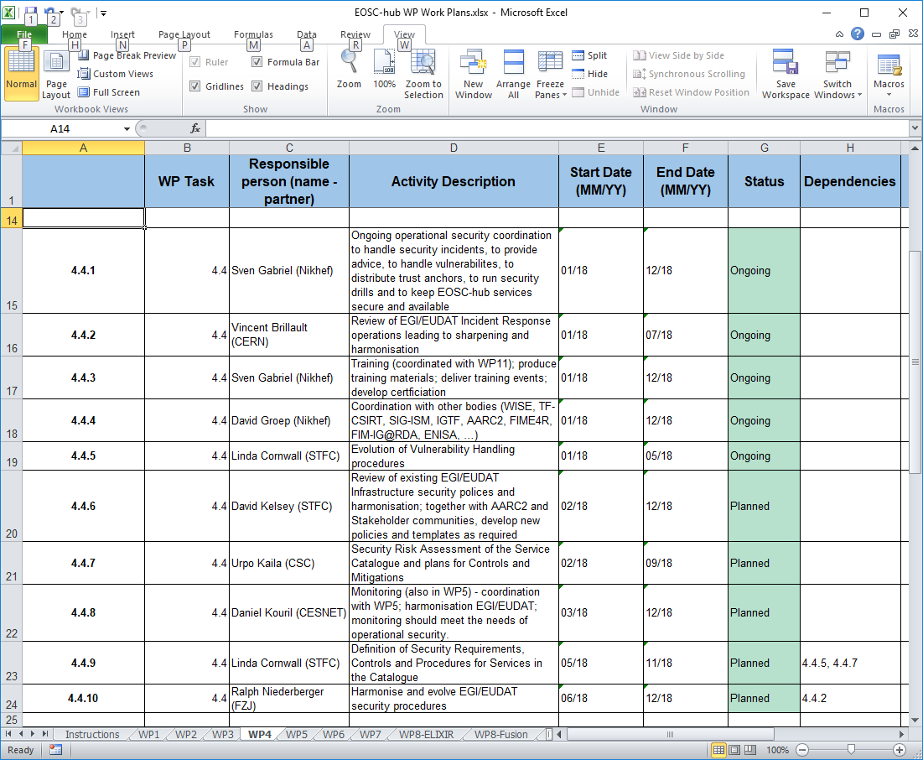
T4.4 Plans

