Slide 1
WISE meeting
Abingdon, UK
26-28 February 2018
David Kelsey
STFC-RAL

Slide 2
6th WISE Community meeting
WELCOME to all
Thanks to our sponsors
  GridPP & STFC Particle Physics Department
And thank you for paying a registration fee :=(

Slide 3
Science and Technology Facilities Council (STFC) and Rutherford Appleton Laboratory (RAL)
Harwell Campus (200 organisations, 5000 staff)
STFC as one of Europe's largest multidisciplinary research organisations
  supports scientists and engineers world-wide
  operates world-class large-scale research facilities
  manages the UK access to large-scale facilities in other countries
  provides strategic advice to the government on development of large-scale science facilities
  manages international research projects in support of a broad cross-section of the UK research community.
We provide science facilities on behalf of the whole UK research community, including (many at RAL):
  Lasers , Accelerators , Neutron and Muon Sources , Synchrotron light sources & Free Electron Lasers, Atmospheric and Space Science, Scientific Computing
We also manage the UK membership of science facilities essential to particle physics, astronomy and nuclear physics, such as CERN
  Particle physics, Astronomy, Nuclear physics, Particle Astrophysics, Computing
Other science facilities include
  The Boulby Underground Laboratory in the north of England
    able to host low-background and deep underground science experiments

Slide 4
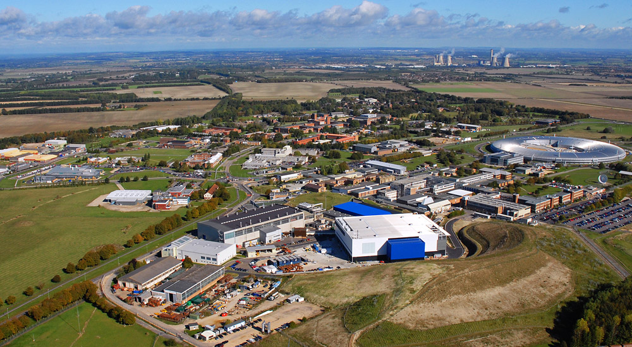
Rutherford Appleton Laboratory
(Harwell Campus - 10 miles from Abingdon)

Slide 5
Abingdon history
https://en.wikipedia.org/wiki/Abingdon-on-Thames
Occupied since early to middle Iron Age (600-100 BC)
Abingdon Abbey founded in ~AD 676
  In 1084, William the Conqueror celebrated Easter here
  Left his son (Henry I) to be educated here
  Abbey dissolved in 1538 (Henry VIII)
Once the county town of Berkshire
  But not on the main railway line
  Moved to Oxfordshire in 1974
Abingdon's proximity to academic and scientific institutions in Oxford, the town has seen an influx of young professionals

Slide 6
Cosener’s House – owned by STFC
It takes its name from the Cuisinier or Kitchener (the official responsible for providing food for the Abbey). The older part of the present building is the central portion which dates from the mid-eighteenth century
The Abbey church was located across the road

Slide 7
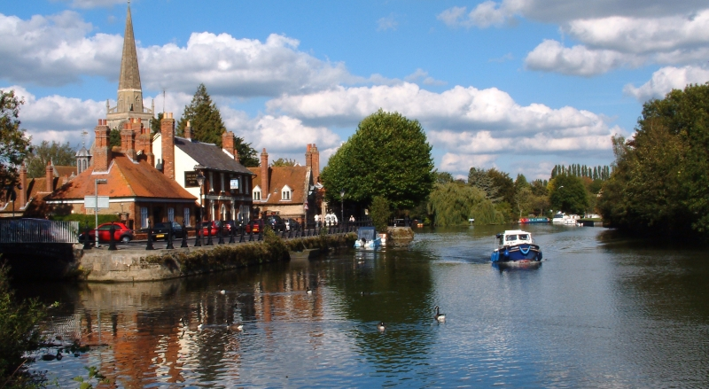
Abingdon – The River Thames

Slide 8
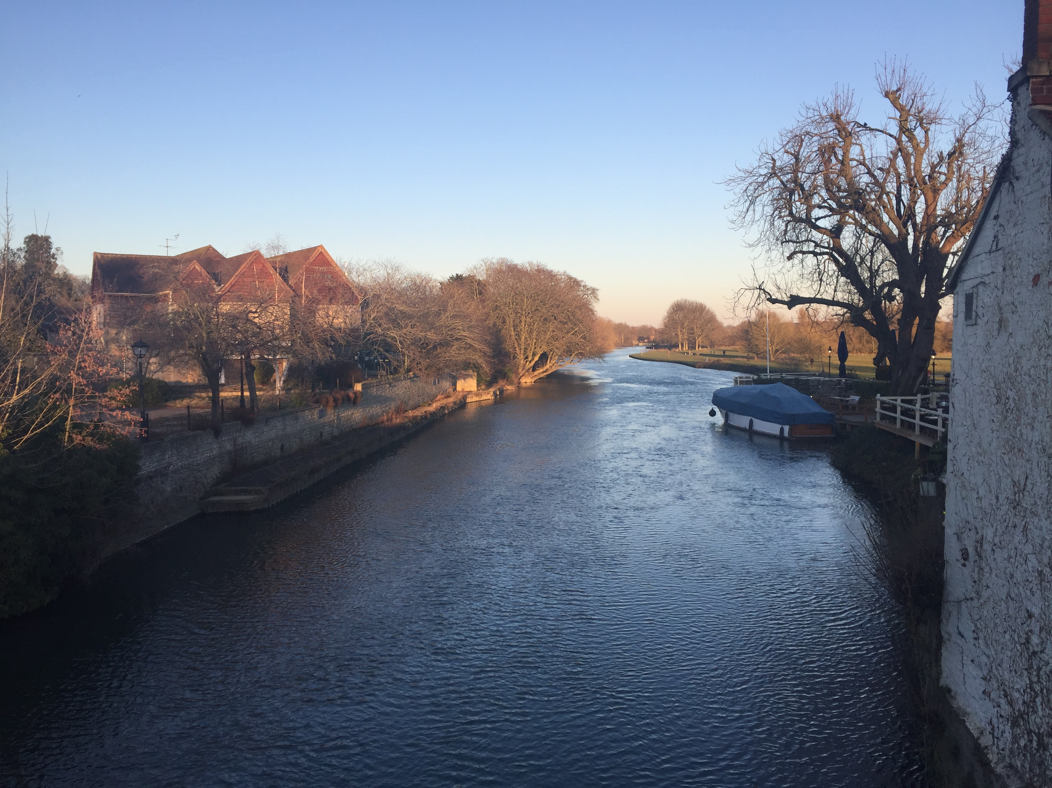
Last night – from the bridge

Slide 9
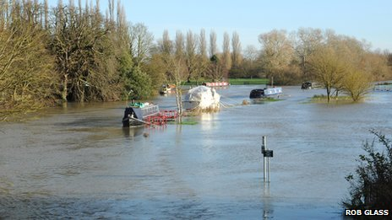
Sometimes it floods!

Slide 10
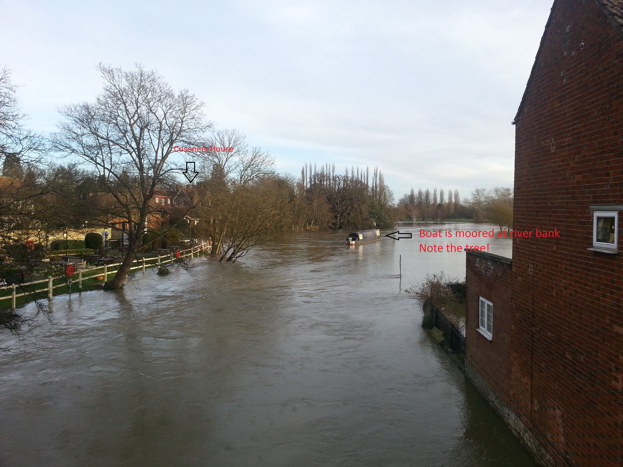
Just before the Jan 2014 meeting

Slide 11
Harwell Campus
http://harwellcampus.com/
Video intros
  https://youtu.be/fIPEBM8GZeI (Harwell)
  https://youtu.be/xJlvHZQAksE (STFC)

Slide 12
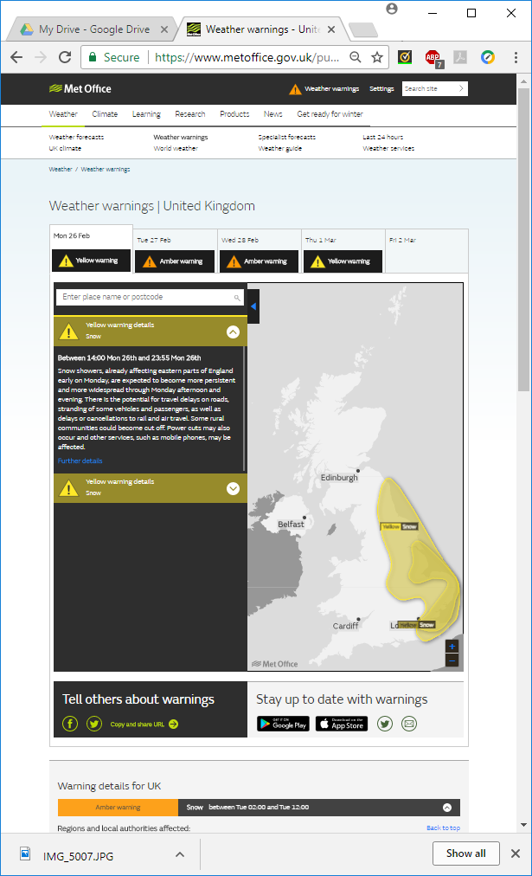
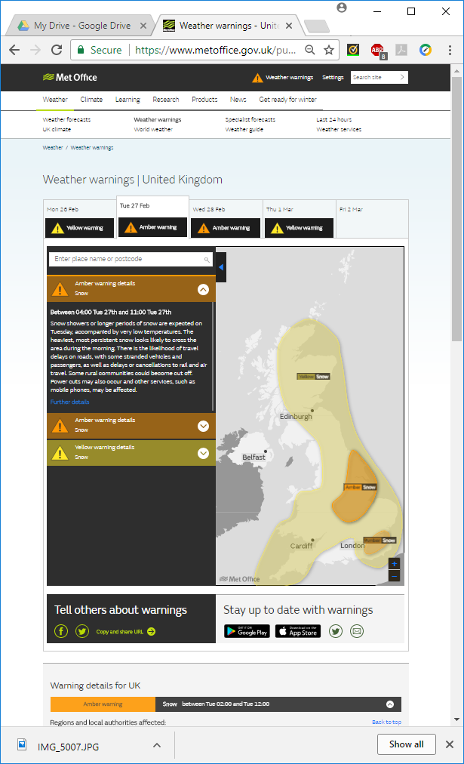
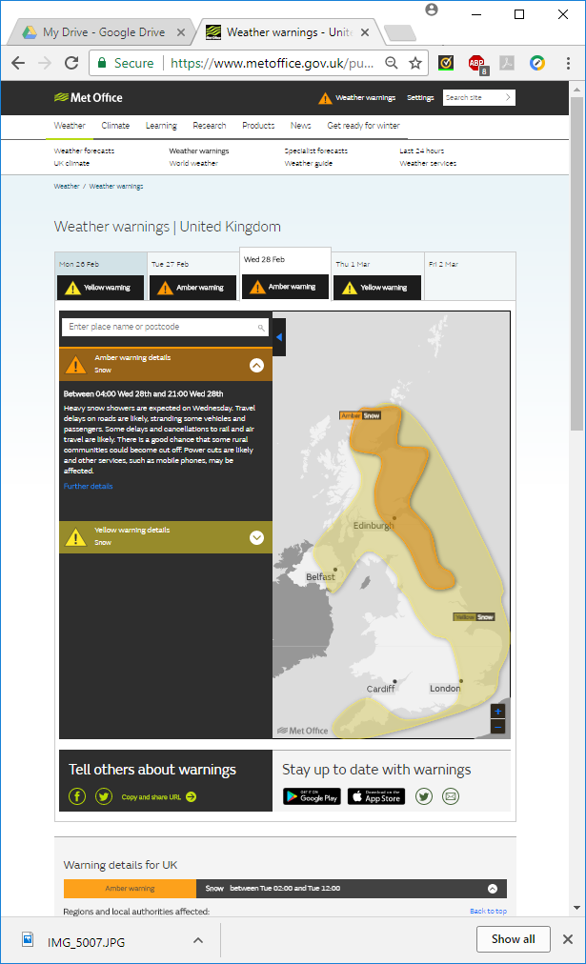
This week’s weather?
https://www.metoffice.gov.uk/public/weather/warnings

Slide 13
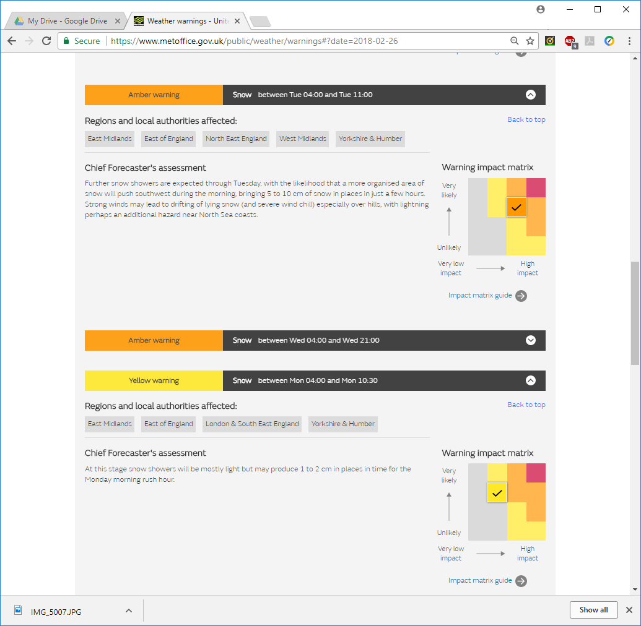
Publishing “risk” to the public?

Slide 14
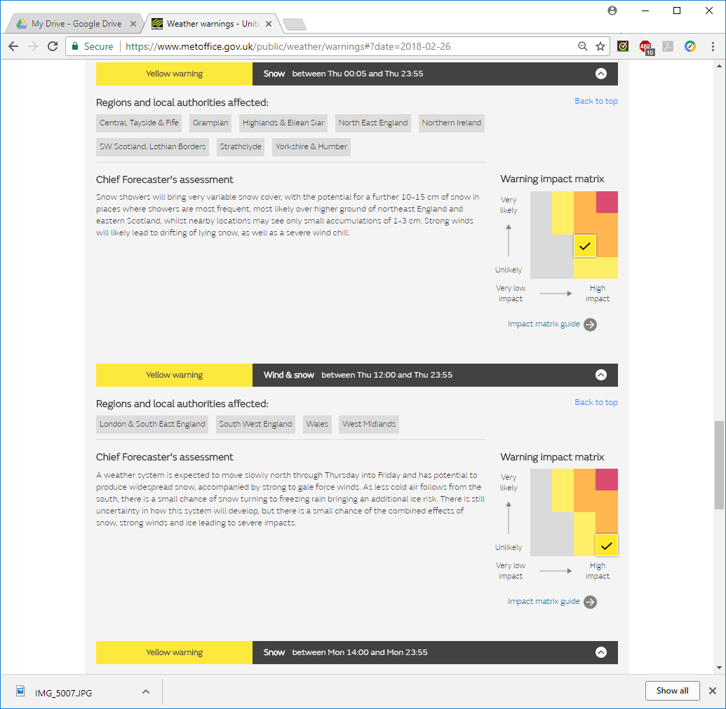
More risks

Slide 15
Meals, refreshments etc
Breakfasts – in the main dining room
  I assume you found it this morning!
Coffee/tea breaks
Lunches – in the main dining room
Dinners – we are eating out
  Monday night – Dil Raj (Indian)
  Tuesday night – Bella Napoli (Italian)

Slide 16
Other logistics
Fire alarms and evacuation
Wireless networking
  eduROAM
  Or I can obtain access tokens
    For STFC-Guest network
Any questions?

