Slide 1
Testing Incident Response Channels and Communications End Points
whilst not overloading the target audience
David Groep
AARC Policy and Best Practice Activity Coordinator
Nikhef
WISE Community meeting, Abingdon
February 27, 2018

Slide 2
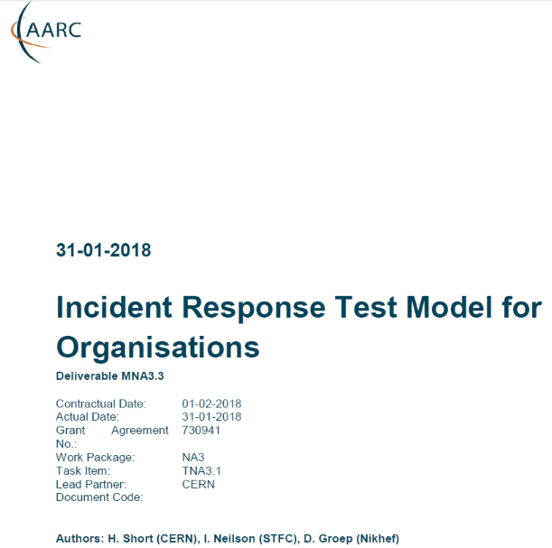
Distributed Incident Response and Readiness Challenges
Sirtfi version 1 is gaining traction
provides - self-asserted - security contacts
point-to-point communications
interaction not usually visible at the ‘global’ level
we need to now go ‘beyond Sirtfi’
incidents are not usually bi-lateral
may spread through federated identity systems
and outside to relying parties or entire Infrastructure

Slide 3
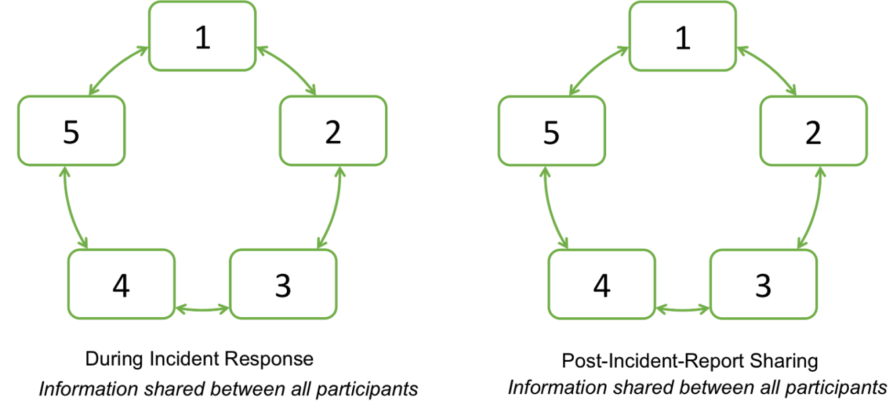
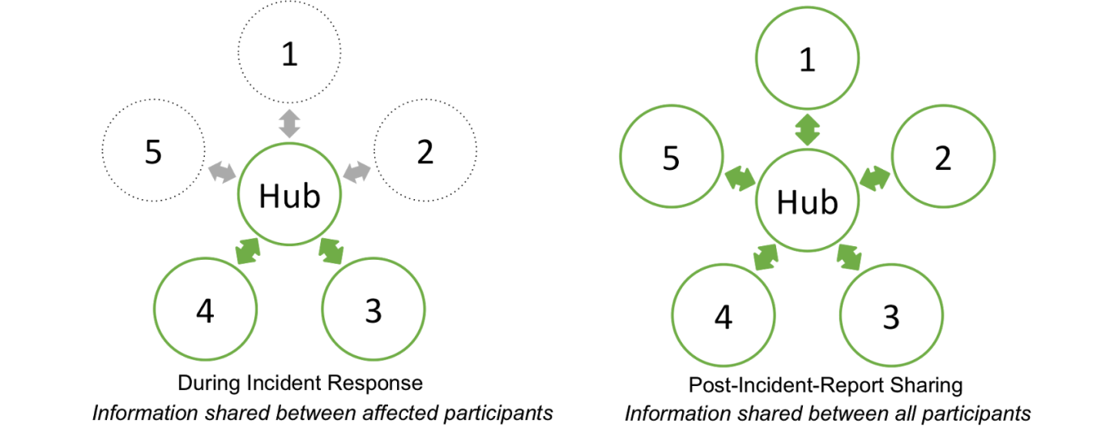
Beyond Sirtfi: streamlining the response process
trust relationships: allow information to flow rapidly to all that need to know
Infrastructure sharing model: PRACE, XSEDE, …
Infrastructure sharing model: EGI, WLCG, …
graphics: Hannah Short, AARC ‘DNA3.1’ incident response models

Slide 4
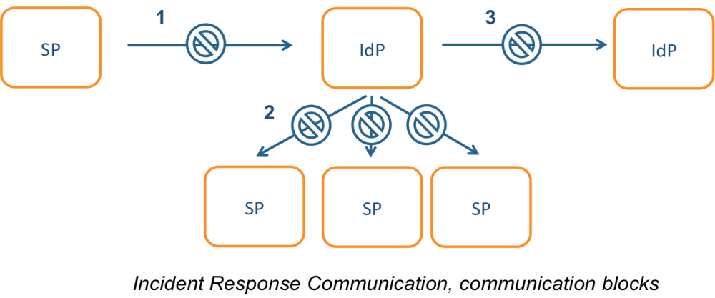
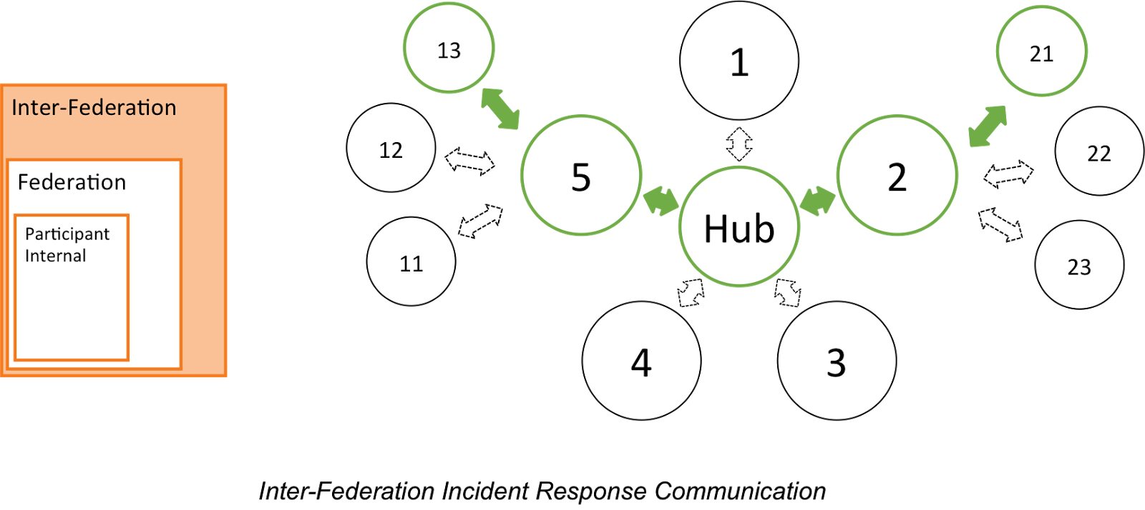
Incident response process evolution in federations
Proposed solutions
Stronger role for federation operators, as
they are known to both SPs and IdPs
Add hub capability centrally (@ eduGAIN)
Challenges
IdP appears ‘outside’ the
service’s security mandate
Lack of contact, or lack of trust, in IdP, which is an ‘unknown party’
IdP fails to inform
other affected SPs, for
fear of leaking data or reputation
No established channels of communication
graphics: Hannah Short, AARC ‘DNA3.1’ incident response models

Slide 5
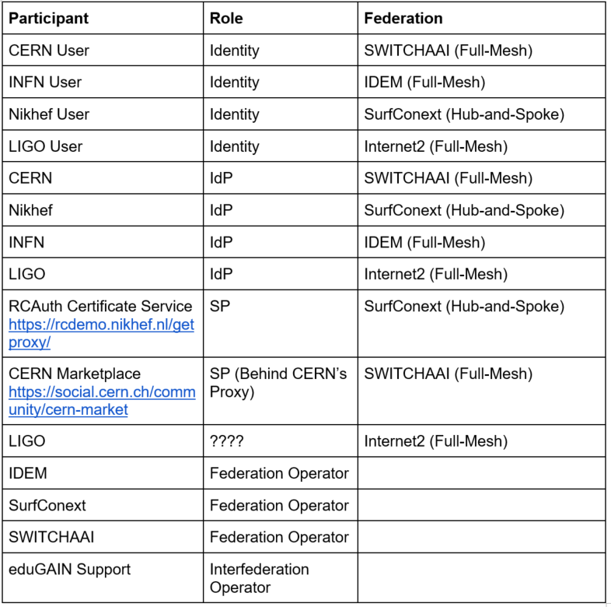
Would this model work? You have to test!
Incident Response Test Model for Organisations
simulated incident to evaluate the model
Many participants
Participants from
multiple (existing) infrastructures
Leverages (and overlaps with) existing groups
Test with these participants was run by Hannah
as ‘AARC’ – phase 1 ran last week

Slide 6
Who runs the test?
Test with these participants was run ‘by AARC’
Logical candidates that could all run the test … and ‘legitimately’ claim an interest
eduGAIN
GEANT.org
EOSC-HUB ops, or EGI CSIRT
IGTF
each of the e-Infrastructures XSEDE, EGI, EUDAT, PRACE, OSG, HPCI, …
every research infra with an interest: WLCG, LSAAI, BBMRI, ELIXIR, …
any institution (or person) with access to https://mds.edugain.org/
so in a short while, all the email in the world will be on Sirtfi Incident Response tests??

Slide 7
Frequency of challenges and tests - examples
Trusted Introducer and TF-CSIRT
2-3 Reaction Tests per year
supported by web click infrastructure, but requires (team) authentication
SURFcert challenges
annual response challenges, just reply to email to a (traceable) ticket
IGTF RAT Communications Challenges
every 1-2 years
in parallel with continuous operational monitoring
yet we already listed 14 entities that have a real interest in running tests, 5000+ entities can claim the same

Slide 8
How to coordinate – discussion items!
Designate a lead ‘management’ organization for each element?
so that each ‘target’ does not get hit by many competing and concurrent challenges?
e.g. eduGAIN to run communications challenges against Sirtfi email addresses
the e-Infrastructures to test responsiveness of SPs and RPs
with each RP/SP/Site having a primary e-Infra as its home?
or can we jointly (EOSC-HUB) run these challenges per continent?
coordination must be global
Communications challenges also build ‘confidence’ and trust – an important social aspect
unless you run the test yourself, or get full insight in the results of a challenge,
you may not be growing more trust in the entities tested
so to get that ‘warm and fuzzy feeling of trust’,
results (responsiveness measurement data) should be shared
but that sharing needs to be confidential as well – limit to WISE SCI checked infrastructures?

Slide 9
davidg@Nikhef.nl

